Slide 1
Lab 9: Resampling methods
Notes:
The data tsunami is coming. Are you ready?
In reality, this is a multi-dimensional wave

Slide 2
Enter the bootstrap
Bradley Efron
The computer

Slide 3
The procedure is quite straightforward
To obtain a sense of how stable a sample mean is (how it distributes).
Simply *resample* (with replacement!) from the existing sample.
Do this n times (10k → 100k → 1m)
Calculate the standard deviation of these resampled means.
Compare with the figure of interest.

Slide 4
Bootstrap logic
3
3
5
7
7
5
5
7
7
7
3
3
5
7
7
7
?
Notes:
Mind is literally unobservable. Brain is, for all intents and purposes. I will never be able to see your mind or brain. But I see the shadows it casts, from carefully recorded data.
The data basket. Drawing with replacement: Putting the data back in the basket, after drawing it.

Slide 5
Use cases
When there is only limited data (controversial)
When the underlying distribution is not normal and/or not known
When estimating sample means of rare events

Slide 6
Bootstrap drawback/assumption
This works if and only if the sample truly is representative of the population.
In other words, if something didn’t happen in the sample, it can’t ever happen.
“The data we have is the only data that can ever be”
So small samples necessarily over- or underestimate the probability of rare events.

Slide 7
It seems like a miracle
But it works (usually)!

Slide 8
Permutation tests
Classical tests (e.g. t-test) assume that the data is distributed in a certain way.
If the distribution of the data is not what is assumed, the reported p-value by the test is not the real p-value (!)
Permutation tests use the actual data to estimate how likely a given result is.
Logic: We pretend we lost the labels (which group data came from), then create a null distribution (by random arrangement of groups) and compare with empirical result.

Slide 9
Example
A rat is stressed out for 2 weeks
10 neurons are then taken out
5 we treat with Ketamine and 5 we don't treat at all
We then count the number of dendritic spines of each neuron
Hypothesis: Ketamine works by growing dendritic spines
K = [117 123 111 101 121]
C = [98 104 106 92 88]
Test statistic: sum(K) – sum(C)
We can now calculate exact p-value by determining the null distribution through resampling methods.

Slide 10
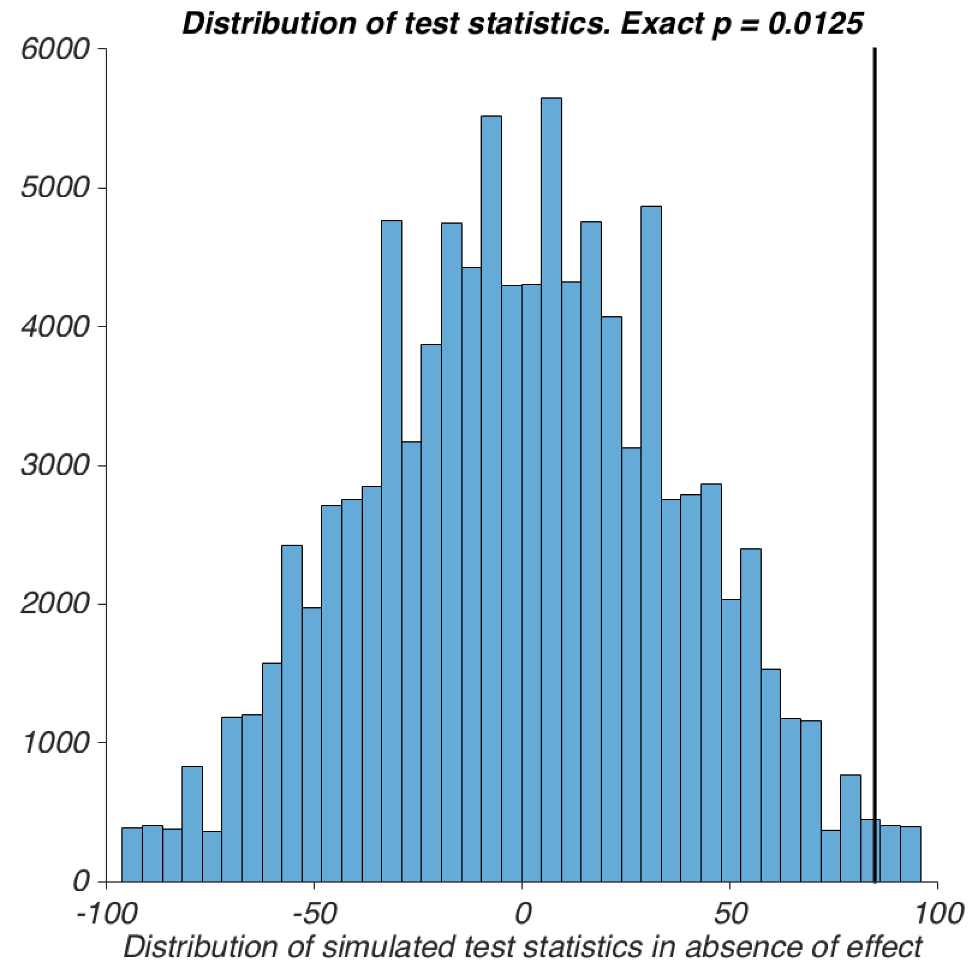
The result

