Slide 1
Lab 5: Convolution and Image Processing

Slide 2
The cousin problem in teaching

Slide 3
Boundary handling and edge artifacts
n = 5, k = 3
0
0
1
2
3
4
5
0
0
1
1
1
1
1
1
1
1
1
1
1
1
1
1
1
1
1
1
1
1
1
1
3
6
9
12
9
5
r = n + k – 1 = 7
“Full”:
Yields outputs when kernel touches inputs

Slide 4
Boundary handling and edge artifacts
n = 5, k = 3
0
0
1
2
3
4
5
0
0
1
1
1
1
1
1
1
1
1
6
9
12
r = n – k + 1 = 3
“Valid”:
Yields outputs when all of kernel is on inputs

Slide 5
Boundary handling and edge artifacts
n = 5, k = 3
0
0
1
2
3
4
5
0
0
1
1
1
1
1
1
1
1
1
1
1
1
1
1
1
3
6
9
12
9
r = n = 5
“Same”:
Output length is input length

Slide 6
We need to talk about zero-padding
(Matlab) default:
0
0
0
0
0
1
2
3
4
5
0
0
0
0
0
“Constant”:
3
3
3
3
3
1
2
3
4
5
3
3
3
3
3
“Reflectance”:
5
4
3
2
1
1
2
3
4
5
5
4
3
2
1
“Circular”:
1
2
3
4
5
1
2
3
4
5
1
2
3
4
5

Slide 7
It is dot products all the way down
Projections
Matrix multiplication
Convolution
…

Slide 8
Convolution as a moving average
Time | 1 | 2 | 3 | 4 | 5 | 6 | 7
Value | 10 | 0 | 10 | 0 | 7 | 7 | 5
Kernel
5
5
5
5
3.5
7
6
2.5
“Valid”
Edge artifacts, due to zero-padding, making output longer
3.3
3.3
6.7
3.3
5.7
4.7
6.3
4
1.7
“Valid”
Edge artifacts, due to zero-padding, making output longer

Slide 9
Common use cases

Slide 10
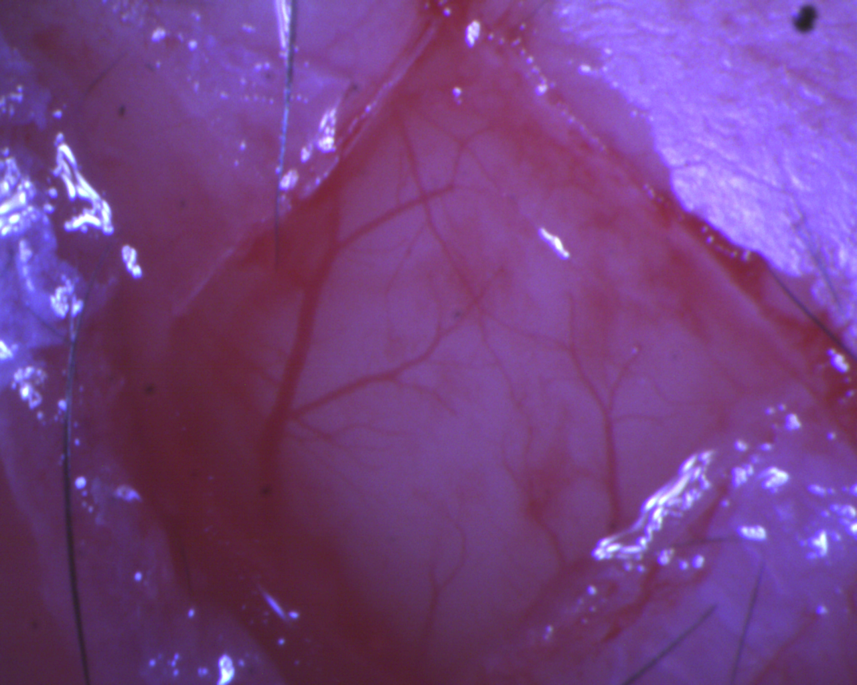
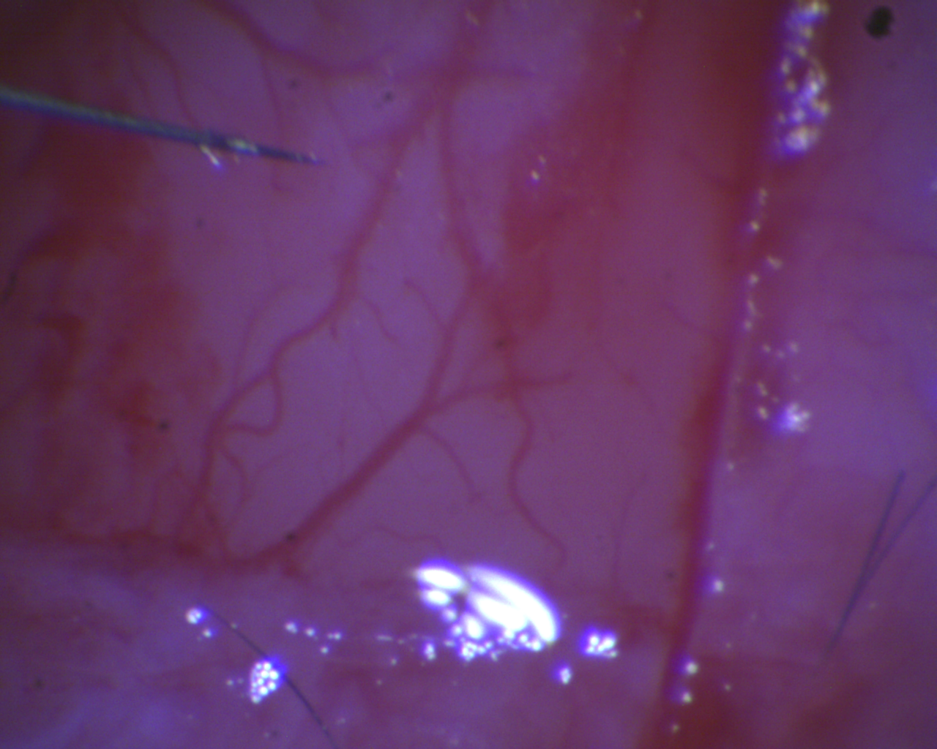
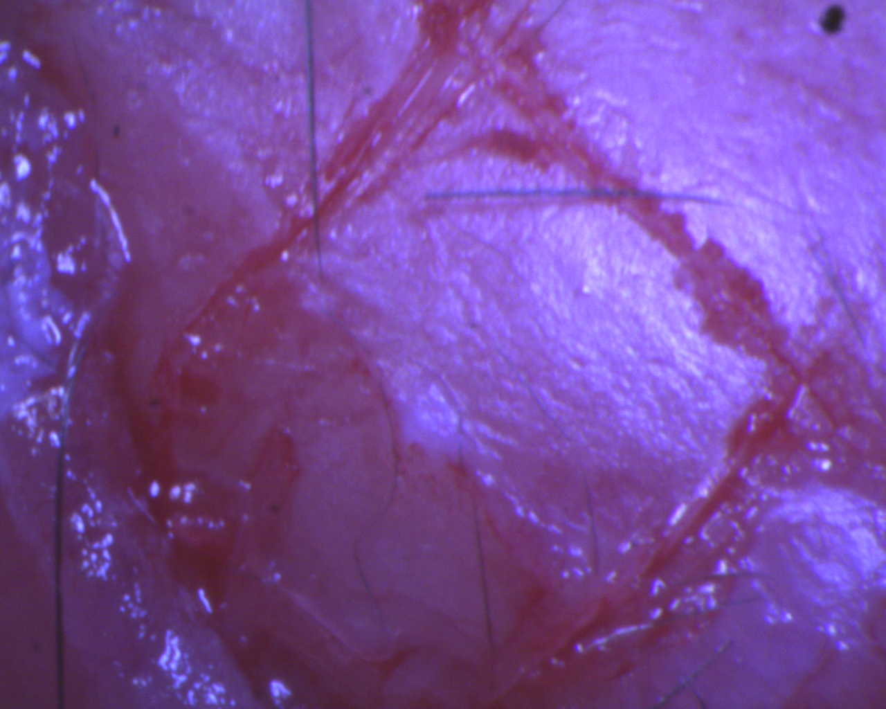
1D convolution to smooth a time series

Slide 11
2D convolution for image processing
Input
Output (normalized)
1
1
2
2
2
3
3
3
4
4
4
4
5
5
5
5
5
6
6
6
6
7
7
7
8
8
8
9
9
1
1
Kernel
1
1

