Slide 1
Lab 4: Optimization and PCA

Slide 2
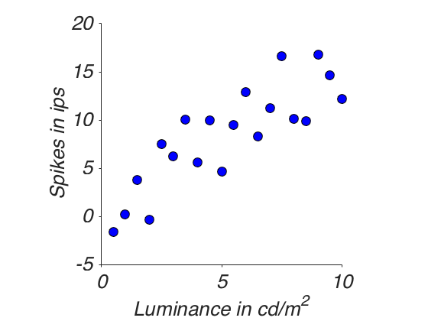
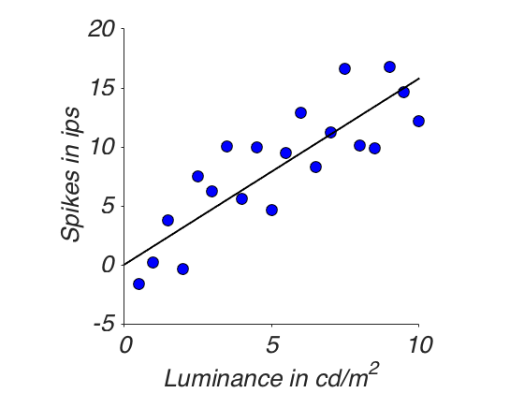
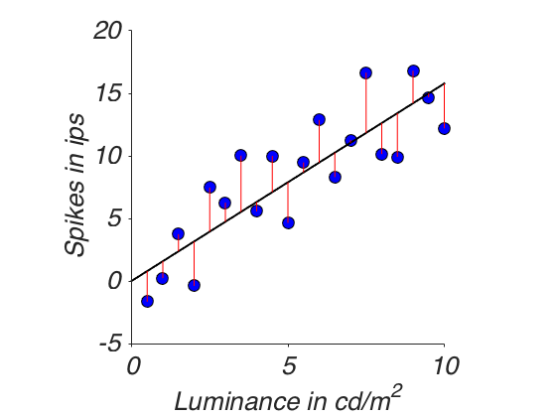
The fundamental problem

Slide 3
The general linear model (GLM)
Y_{n} = b X_{n} + e_{n}
To optimize:

Slide 4
How to do this most effectively?
Linear Algebra to the rescue
Write X and Y values as column vectors:
How to express this squared vector length?

Slide 5
Solving for the optimal b
y
bx
x

Slide 6
Let’s do this in MATLAB

Slide 7
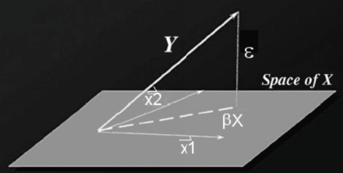
Multiple regression
Orthogonality principle:

Slide 8
Let’s do this in MATLAB

Slide 9
Another perspective on PCA
In class, we saw how PCA comes out of total least squares.
It yields the eigenvectors from V^{T} of the SVD.
Those that – explain – in order most of the variance in the data.
And in a fashion so that they are all orthogonal to each other.

Slide 10
Remember Eero’s slide?

Slide 11
Question
What correlation in the data corresponds to which slope of the first dimension (eigenvector)?

