Slide 1
Lab 9: Signal detection theory
Notes:
The data tsunami is coming. Are you ready?
In reality, this is a multi-dimensional wave

Slide 3
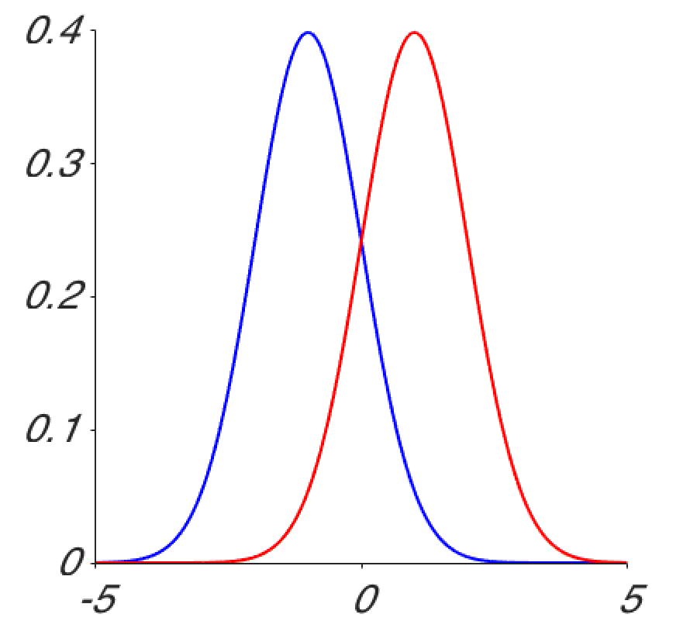

Slide 4
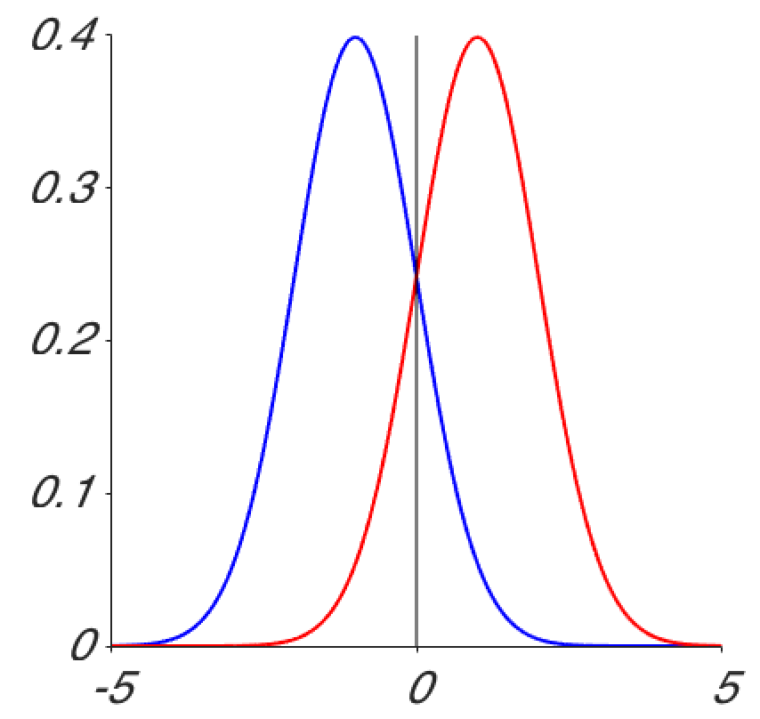

Slide 5
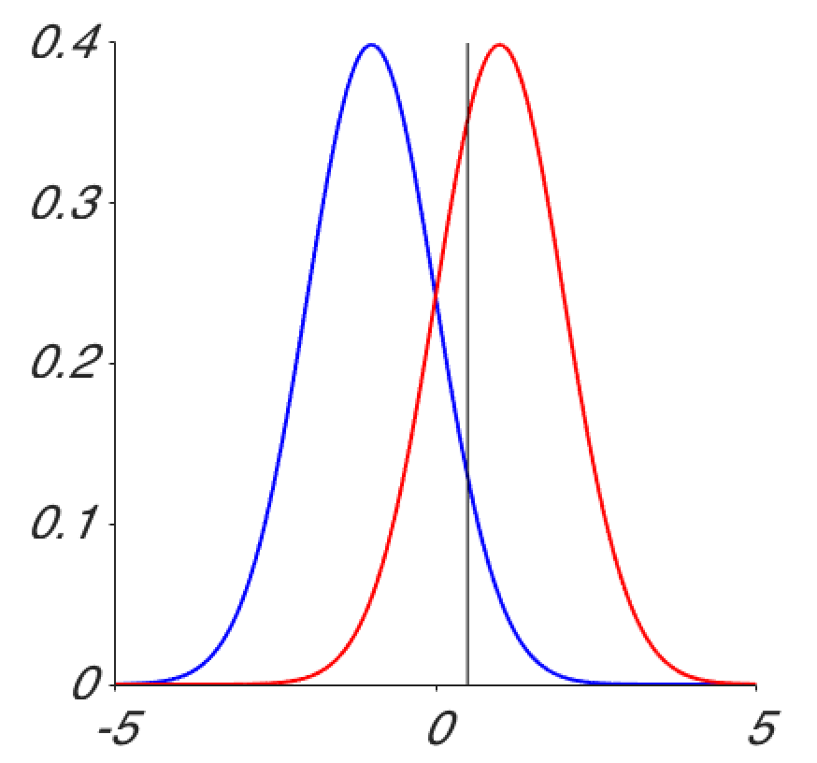

Slide 6
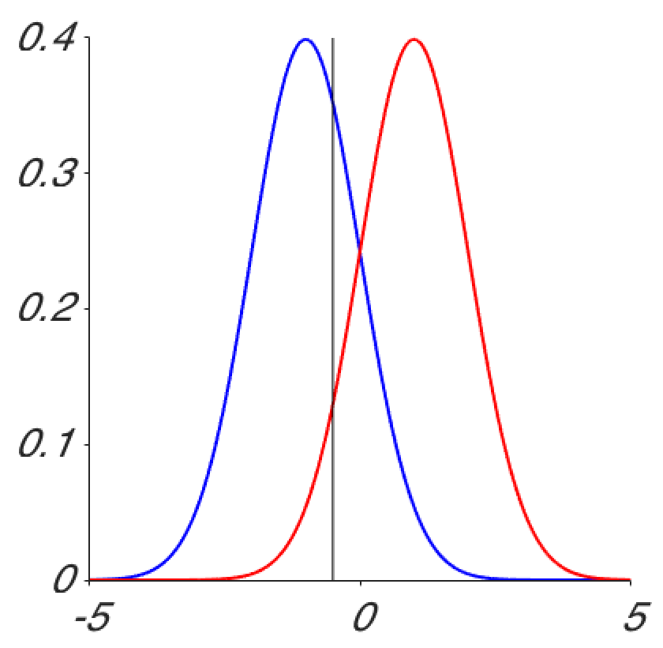

Slide 7
GUIs
Making an applet

