Slide 1
Lab 7: Simulation and Power
Notes:
The data tsunami is coming. Are you ready?
In reality, this is a multi-dimensional wave

Slide 2
Effect size: Cohen’s d

Slide 3
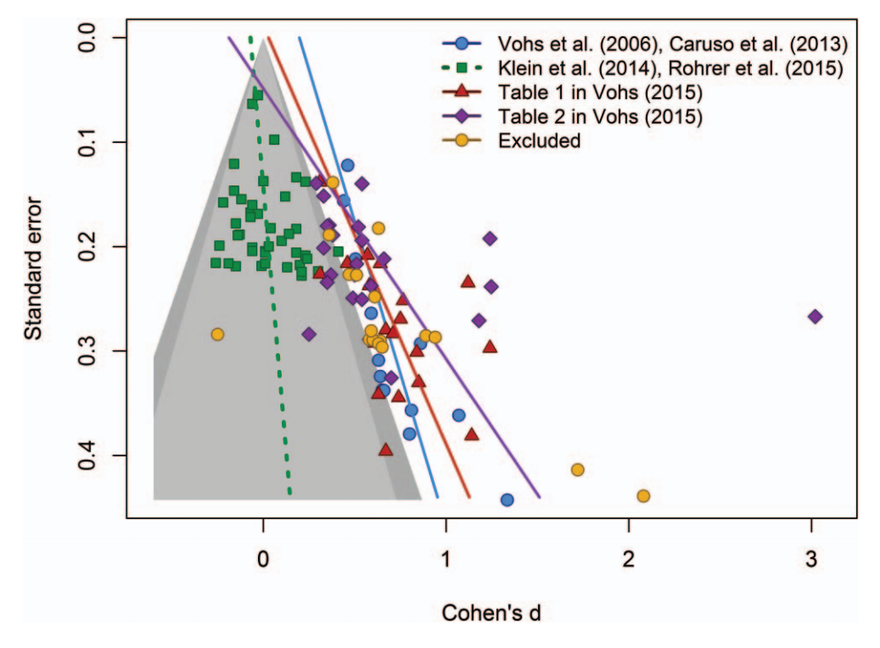
Funnel plots

Slide 4
PPV
RESEARCH/REALITY | TRUE | FALSE | TOTAL
SIG | 1-β | α | 1-β + α
NONSIG | β | 1-α | β + 1-α
TOTAL | 1 | 1 | 2
Notes:
Posterior probability that a result is true, if it is significant
R: Ratio of true to false effects

Slide 5
Power
The probability of *not* making a type II error, i.e. the probability that a test will reject the null hypothesis if the alternative hypothesis is true (1-β).

Slide 6
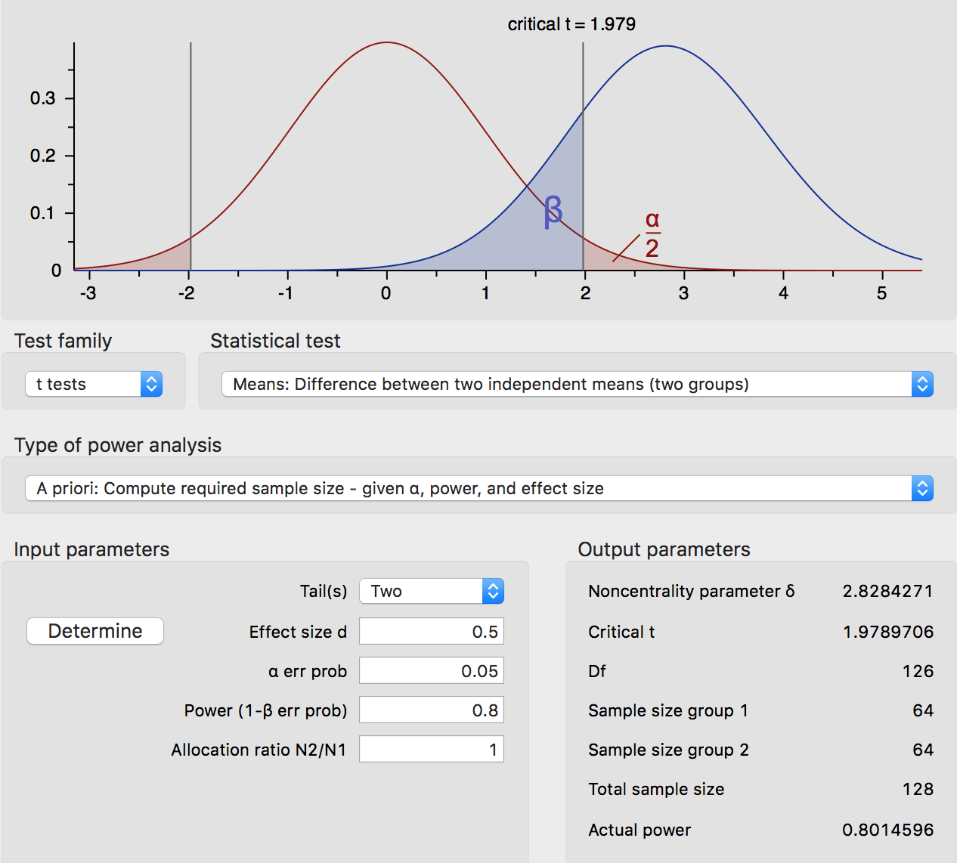
G*Power

Slide 7
The powerscape

