Slide 1
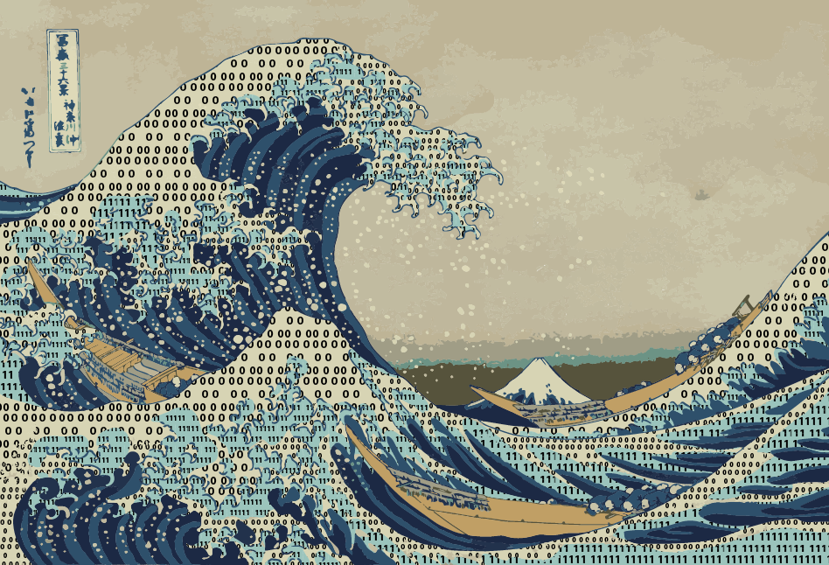
Lab 6: The Fourier Transform
Notes:
The data tsunami is coming. Are you ready?
In reality, this is a multi-dimensional wave

Slide 2
How to transform signals from the time domain to the frequency domain?
Figured out by Joseph Fourier.
Studying periodic signals.
Not to be confused with Charles Fourier.
Notes:
Figured out by Joseph Fourier. Studying heat distributions in cannon. Muzzles. Napoleonic time. The problem of the day.
Charles Fourier: Contemporary. Socialist philosopher. Originated the concept of feminism.
I told Mike X Cohen – he had the wrong Fourier. This happens.

Slide 3
Different representations emphasize different properties

Slide 4
The Fourier Transform
Notes:
Integrating complex sine waves

Slide 5
Complex numbers
Complex numbers have a real part and an imaginary part.
C = R + I, e.g.
C = 5 + 2i
i = sqrt(-1)
Allows to represent the magnitude and the phase of something in a single number.
Notes:
Not a nuisance, a tool

Slide 6
The complex plane
5i
4i
3i
2i
i
-5 -4 -3 -2 -1
0
-i
1 2 3 4 5
-2i
-3i
-4i
-5i

Slide 7
Complex numbers are inherently vectors
5i
4i
3i
2i
3 + 2i
i
-5 -4 -3 -2 -1
0
-i
1 2 3 4 5
-2i
-3i
-4i
-5i
Notes:
This allows to represent phase well
In addition to magnitude, carrying information about a 2nd parameter.

Slide 8
The complex conjugate
5i
4i
3i
2i
3 + 2i
i
-5 -4 -3 -2 -1
0
-i
1 2 3 4 5
-2i
3 - 2i
-3i
-4i
-5i
Notes:
This allows to represent phase well
In addition to magnitude, carrying information about a 2nd parameter.

Slide 9
Moving around on a circle

Slide 10
Any signal in the time domain can be approximated by adding sinusoids

Slide 11
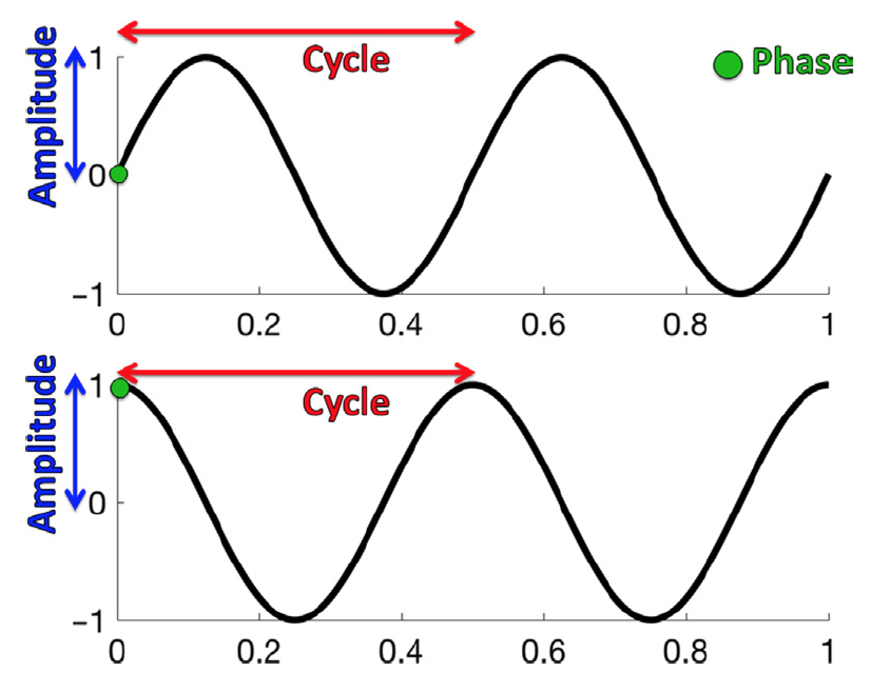
Sinusoids

Slide 12
Illustration

Slide 13
Historical context: Epicycles
The proper combination of cycles can reconstruct *any* orbit, no matter how convoluted. Also reach any point in the space. So any signal in space/time can be represented as a combination of cycles with properly picked radii and phases.

Slide 14
Game changers: 1 - FFT
Original Fourier Transform has been known since early 19th century.
“Fast Fourier Transform” does a discrete Fourier Transform.
It is fast.
Given modern computers, it is even faster.
Fourier Transform becomes useful

Slide 15
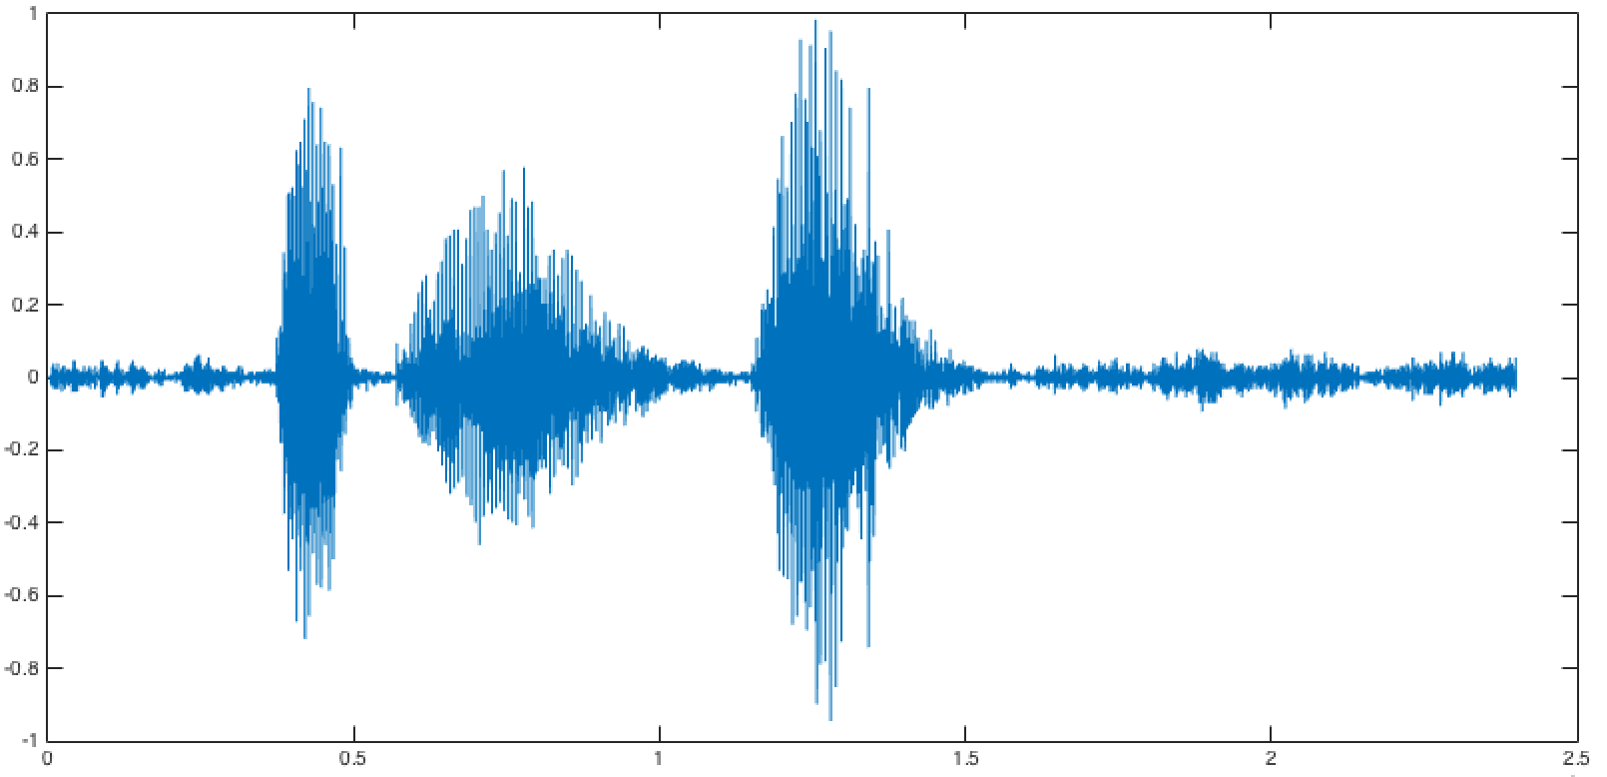
Game changers 2 - STFT
Most interesting real life signals are changing over time.
The frequency composition changes moment by moment.
Key: Compute the FFT only for a short snippet over which frequency content is presumably stable. Plot that – that is a spectrogram.

Slide 16
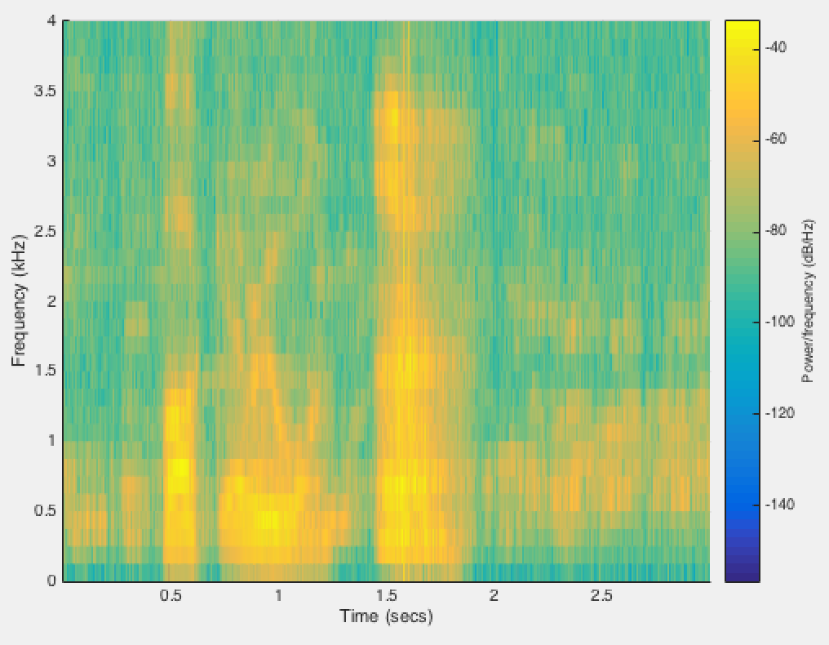
“The” spectrogram
Notes:
Plotting amplitude of the signal or “power” at a given frequency over time. For a given window.

Slide 17
Windowing causes artifacts
The full Fourier theorem only applies for infinite time and involving an infinite number of frequencies.
Notes:
In real life, one never has that.

Slide 18
Aliasing: The Nyquist frequency
The maximal frequency that one can represent without aliasing the signal is the “Nyquist frequency”.
It corresponds to half the sampling rate.
We’ll do stuff in Matlab to understand this.
First: The GUI
Notes:
Harry Nyquist.

