Slide 1
Lab 5: Convolution and Image Processing
Notes:
The data tsunami is coming. Are you ready?
In reality, this is a multi-dimensional wave

Slide 2
The cousin problem
Notes:
Did you know that?

Slide 3
Convolution as a moving average
Time | 1 | 2 | 3 | 4 | 5 | 6 | 7
Value | 10 | 0 | 10 | 0 | 7 | 7 | 5
Kernel
5
5
5
5
3.5
7
6
2.5
“Valid”
Edge artifacts, due to zero-padding, making output longer
3.3
3.3
6.7
3.3
5.7
4.7
6.3
4
1.7
“Valid”
Edge artifacts, due to zero-padding, making output longer
Notes:
5 things to see:
1. Convolution with a symmetric kernel amounts to smoothing
2. Two simple solutions to edge issues: Zero-pad or take only the “valid” part
3. Zero-padding: Result is n+(k-1) long.
4. Valid: Result is n-(k-1) long.
5. Even length kernels shift the result weirdly. Use odd numbered kernel lengths. Result is in the middle of the numbers.

Slide 4
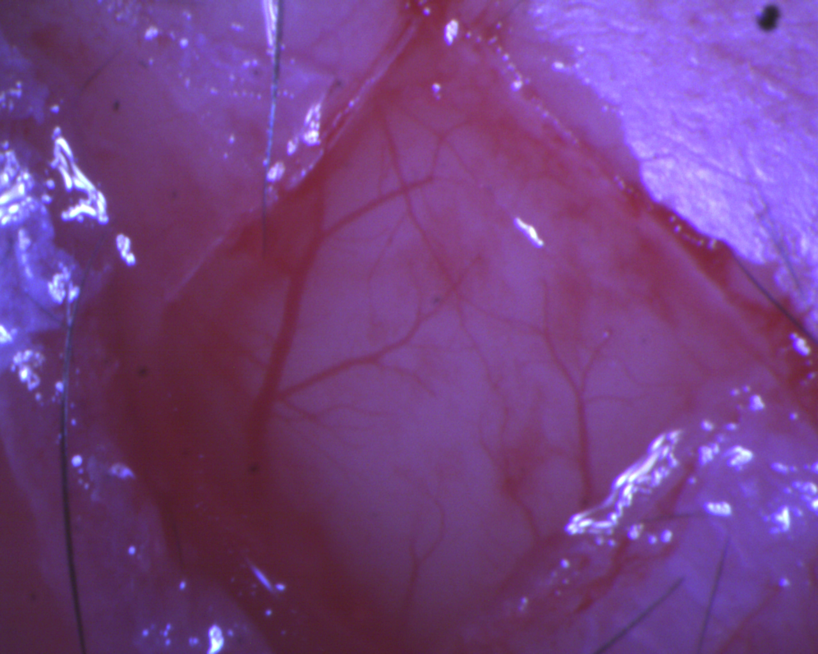
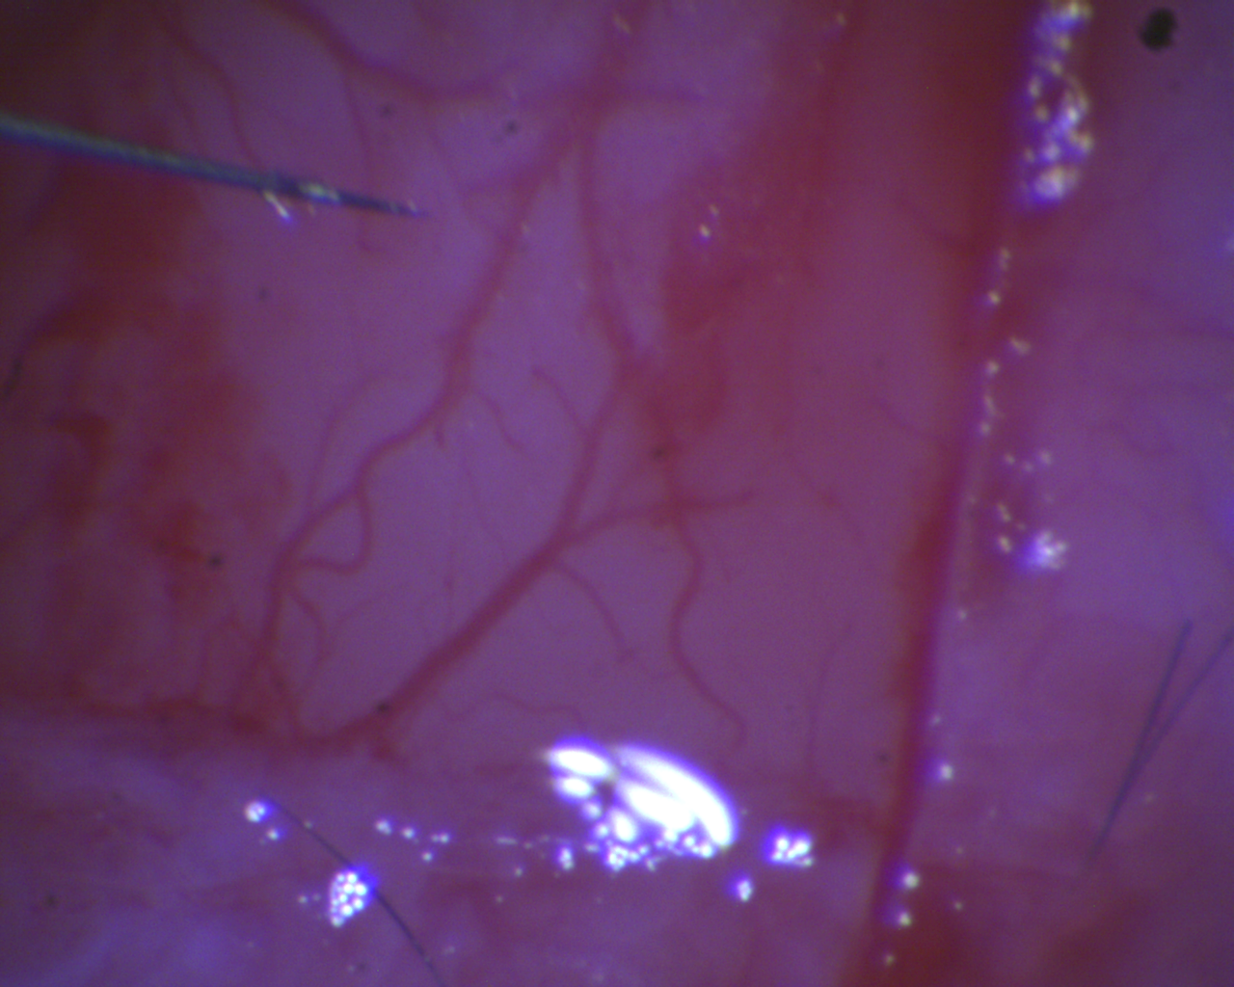
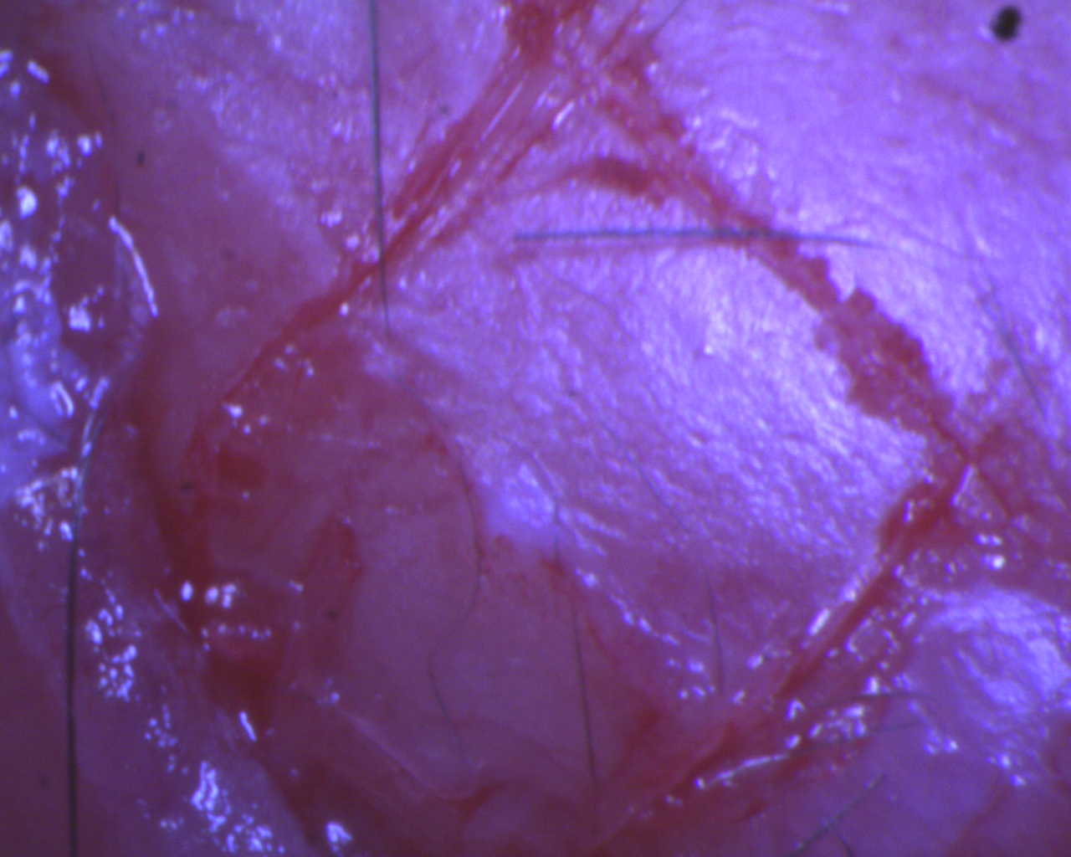
1D convolution to smooth a time series
Notes:
Iraq. Euphrates, Tigris. Oil drilling. Open up the lid.
1D = time, usually

Slide 5
2D convolution for image processing
Input
Output (normalized)
1
1
2
2
2
3
3
3
4
4
4
4
5
5
5
5
5
6
6
6
6
7
7
7
8
8
8
9
9
1
1
Kernel
1
1
Notes:
Iraq. Euphrates, Tigris. Oil drilling. Open up the lid.
2D = space, usually

