Slide 1
Classical statistical methods 2
Data based inference
Notes:
Our stats treatment recaptures the historical development.
The “tests lecture”. But we want to go beyond the cookbook. Principles of what we are doing, not recipes. The field has gotten into serious trouble doing that. As we will see next time.
Still what people actually do – frequentist null hypothesis testing. In future: Bayesian generative models. Taking the data as cues to what process could have given rise to the data. In all likelihood. A spy novel.
Before we can move on, we need to close out some of the material.

Slide 2
Reminder: Orthogonality principle
y
bx
Total var:
x
Var explained:
Var residual:
Notes:
Variance partitioning

Slide 3
Partitioning of sum of squared deviations
Total Deviation
Dev of pred point (on line)
from mean
Dev of pred point (on line) from data
Y
Y
X
Notes:
Y Floor (a-axis): 6.49
5.6
4.88
2.76
X Floor (y-axis): 1.06
1.85
5.81
7.77

Slide 4
Sampling from populations to infer which population the sample came from
Notes:
General idea. Recording from neurons – can we infer what neuron we are recording from, just from the properties of the sample?

Slide 5
The sampling game
_
X = 3.50
s = 1.73
6
2
Population of neurons in a given cortical area
μ = 4.57
σ = 2.76
3
3
_
X = 4.67
s = 2.45
6
2
3
3
3
9
8
4
4
6
2
3
6
2
_
X = 5.25
s = 3.86
6
2
3
5
0
9
0
1
0
1
3
3
9
3
3
9
3
3
2
2
5
8
6
7
2
4
8
4
4
8
4
8
3
8
8
4
6
5
9
5
9
1
5
2
1
7
0
2
7
7
4
0
3
2
3
3
3
9
2
0
8
9
8
9
4
8
9
7
8
4
9
_
X = 5.89
s = 3.33
1
1
9
1
6
9
6
9
9
7
9
9
1
2
9
1
9
1
1
3
8
9
8
2
8
4
8
6
9
8
2
6
2
2
2
4
4
3
4
9
1
9
5
1
3
1
1
5
8
7
5
1
3
3
6
3
8
2
4
6
2
2
4
2
3
1
6
8
5
_
X = 4.25
s = 3.24
5
4
4
5
4
9
7
1
5
4
3
8
9
2
9
1
9
1
8
2
4
2
5
1
1
3
Notes:
There are many ways to draw a sample from a population.
Number of chemical synapses per neuron.

Slide 6
Why does this work? The central limit theorem
If drawn randomly and independently, the sample means distribute normally as the sample size increases, regardless of how the underlying population is distributed.
If the sampling is independent and representative (each member of the population has an equal chance of being in the sample), then sample parameters (mean, SD) will approach the parameters (mean, SD) of the population, as one increases sample size.

Slide 7
To understand what is going on, we differentiate:
Population
Sample
Observations (that make up each sample)
Population mean
Population standard deviation
Sample mean
Sample standard deviation
The distribution of values (in a population or sample)
The distribution of sample means (not population means)
The standard deviation of the sample means =
The standard error of the mean

Slide 8
Estimates of the sample mean distribute normally, as n increases
Notes:
The sample mean is a big deal because large samples can be described by it. Differences between samples by differences in mean.

Slide 9
Regardless of the shape of the underlying distribution, e.g. gamma here.
Notes:
The sample mean is a big deal because large samples can be described by it. Differences between samples by differences in mean.

Slide 10
What is the standard deviation of the sample means as function of sample size?
All important: How large does our sample need to be (n), in order for sample means to be stable estimates of the population mean?
This is usually characterized by the standard error (of the mean) or SEM.
AKA the standard deviation of the sample means.

Slide 11
Why square root of n, not n?
The variance of the sample mean scales inversely with n.
But we are interested in the standard deviation
So we take the square root on both sides:
Notes:
I will owe the derivation.

Slide 12
How does the SEM fall off?
Notes:
Also true empirically. Simulation of the standard deviation of the sample means as a function of sample size. Black: Empirical. Blue: What would would expect if it was divided by sqrt of n, red if it was divided by n itself

Slide 13
Statistical significance Null hypothesis Significance testing (NHST)
Notes:
Have you heard of the concept of statistical significance before? Who here has heard of the concept of statistical significance?

Slide 14
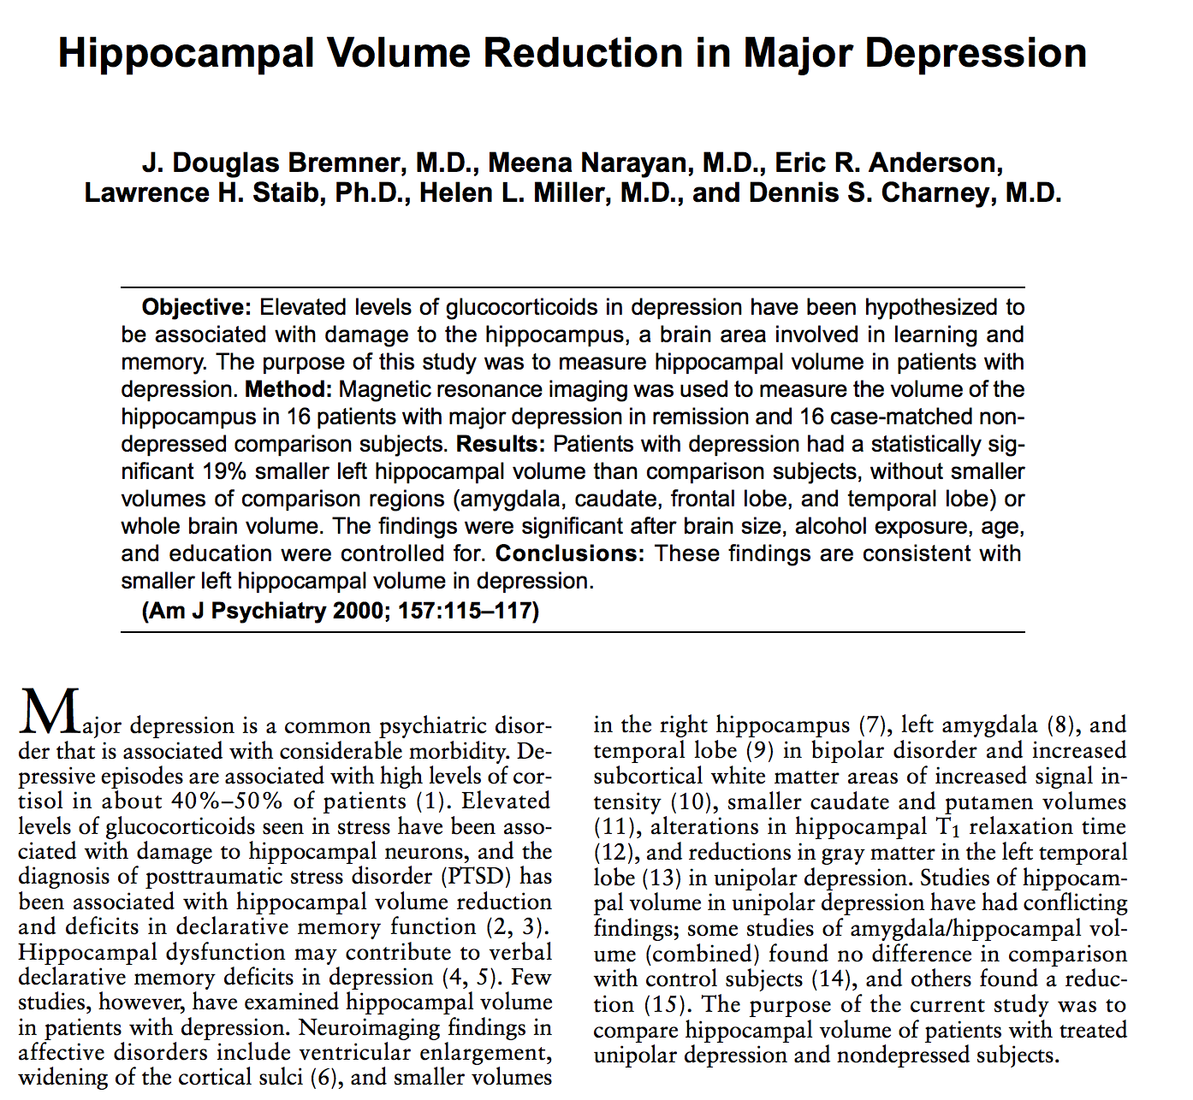

Slide 15
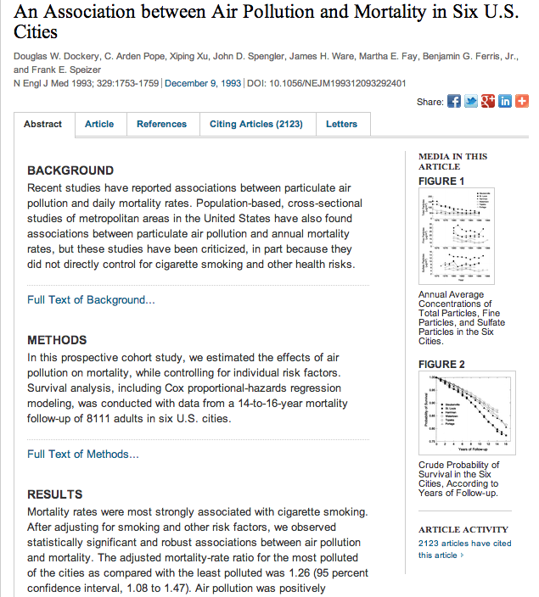

Slide 16
What does this mean?
Notes:
.Gonna get something incoherent – again, you are in good company!

Slide 17
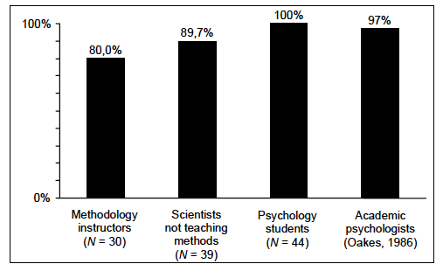
You are in good company…
“Your results are statistically significant. This means that you have found the probability of the null hypothesis being true.” True or false?
Haller & Krause, 2002
Notes:
You are not alone. The term is ubiquitous in science, particularly the social sciences. And it has now made its way into the popular media

Slide 18
Common misconceptions
“Statistically significant” is a synonym for
Substantial
Important
Big
Real
Statistical significance gives the
probability that the null hypothesis is true
probability that the null hypothesis is false
probability that the alternative hypothesis is true
probability that the alternative hypothesis is false
Wrong!

Slide 19
Statistical significance means
an observed result is unlikely to be due to chance alone.
Formally:
The probability of the data, assuming that the null hypothesis is true is less than the chosen significance level.
Null hypothesis: No (mean) difference between experimental groups.
It is a statement about the probability of data, *not* hypotheses.
If something is significant, you did *not* show that the null hypothesis is false.
Just unlikely to be true…

Slide 20
Why statistical significance testing?
We are trying to assess the truth status of statements (claims) about the world.
For instance: A new drug – NZT – improves IQ. (?)
Compare
Diversity
Reliability
Consistency

Slide 21
We want to know whether the treatment makes a difference
In the real world, variability and uncertainty are always an issue.
Any result we observe could be due to random chance alone (variability of uncertain origin that we do not control).
The only question is how likely that is, assuming chance.
This likelihood can be assessed by the procedure of null hypothesis significance testing.
Notes:
Psychology often deals with hard questions that are inherently complex.

Slide 22
Null hypothesis significance testing
We assume that the treatment has no effect (H₀).
So the sample means of two treatment groups (one that receives the treatment and one doesn’t) should be the same.
Alternatively – if we know population parameters – we can compare the sample parameters to that.
Due to variability, it will never be exactly the same.
But assuming H₀ = true, we can calculate the probability (p) to observe a given difference in sample means.

Slide 23
1) How likely is each sample?
p = 1/2
2) How unlikely does it have to be for you to reject the notion that it is due to chance (random sampling)?
p = 0.5
p = 0.25
p = 0.125
p = 0.0625
p = 0.0313
p = 0.0156
p = 1/2²=1/4
p = 1/2³=1/8
p = 1/2⁴=1/16
p = 1/2⁵=1/32
p = 1/2⁶=1/64
Where would you draw the line?
Notes:
Drawing randomly from the population. Which sample supports that NZT is effective – given that it is unlikely enough? Coin tossing basically. We assume that the coin is fair until its behavior suggests that it is not. This is America - we presume innocence until proven guilty. Can still be fair. Even a fair coin will give 7 heads in a row. It has been shown that people underestimate the number of such runs, when asked to generate random series of heads and tails. Even 10 heads, slightly less than 1 in 1000. Meaning extremely significant.

Slide 24
1) How likely is each sample?
p = 1/2
2) How unlikely does it have to be for you to reject the notion that it is due to chance (random sampling)?
p = 0.5
p = 0.25
p = 0.125
p = 0.0625
p = 0.0313
p = 0.0156
p = 1/2²=1/4
p = 1/2³=1/8
p = 1/2⁴=1/16
p = 1/2⁵=1/32
p = 1/2⁶=1/64
HHH
HHL
HLL
HLH
LHH
LLH
LLL
HHHH
HHLH
HLLH
HLHH
LHHH
LLHH
LLLH
HHHL
HHLL
HLLL
HLHL
LHHL
LLHL
LLLL
p = 3/8 = 0.375
p = 4/16 = 0.25
Notes:
Of course such lack of diversity is rare. But the general logic holds. But even one counterexample makes it much more likely. Because of permutations. Order doesn’t matter.

Slide 25
A practical example
H: NZT improves IQ (?)
In the general population, IQ is known to be distributed normally with
μ = 100
σ = 15
We give the drug to 30 people and test their IQ.
Notes:
Illustrate it with a practical example. God knows we could use a boost.

Slide 26
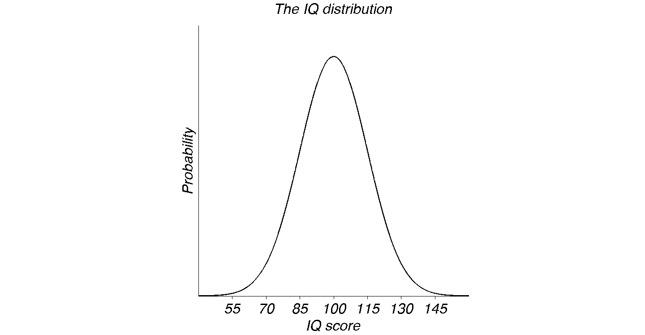
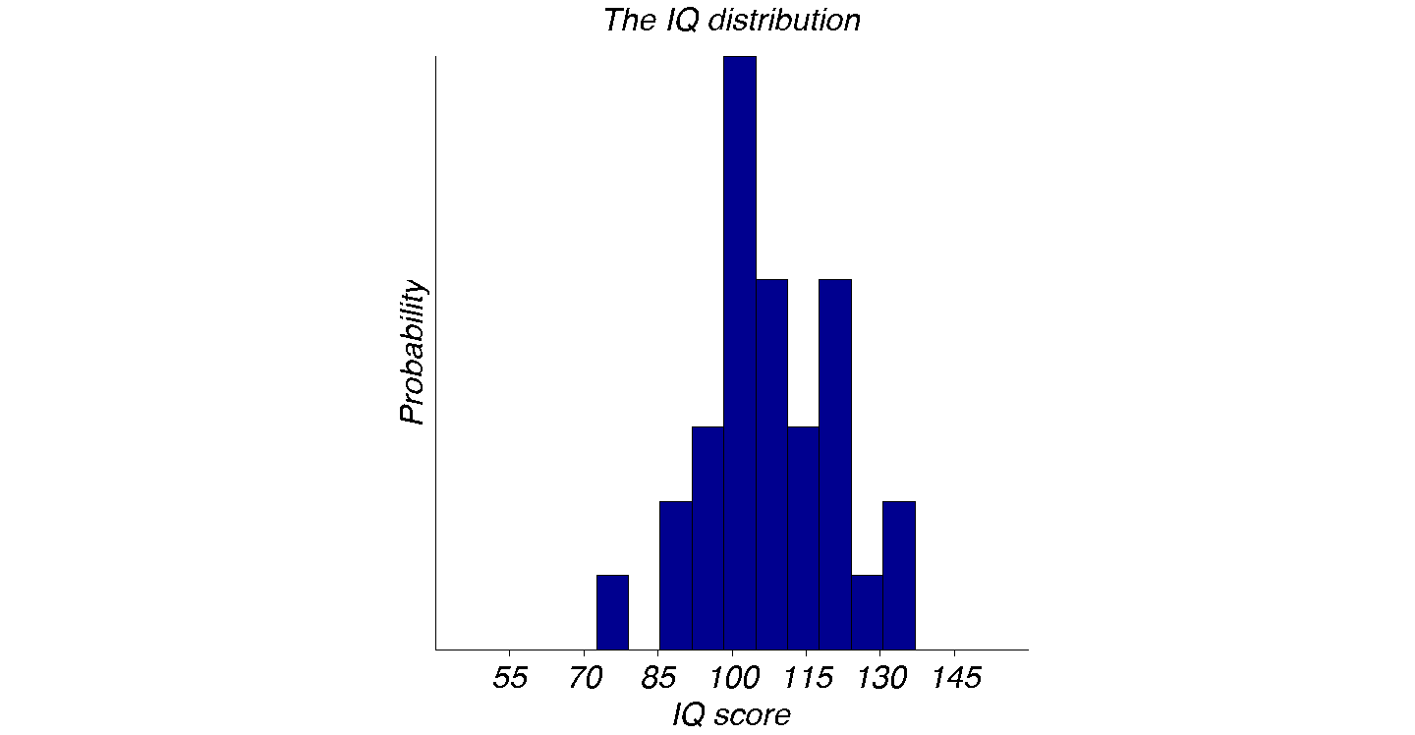
A possible outcome…
Was the sample drawn from this known distribution?
μ = 100 (Population mean)
σ = 15 (Population standard deviation)
n = 30 (Sample contains scores from 30 participants)
x = 108.3 (Sample mean)
z = (x – μ)/SE = (108.3-100)/SE (Standardized score)
SE = σ / √n = 15/√30 = 2.74
z = 8.3/2.74 = 3.03
p = 0.0012
Significant?
Notes:
What we are testing? What is the probability that the data comes from a normal distribution with mean 100 and SD 15, which is the null hypothesis? The individual scores vary considerably. But the means don’t. Again, from central limit theorem. So we need to compare against the standard error. As the number of people tested gets larger, and the sample is unbiased, the sample mean will converge to the population mean.
What we want to know: Was this sample drawn from this distribution? It is kind of hard to tell. What significance testing does is that it formalizes this procedure. Hard to tell just by looking at it. Critical z score for 1 tailed test is 1.645, so yes. This is significant.

Slide 27
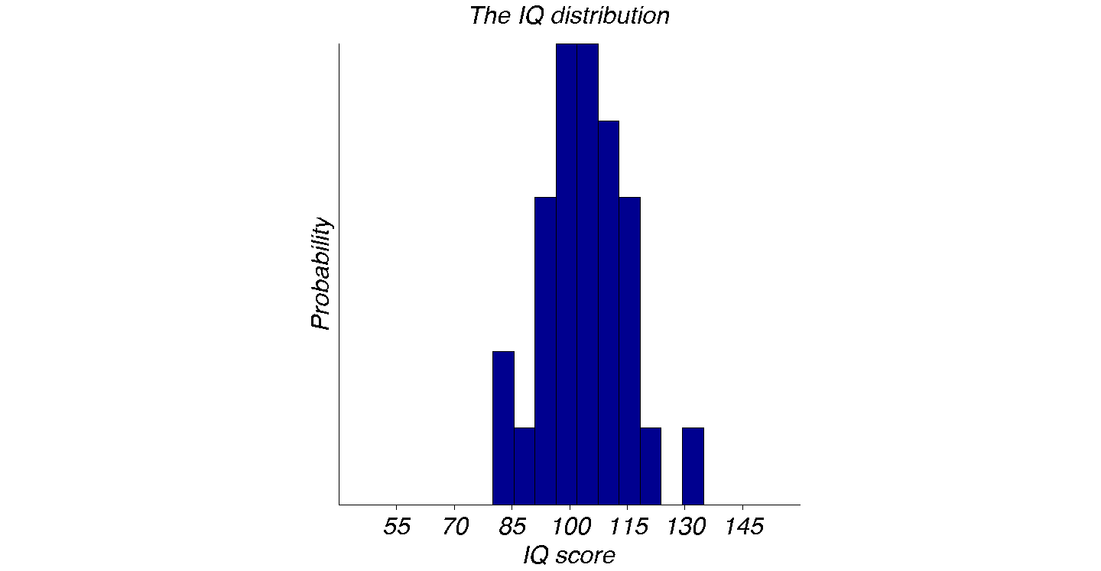
What if the effect of NZT had been half that?
μ = 100 (Population mean)
σ = 15 (Population standard deviation)
n = 30 (Sample contains scores from 30 participants)
x = 104.2 (Sample mean)
z = (x – μ)/SE = (104.2-100)/SE (Standardized score)
SE = σ / √n = 15/√30 = 2.74
z = 4.2/2.74 = 1.53
p = 0.061
Significant?
Notes:
What we are testing? What is the probability that the data comes from a normal distribution with mean 100 and SD 15, which is the null hypothesis? The individual scores vary considerably. But the means don’t. Again, from central limit theorem. So we need to compare against the standard error. As the number of people tested gets larger, and the sample is unbiased, the sample mean will converge to the population mean. This is smaller than 1.645.

Slide 28
Significance levels
Are denoted by the Greek letter α.
In principle, we can pick anything that we consider unlikely.
In practice, the consensus is that a level of 0.05 or 1 in 20 is considered as unlikely enough.
A level of 0.01 or 1 in 100 is considered “highly significant” or really unlikely.
Notes:
This goes back to Fisher, he picked 1 in 20.

Slide 29
Does NZT improve IQ scores or not?
Reality
Yes
No
Type I error
α-error
False alarm
Correct
Yes
Significant?
Type II error
β-error
Miss
No
Correct
Notes:
Correct: Can publish, market the drug. Type I: People spend money on a drug that doesn’t work. Maybe the drug has bad side effects. Correct II: This leads to a lot of gnashing of teeth in the lab. But it is also correct. You did not make a mistake. The drug has no effect and you said it didn’t. The reason there is gnashing of teeth is because you don’t know that. We don’t know reality. It is unknowable, which we know since can’t. That’s why we can’t conclude anything if we fail to reject the null hypothesis. We could be correct keeping the null hypothesis, or we could simply be missing a real effect. We only know about significance, not reality. So we know which row we are in, but uncertain about the column. You could have made a type II error. Missing a real effect. How bad? God knows we could use a drug that raises IQ. But a type II error is closely linked to the issue of power. Statistical power.

Slide 30
Test statistics
We calculate how far the observed value of the sample average is away from its expected value.
In units of standard error.
In this case, the test statistic is z.

Slide 31
In this case
Significance testing boils down to establishing the distance of the observed z value to the critical one, in units of standard error.

Slide 32
Inferential statistics in general
The need for inferential statistics results from an information gap.
We usually want to know something about a population (general truths).
We usually only get information about a sample.
The question is what we can conclude about the population, given that we only have the sample.
This is a general problem. All cognitive systems have it.

Slide 33
Null hypothesis significance testing
How far – in units of SEM – is an empirical sample mean from its expected population mean.
How likely is that to happen by chance (p)?
Unknown sample standard deviation → t-test.
Comparing more than
2 sample means
Violated assumptions
ANOVA
Nonparametric tests

Slide 34
The t-test
Notes:
What on earth is t and why are we testing it?

Slide 35
Inferential statistics
We want to know general truths about populations
We only ever have access to samples. In science, as in life.
In order to close this fundamental gap as best as we can, we do inferential statistics.
We use some kind of test statistic to assess how likely the observed difference between an observed and expected sample mean is.
We already encountered one:
Notes:
But we can’t always use z. There are two problems with it.

Slide 36
Why can’t we always just use z?
It relies on the central limit theorem.
In other words, it doesn’t work for small samples (below n=20 or so).
Also, it relies on a known standard deviation:
We don’t always have that, but need to estimate it from the sample itself.
So we use have to use t instead.
What is t and how is it distributed?

Slide 37
Student’s t-test
William Gosset
Employed by Guinness brewery.
Not allowed to publish under his name.
Published as “student”
Worked out a test for small sample sizes and unknown population variance.
Intended for quality control.

Slide 38
The rationale
Due to central limit theorem, sample means will distribute normally, given a large number of observations in the sample.
This is not always possible.
In this case, the sample means will follow a t-distribution.
That’s basically what Gosset worked out.
t:
Normal:

Slide 39
The t distribution approaches the normal distribution for large n
Probability
x (z or t)
Notes:
Which is which?
t varies as a function of v
t has “fat tails”

Slide 40
What does this mean in practice?
We can’t just use
because we don’t know the population standard deviation.
We have to estimate it from the sample itself.
This introduces a degree of uncertainty.
At small sample sizes, this matters.
The SE will be larger than expected.
To correct, we use a t distribution instead (and use s as an estimate of σ, but we lose degrees of freedom).

Slide 41
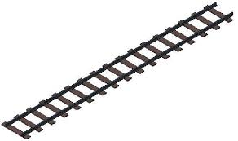
We need to talk
About degrees of freedom.
Conceptually simple, but considered obscure.
Train
Arm
1 degree of freedom
7 degrees of freedom
Notes:
They matter

Slide 42
Degrees of freedom
In general: Number of parameters that are free to vary.
In mechanics, this translates to the number of independent motions that a body can make.
In physics, it translates to independent dimensions.
In statistics, it is the number of values in a calculation that is free to vary.

Slide 43
Degree of freedom = independent pieces of information.
Sample size of 100 contains 100 independent pieces of information.
Sample size of 100 and knowing the sample mean contains 99 independent pieces of information.
5 samples with a combined size of 100 and knowing their 5 sample means contains 95 independent pieces of information.
Calculating a mean does not generate new independent information, so we have to adjust the degrees of freedom.

Slide 44
An illustration
# free to vary
SS_{explained}
SS_{residual}
2
SS_{total} =
SS_{explained} +
SS_{residual}
2
500 =
SS_{explained} +
SS_{residual}
1

Slide 45
We have to adjust the formula because we estimated the sample mean from the data itself.
Population SD:
Sample SD:
Notes:
No double dipping

Slide 46
It really matters: Pseudoreplication
You work for the Department of Transportation
You want to know how big you have to make a stop sign to make sure that observers see it reliably.
You show people signs of a random size and ask them whether they can see it or not.
You could either
Invite 1000 people and ask them to each judge 1 sign
or
Invite 10 people and ask them to each judge 100 signs
Does it matter?
Notes:
Or why degrees of freedom really do matter.

Slide 47
The issue
Central limit theorem applies if (and only if) *independent information* is combined.
Sample will only be representative of the population if one is randomly (and independently) drawing from the population.
If one is not doing that, one cannot make conclusions about the population, only about the sample itself.
This is usually rather uninteresting (although there are special cases, e.g. Einstein’s brain).

Slide 48
This is surprisingly common in (neuro)science and psychology
We record 130 neurons from 2 monkeys. Do we have 129 df or 1?
We log data in 20,000 trials from 2 psychophysical observers. What are our df?
You are interested in whether female menstrual cycles synchronize when they live together. You study 150 women in 50 dorm rooms. df?
You want to compare happiness in randomly picked cities. You ask 100,000 people in 3 cities. df?
Randomly picked issue of NN: 1/3 of studies have unaddressed pseudoreplication issues.
Notes:
The pseudoreplication bingo. Do this in your class.

Slide 49
An example from the published literature

Slide 50
Units of analysis?
The fundamental question is always: What is the unit of analysis about which we want to make conclusions.
For instance, if we want to study the activity patterns of *neurons* and we are reasonably certain that the underlying brains are relatively similar, the unit of analysis might be neurons.
In other words, there will be no pseudoreplication problem.
But if we start to look at the relationship between neurons and behavior, things get complicated. Most neurons will “share” a monkey. Not independent.
Notes:
Have to account for noise correlation. Measure the shared variation.

