Slide 1
Classical statistical methods I
Summaries of and predictions from data

Slide 2
Why do statistics?
We have done a lot in this class without resorting to statistical methods at all.
To handle data.
Data is special.
A relatively recent thing:
“Data” = “A given thing” (latin), ~1645)
Notes:
Why do we need it?

Slide 3
The birth/making of data
Things that exist
Things people make up
Data
(as the result of a measurement process)
Notes:
Data is interesting. It exists in the intersection of human creation and independent existence. There are things that exist, but haven’t been measured yet and things that are just made up.
That’s why you want your models bound by data. As much as possible.
That is why making up data is the cardinal sin in science

Slide 4
The use of data in science
Natural phenomenon or process
Measurement
Inference
Data
Notes:
Many ways in which the data is an imperfect representation of the natural phenomenon.
There might be measurement error (there always is)
The phenomenon might be inherently stochastic, so the data is just a – rather incomplete – sample of the larger phenomenon.
Statistical methods were conceived to deal with that. On top of that, we usually quantify a very specific aspect of the natural phenomenon. Not all of it. That’s a whole field.
Measurement: Formal, quantified observation

Slide 5
Summarizing data

Slide 6
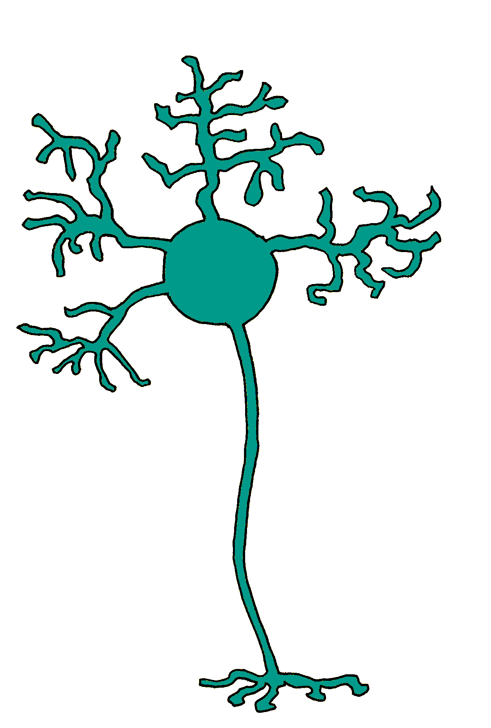
t
“Firing rate”: ?
t
t
t
“Firing rate”: ?
t
t
Notes:
We’re looking for a single number that characterizes the neurons, regardless of how often we measure. We want to summarize the measurements.
Upper neuron: Firing rate: 10 sp/s
Lower neuron: Firing rate: 5 sp/s

Slide 7
Statistical methods to tame variability: Measures of central tendency
We are looking for a very special number.
One that optimally summarizes the behavior of the neuron in all the trials of a given condition.
A reasonable choice for an optimality criterion:
The squared distance between the number and each data point in the sample should be minimal.
Notes:
Objective function

Slide 8
Solving for a (with calculus)
Notes:
We could also solve it with linear algebra

Slide 9
Statistical methods to tame variability: Measures of central tendency
One instantiation: The sample average

Slide 10
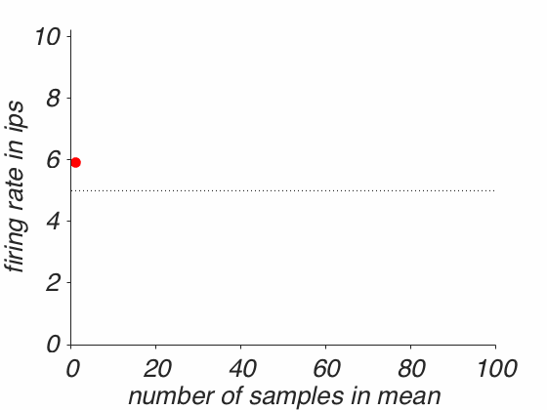
Why is averaging useful?
Taming random variability
Convergence to the “true” value, as n increases.
Notes:
This is why first impressions are so unreliable. And why people use prior information to blend with the first impressions. Which is why it is so unfair if you are not representative of the category you belong to – because people will reduce you to your category.

Slide 11
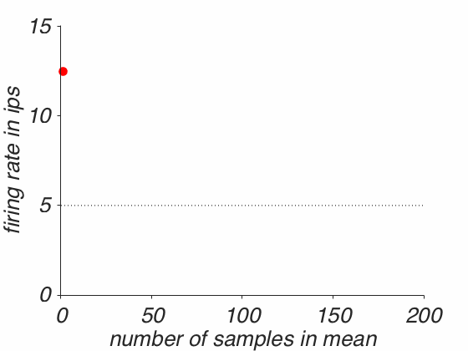
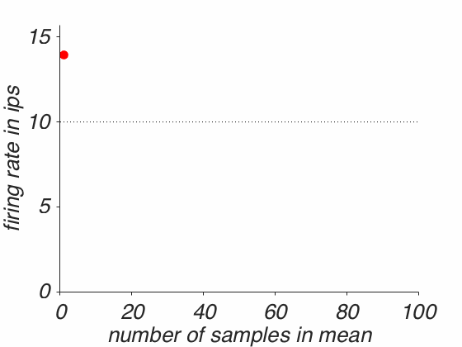
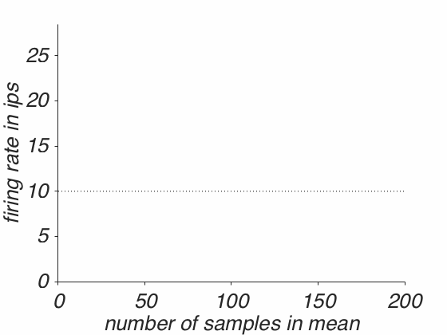
This even works in the presence of serious noise
Notes:
If it is gaussian, as it is here.
Might need more samples.

Slide 12
Where does this come from?

Slide 13
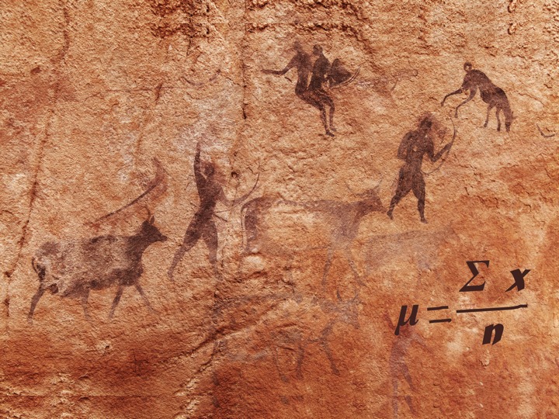
Notes:
Rock paintings of Tassili N'Ajjer, Algeria (~10,000 years old).
We routinely take the mean like there is nothing to it. Like we’ve always been doing this. But that is not true.

Slide 14
Where does this come from?
Why do we believe that mixing all measurements together will yield the best estimate of the natural phenomenon?
Why not just retain the best measurement?
Averaging is a radical act.
We have just gotten used to doing it.
What does it mean to take the average?
Notes:
Radical: Throwing away most of the information.

Slide 15
This comes to us from astronomy
Quetelet trained as an astronomer, brought statistical methods to other sciences. (e.g. “Social physics”)
A chief task at the time: Determining the speed of heavenly objects by measuring the time it takes them to pass through two parallel lines etched on the glass of the telescope.
Adolphe Quetelet (1796-1874)
Notes:
He came up with the formula for body mass index (BMI). Been doing this outside of astronomy for about 200 years. Not longer (!)
In astronomy for about 400 years.

Slide 16
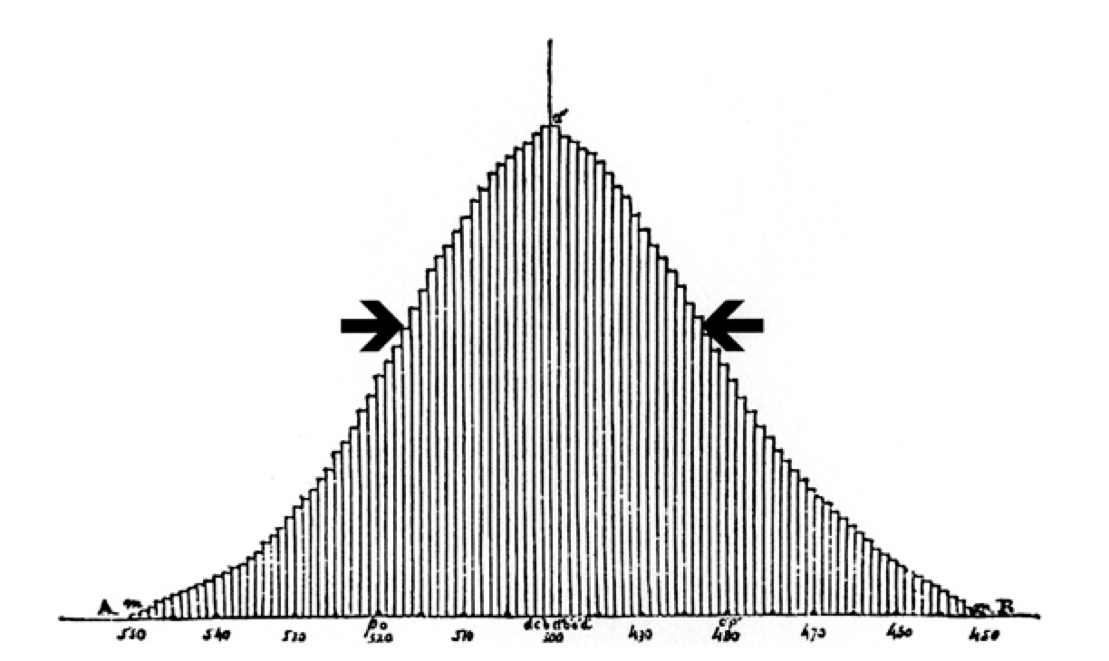
Statistical properties of this task
Every measurement is not free of (random) error.
But the object has an actual real speed.
Combine enough measurements and the errors will “average out”
Notes:
They are normally distributed.

Slide 17
Why is there more than one shoe size?
Implied model: Deviations from mean are error.
Instead of measuring one individual many times (e.g. in different context), most researchers measure many individuals once, then combine the measurements by calculating the group average.
According to ergodic theory, one can use the group average to predict the average behavior of individuals if:
Every member of the group is identical
Every member of the group remains the same (doesn’t change over time)
This works reasonably well in statistical physics, e.g. predicting the behavior of ideal gases and gas molecules.
How about psychology and neuroscience?
Notes:
Because if we simply averaged the foot size, the shoes wouldn’t really fit anyone. There is more than one foot size. There is inherent diversity. That is not error. It is very real.

Slide 18
It matters: fMRI activation in a memory task…
Miller et al. 2002

Slide 19
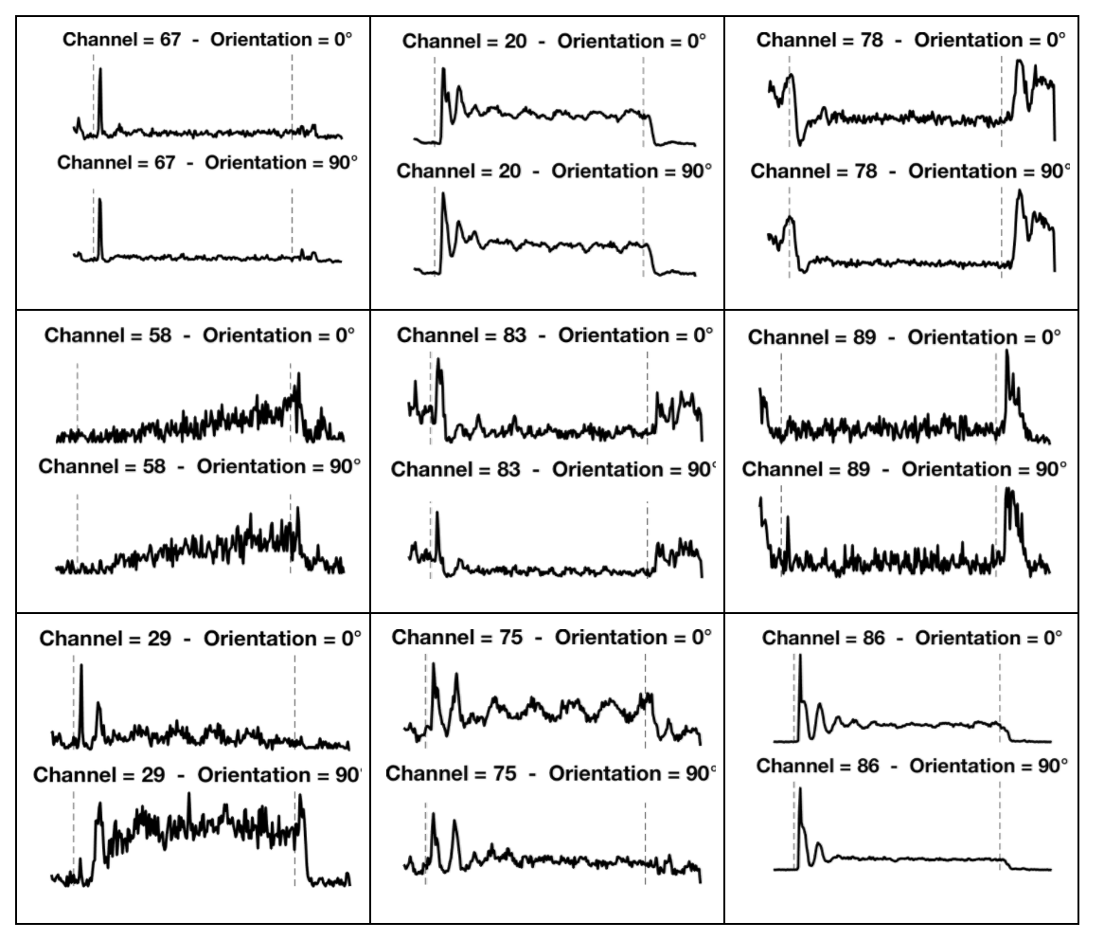
Neural activity in V4 in response to sine wave gratings
Notes:
Smith et al.

Slide 20
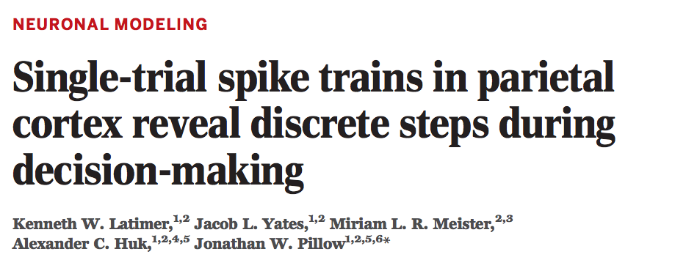
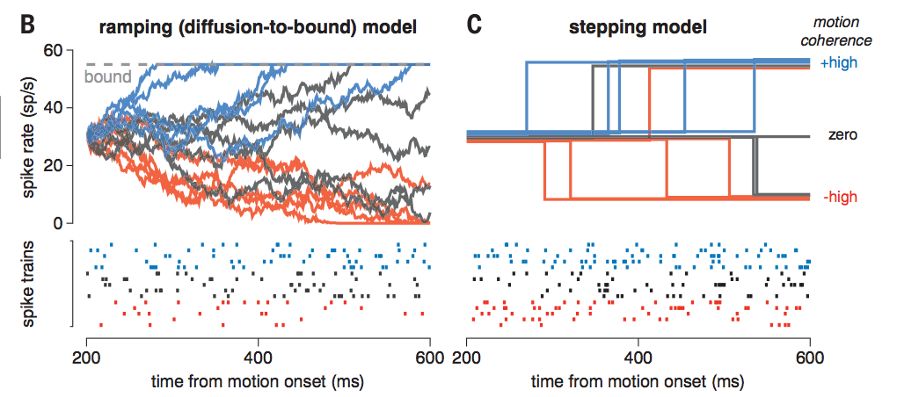
Recently quite controversial
Notes:
Paper by a former TA of this course

Slide 21
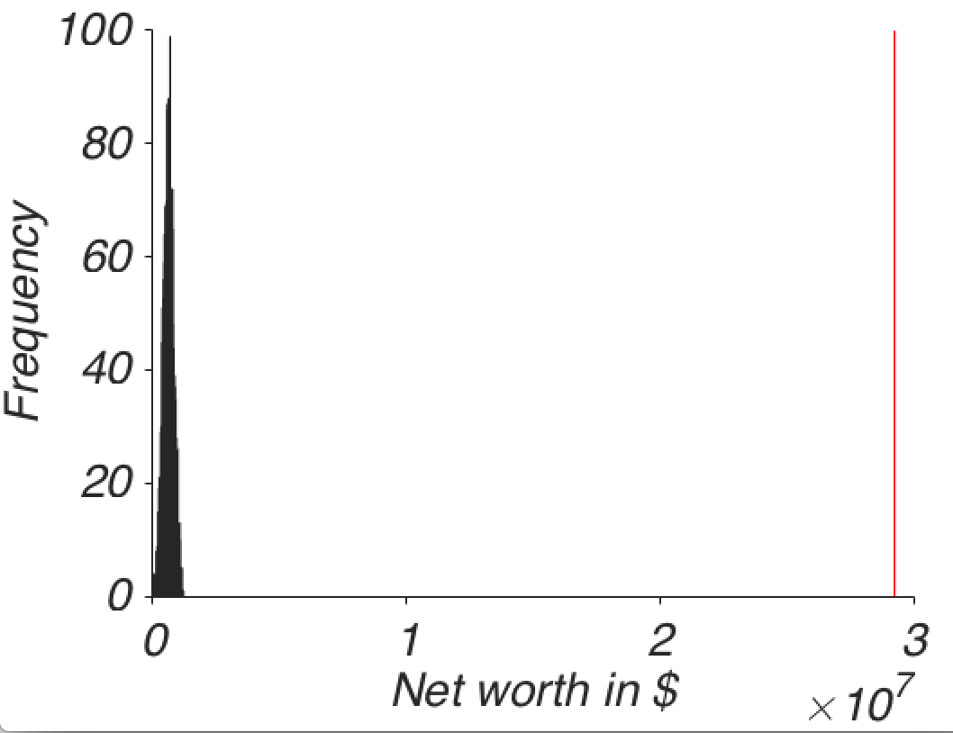
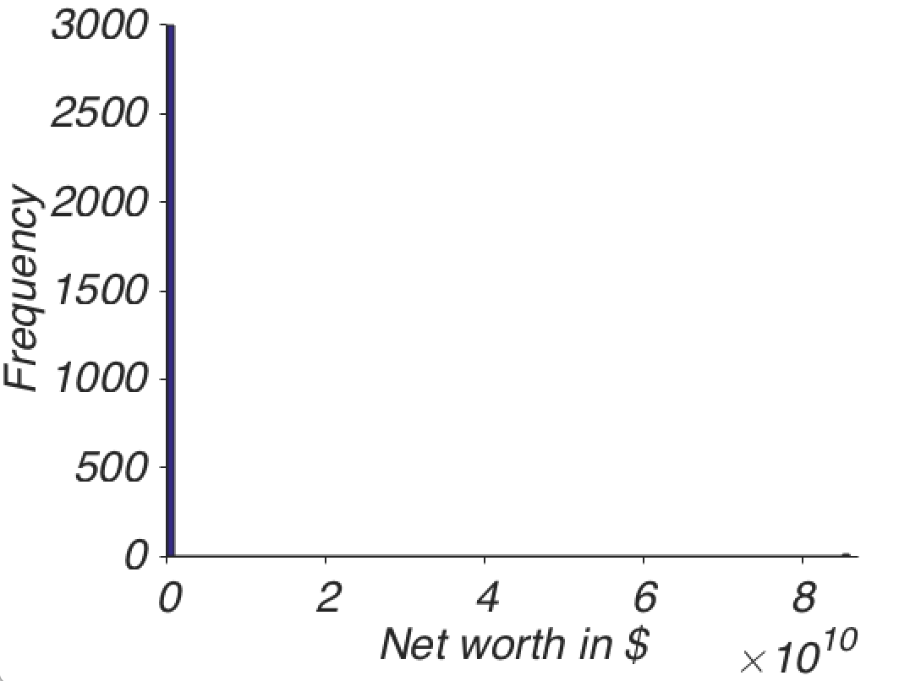
Another issues with the average
It is sensitive to outliers that can make it unrepresentative of most of the data in the sample.
Notes:
We have already seen that least squares regression is sensitive to outliers. So it should not come as a surprise that the average – which minimizes squared error is also sensitive to outliers.

Slide 22
We could now look for a number that also represents the central tendency of a sample but is not as sensitive to outliers.
One that minimizes absolute deviations
This is the median, the central value of a sample.
It relies only on rank order (not absolute magnitude)
Computationally intensive (we’re only able to sort long lists efficiently since the 1960s with algorithms like quicksort or heapsort)

Slide 23
The median is the number we are looking for – derivation:
True for

Slide 24
It is often indicated in psychology and neuroscience for measurement reasons.
An ordinal scale is probably the most common scale type in psychology and cognitive neuroscience.
The distances between numbers are not assumed to be equal and are not interpretable.
Strongly
disagree
Strongly
agree
Disagree
Indifferent
Agree
1
2
3
4
5
Notes:
The distance is not interpretable. Only the order is.
So technically, the mean is not interpretable either. But the median is.
For this, one has to do the median.

Slide 25
Statistical methods to tame variability: Measures of dispersion
We want to know how much variability to expect.
The sum of simple deviations from the mean won’t do:
Two simple ways of dealing with this:
Squaring → Standard deviation (SD or STD)
Taking the absolute value → Mean absolute deviation (MAD)
x = 1, 2, 3
x_{bar}= 2
x₁: 1-2 = -1
x₂: 2-2 = 0
x₃: 3 - 2 = 1
---------------
-1 + 1 = 0
Notes:
This is a fundamental property of the mean

Slide 26
The standard deviation (SD)
Given that the average minimizes squared error, the squared error is the natural dispersion measure.
But larger difference from mean have larger impact, due to squaring, again – not robust.

Slide 27
The mean absolute deviation (MAD)
A more robust alternative.
Much less commonly used.
But catching on.

Slide 28
Comparing MAD and STD

Slide 29
Summarizing relationships between two variables: Correlation

Slide 30
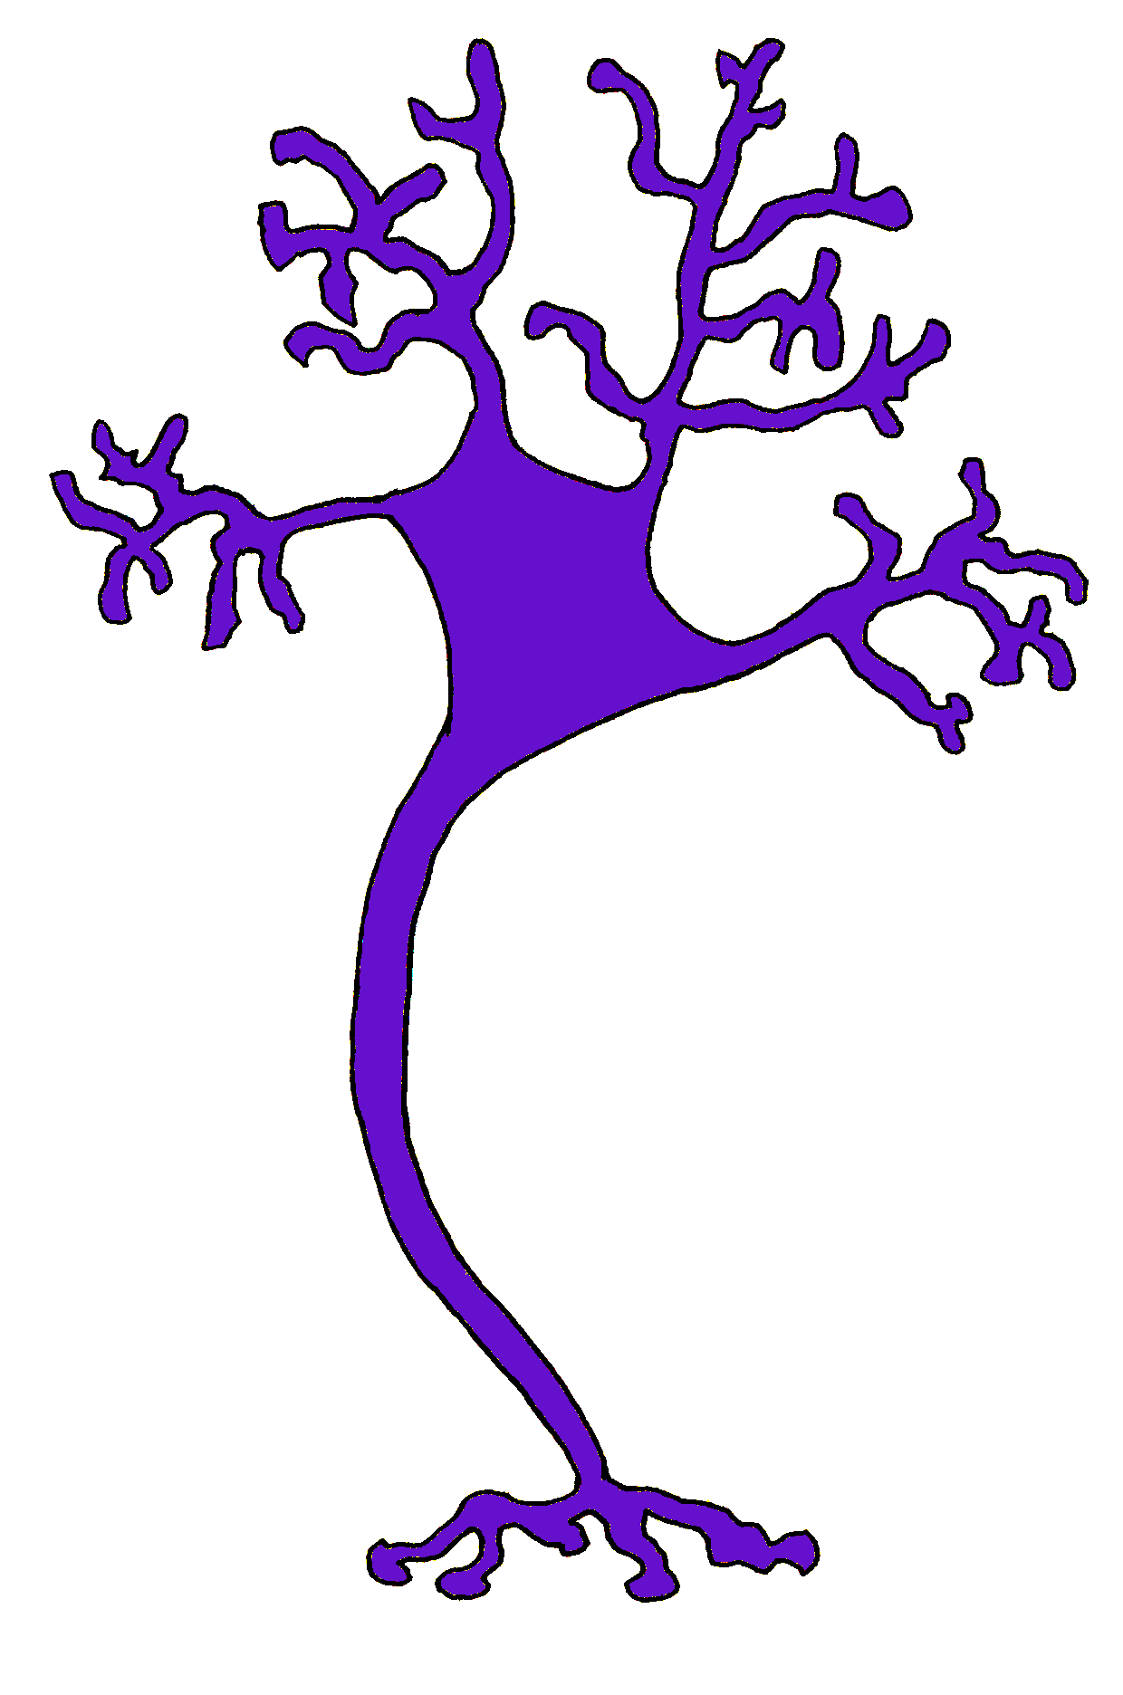
I
II
1
t
t
2
t
t
3
t
t
6
r
II
5
4
9
10
11
I

Slide 31
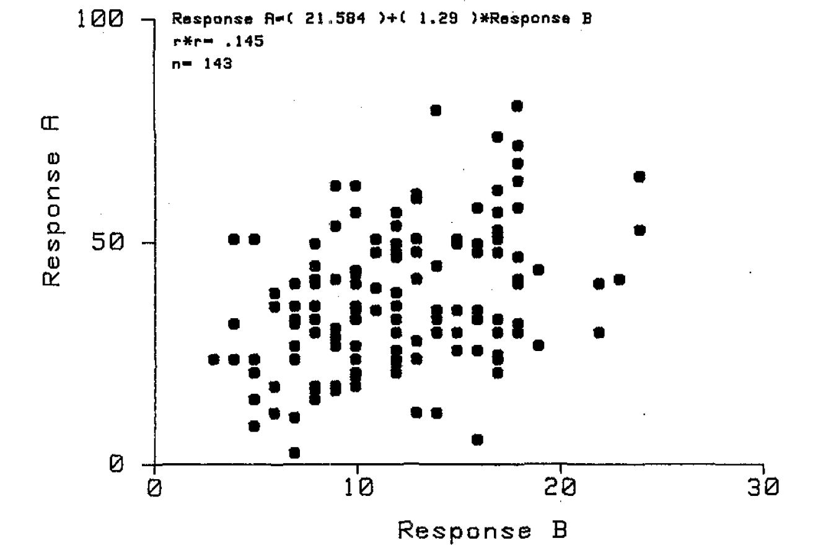
r = 0.381
Kan, Scobey & Gabor (1985)
Notes:
Sample correlation. What is r? Building up to that.

Slide 32
Deriving correlation
We start with the dispersion metric of one variable, which we just defined – the standard deviation:

Slide 33
From standard deviation to variance
Notes:
The variance is simply the square of the standard deviation

Slide 34
From variance to covariance

Slide 35
Another (familiar) path to covariance: LA
x y
M =
Notes:
C: The covariance matrix

Slide 36
Properties of the covariance
When a given x is above its mean and a given y is above its mean (if they are both above *their* mean), cov is positive.
When a given x is below its mean and a given y is below its mean (if they are both below *their* mean), cov is also positive.
Otherwise – if x and y are not on the same side of their respective mean, cov is negative.
So the general idea to quantify a relationship is sound qualitatively.
But the magnitude is hard to interpret.

Slide 37
Example: Height and intelligence
μ_{x}= 67” (height)
μ_{y} = 100 (intelligence)
Height | IQ | x_{i}-μ_{x} | y_{i}-μ_{y} | Product
x₁= 60 | y₁ = 85 | -7 | -15 | 105
x₂= 71 | y₂ = 130 | 4 | 30 | 120
x₃= 73 | y₃ = 90 | 6 | -10 | -60
x₄= 57 | y₃ = 115 | -10 | 15 | -150
Sum: 15
Sum/n: 3.75

Slide 38
From covariance to correlation
Correlation = Normalized covariance
Normalized by the product of the respective standard deviations

Slide 39
Going from cov → r in LA
C
r
S⁻¹
Notes:
Normalizing the axes (as we showed before). 1 df. A single number that characterizes the shape of the data cloud.

Slide 40
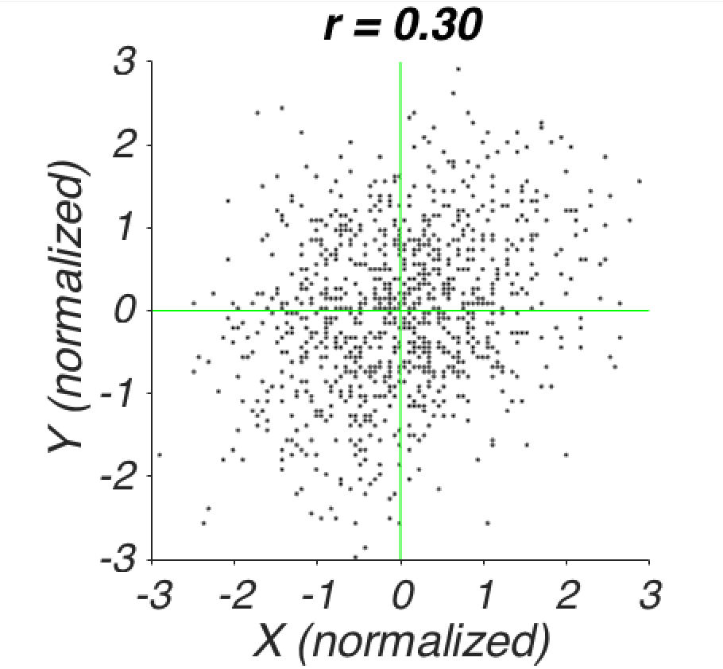
Characterizing the shape of the data cloud
-
+
-
+
Notes:
Correlation = summarizing the relationship = characterizing the shape of the data cloud.

Slide 41
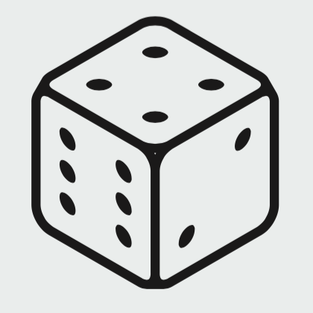
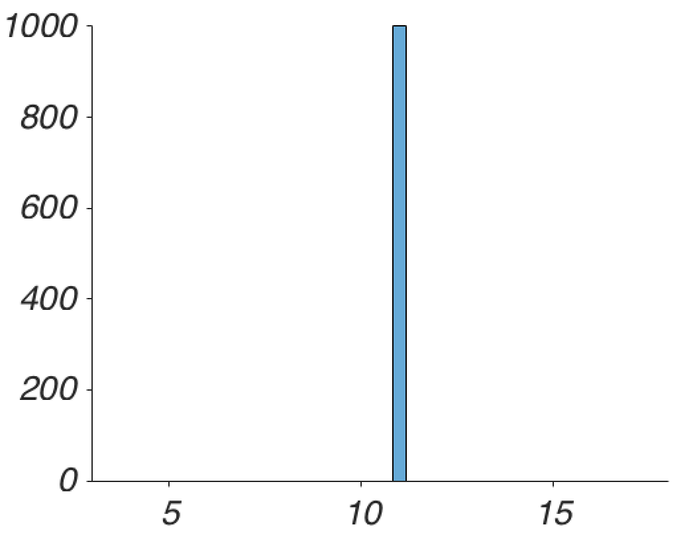
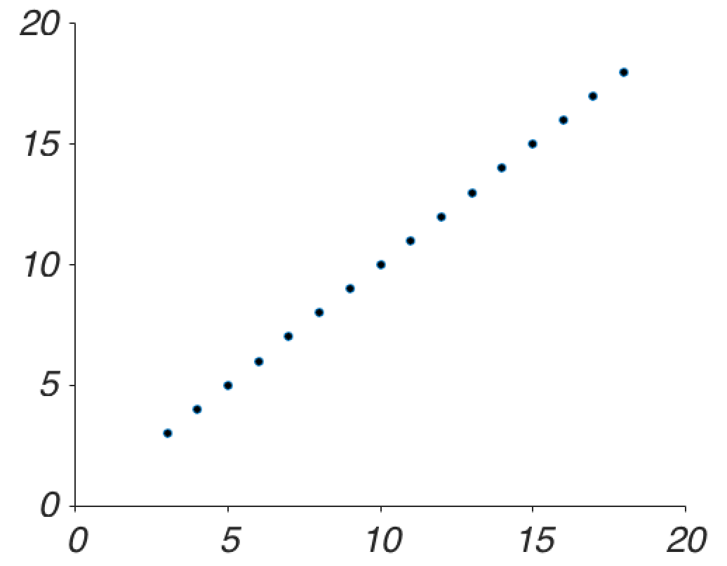
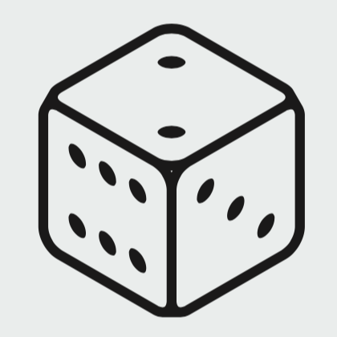
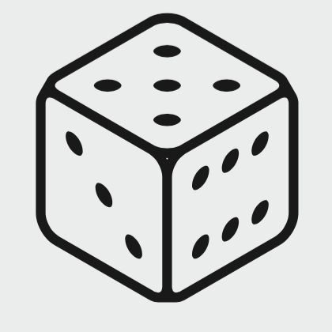
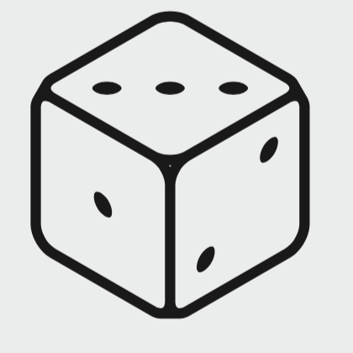
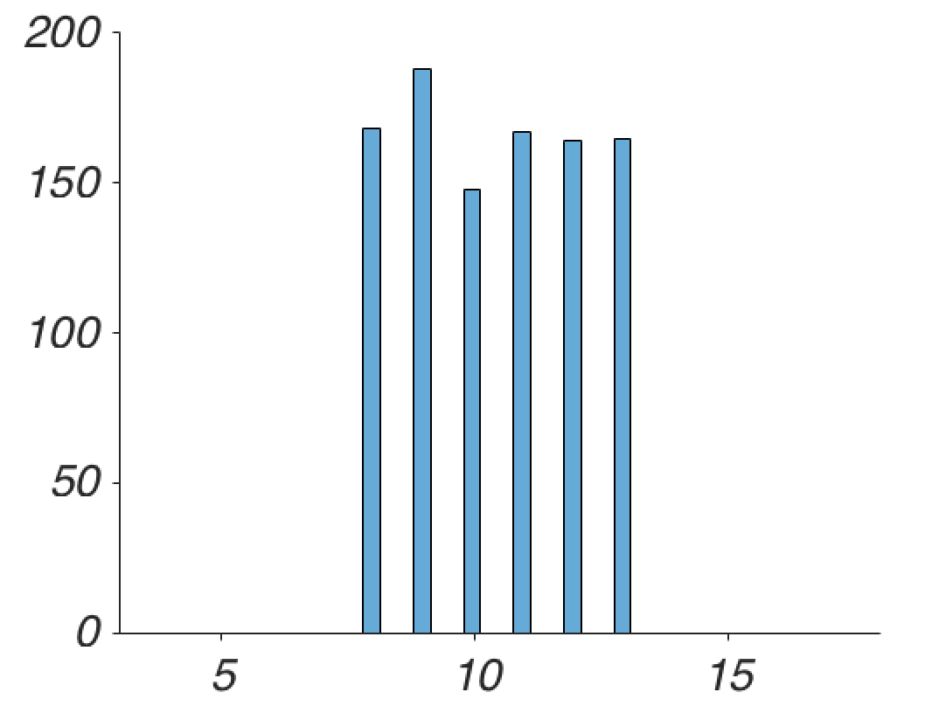
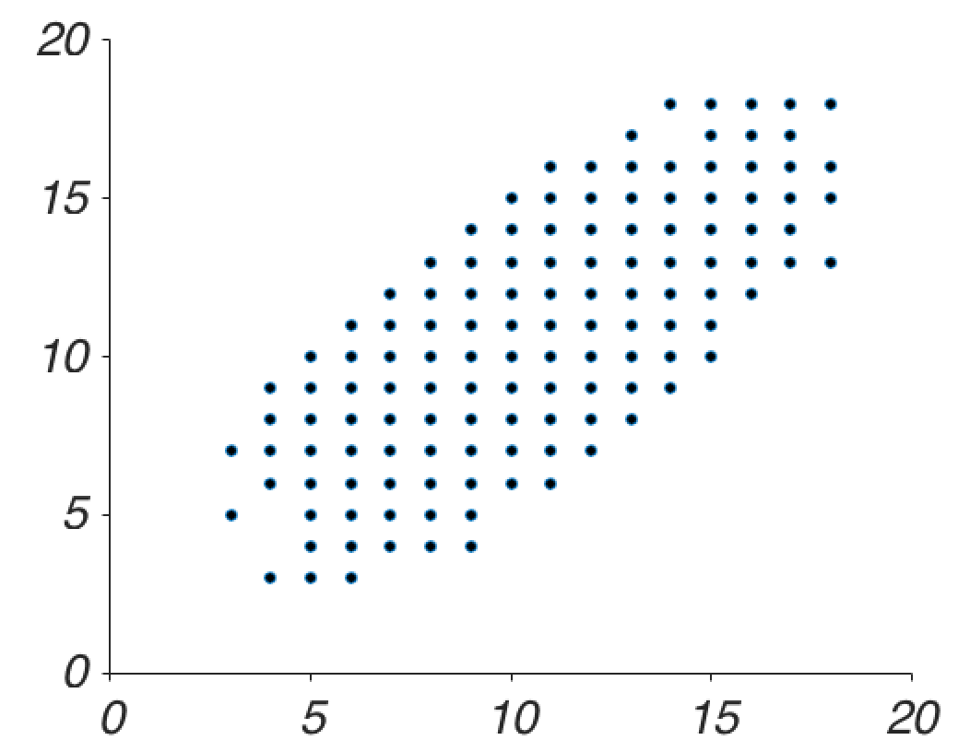
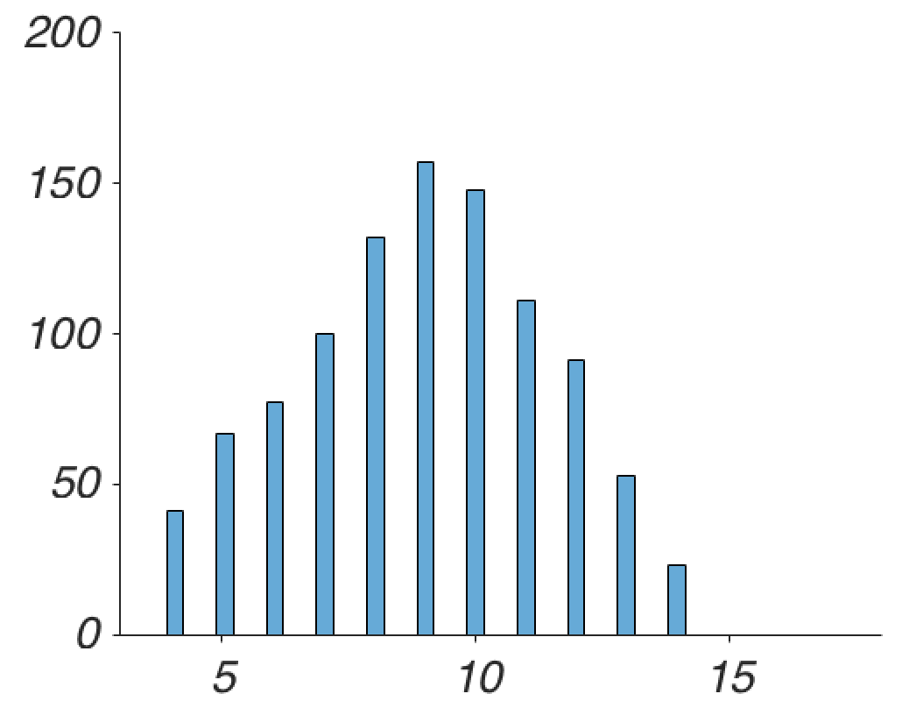
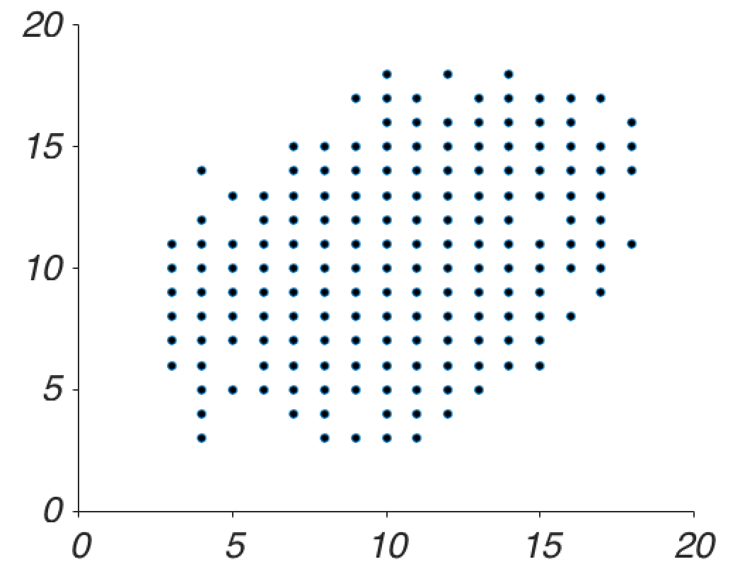
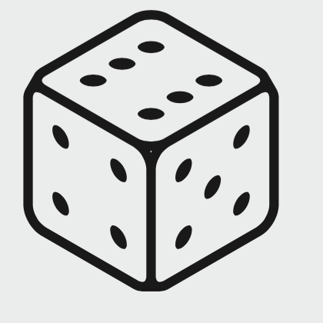
Interpreting correlation strength: Aleatory considerations
I
II
Σd_{i}
r = 1
r = 0.66
r = 0.33
Notes:
Pertaining to the throwing of dice.
Why do we need to correlate? Because we have no access to the true value. So we simply correlate two values.
Give me some psychological construct. If no one else says something, I’ll use intelligence. Environment, Genes and Daily form.

Slide 42
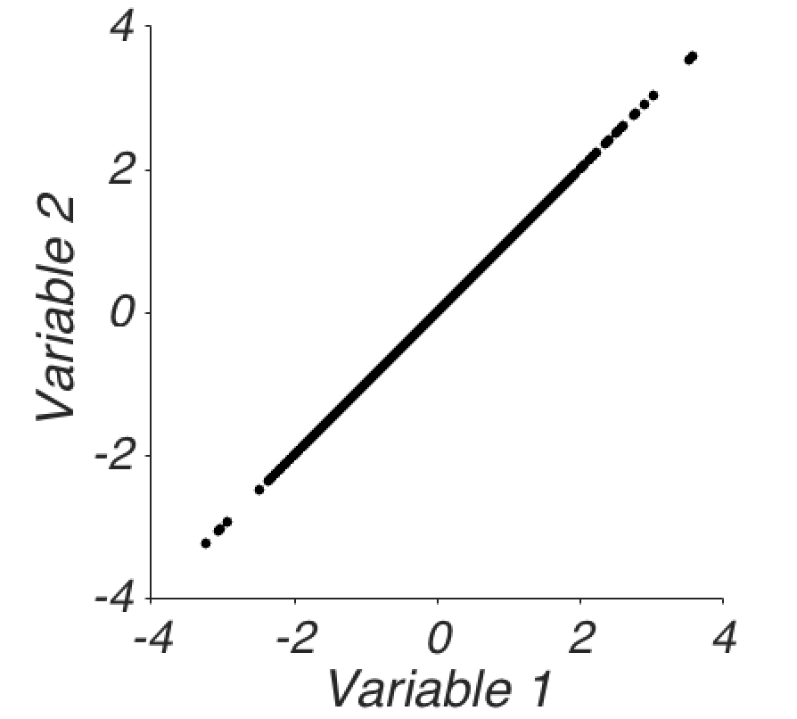
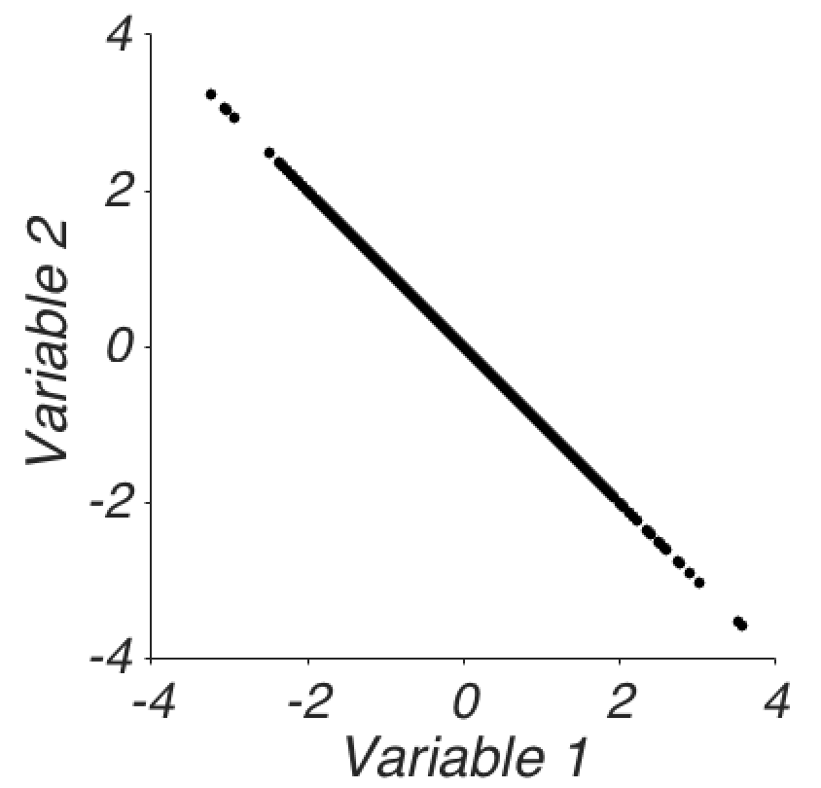
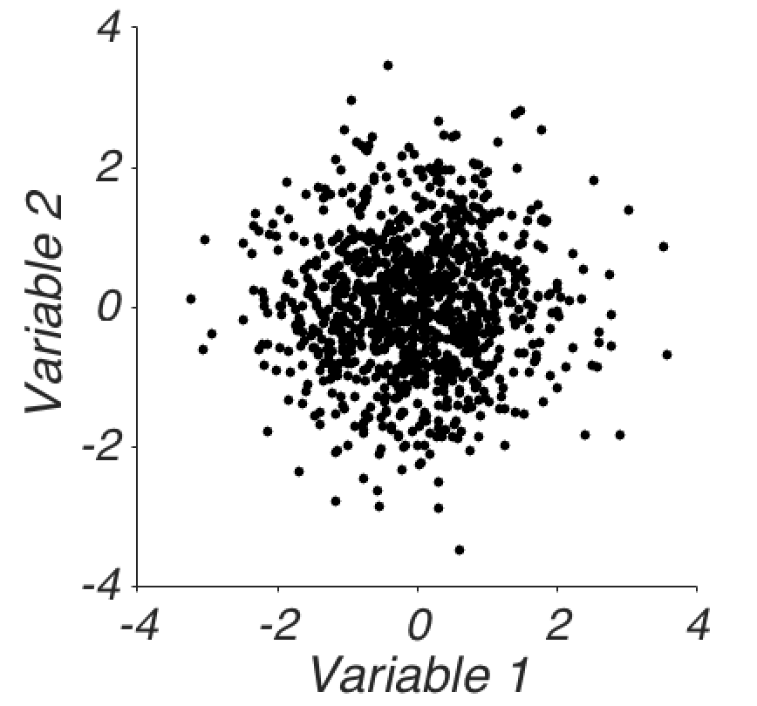
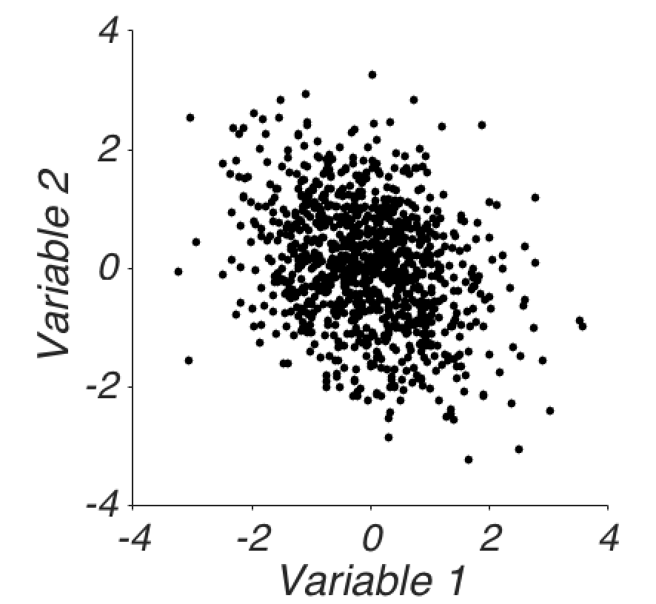
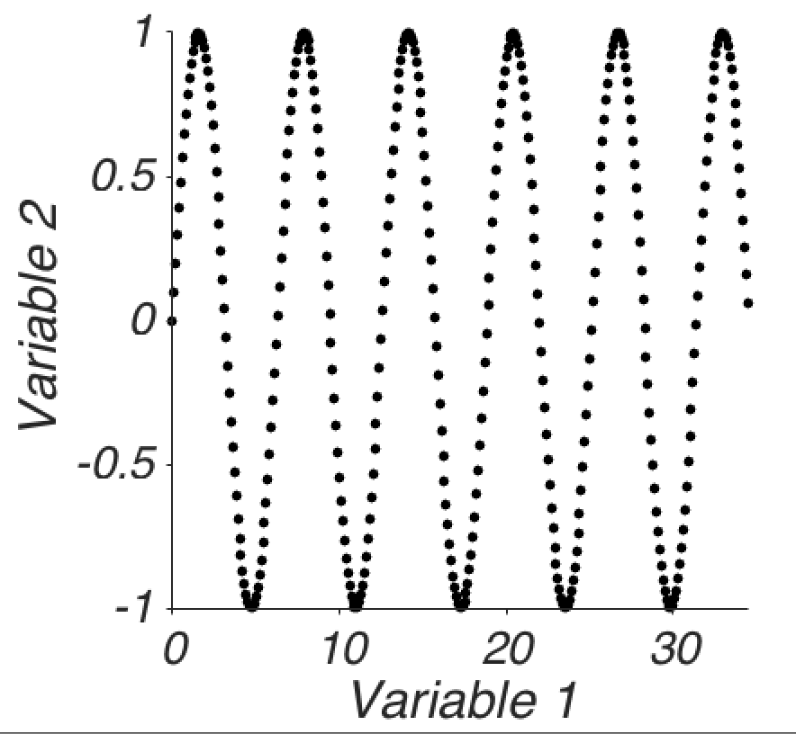
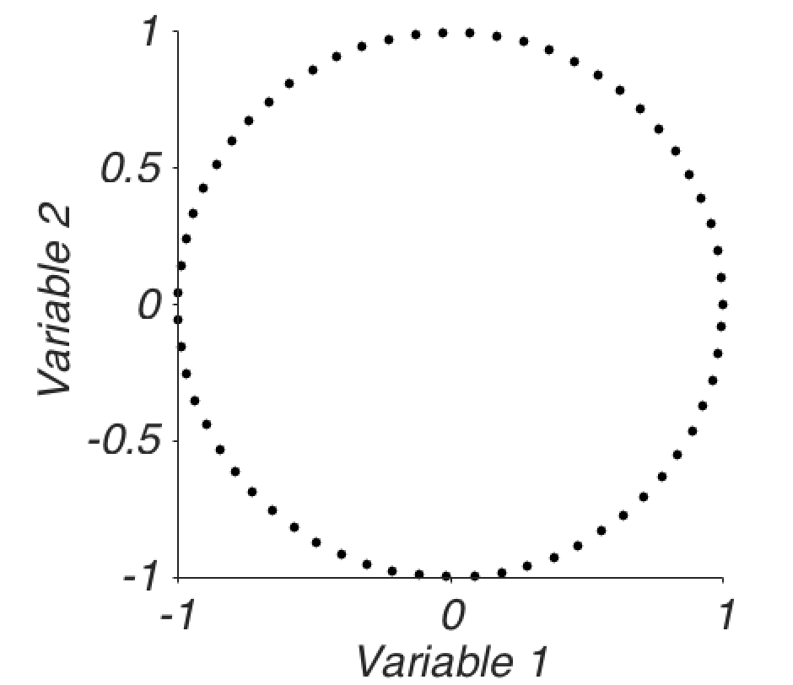
r captures *linear* relations
r=1
r=-1
r=0
r=-0.3
r=0
r=0

Slide 43
Correlation is a simple statistical relation between two variables

Slide 44
What is the problem with interpreting this causally?
Even if there are only 2 variables, the direction of causality is unclear.
It is unclear which is influencing which.
But in reality, there are always more than 2 variables.

Slide 45
More problems interpreting correlations
In the real world, there are usually more than two variables…
They can influence the relationship between the two we decided to look at.
The correlation can be epiphenomenal to the causal processes (e.g. smoke vs. fire)

Slide 46
Classic example: A third, unknown variable
Notes:
Pulling it all over the place

Slide 47
Pearson vs. Spearman
Charles Spearman (1863 – 1945)
Karl Pearson (1857-1936)

Slide 48
The idea
IQ score | Rank (IQ) | Height inches | Rank (Height)
85 | 1 | 69 | 6
87 | 2 | 68 | 5
95 | 3 | 70 | 7
100 | 4 | 65 | 3
102 | 5 | 60 | 1
105 | 6 | 61 | 2
110 | 7 | 75 | 9
120 | 8 | 67 | 4
140 | 9 | 71 | 8
Transform values to ranks (for each variable).
Calculate Pearson’s product-moment correlation between the ranks (not the actual values).

Slide 49
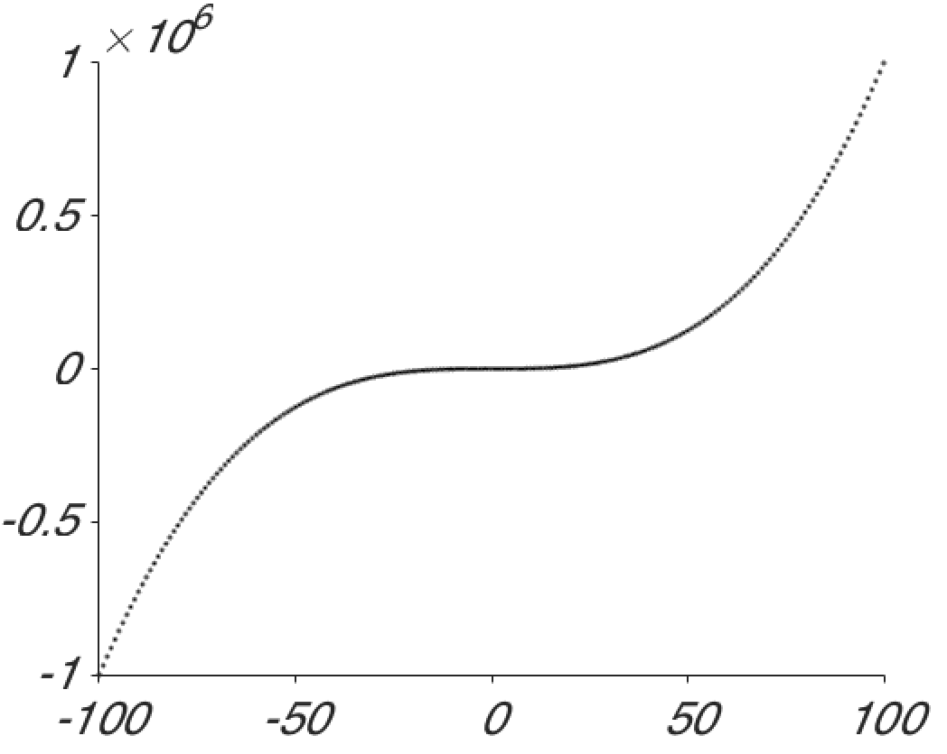
Why is Spearman’s rank correlation useful?
In analogy to the median. What matters is not the absolute value of measurements, but their rank order.
Product-moment correlation relies on linear relationship. Spearman’s rank correlation can represent nonlinear relationships, as long as it is monotonic.
Pearson: r= 0.91
Spearman: ρ = 1
Notes:
^3

Slide 50
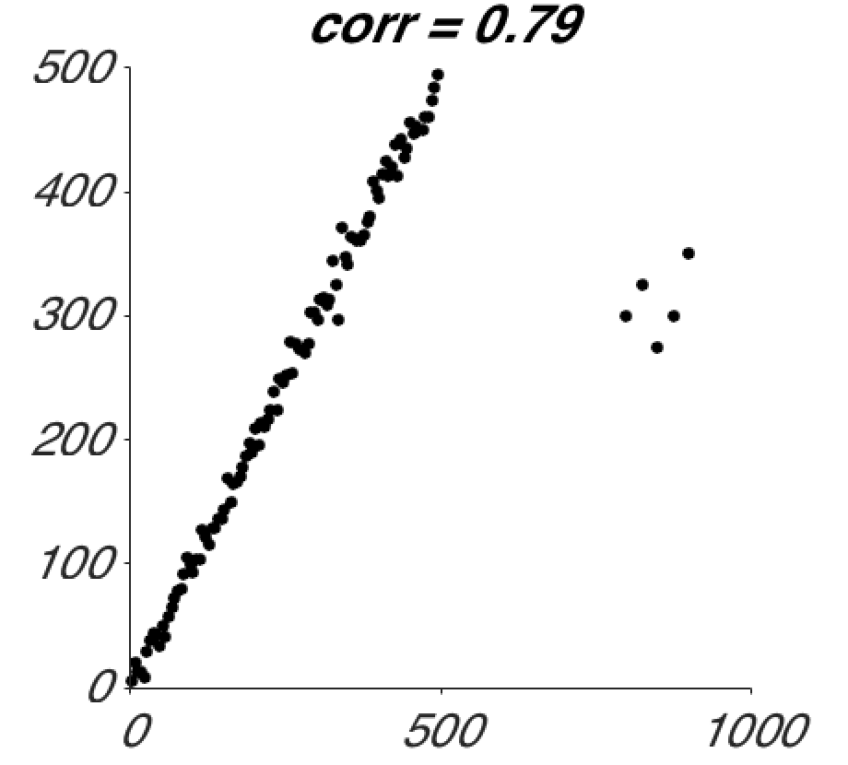
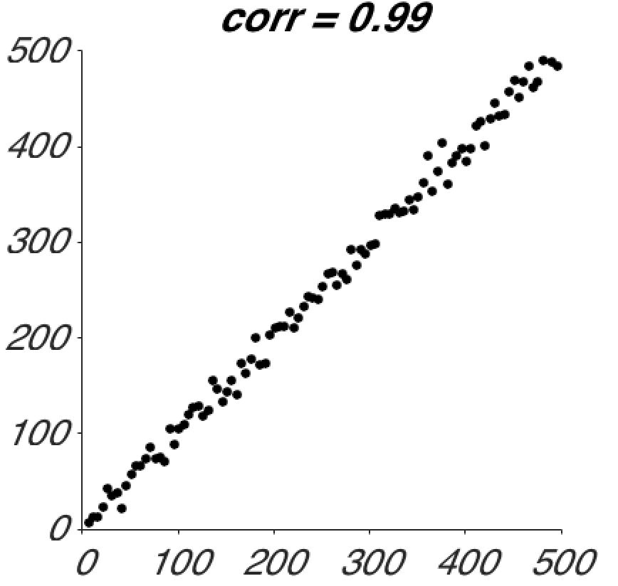
It is also more robust
Pearson’s r is very susceptible to outliers.
Outliers dramatically affect Product-Moment correlations: 0.99 → 0.79.
Spearman: 0.99 → 0.95

Slide 51
Data-based prediction
“I have no faith in anything short of actual measurement and the Rule of Three”
-Charles Darwin, 1855
Notes:
Finding a number in the same ratio to a given number as those between two other numbers.
Used to extrapolate.
A well placed faith?

Slide 52
Regression (historical)
Francis Galton, 1822-1911

Slide 53
Regression
A historical term.
Introduced by Galton.
Wanted to know the height of children based on the height of their parents.
He noticed that one can predict the height of children based on the height of the parents.
But the prediction is not perfect. He observed that the height of the children is “regressing” to the mean, i.e. taller parents would tend to have children that are tall, but not as tall as them. = Failure of the rule of three (!)
Why?
Height = Nature + Nurture + Luck
Regression is only avoided if measurements are perfect and completely determined by the predictor.
A better term would be prediction (instead of regression).
Notes:
Measurement error: Rule of three fails. If correlation is not perfect.

Slide 54
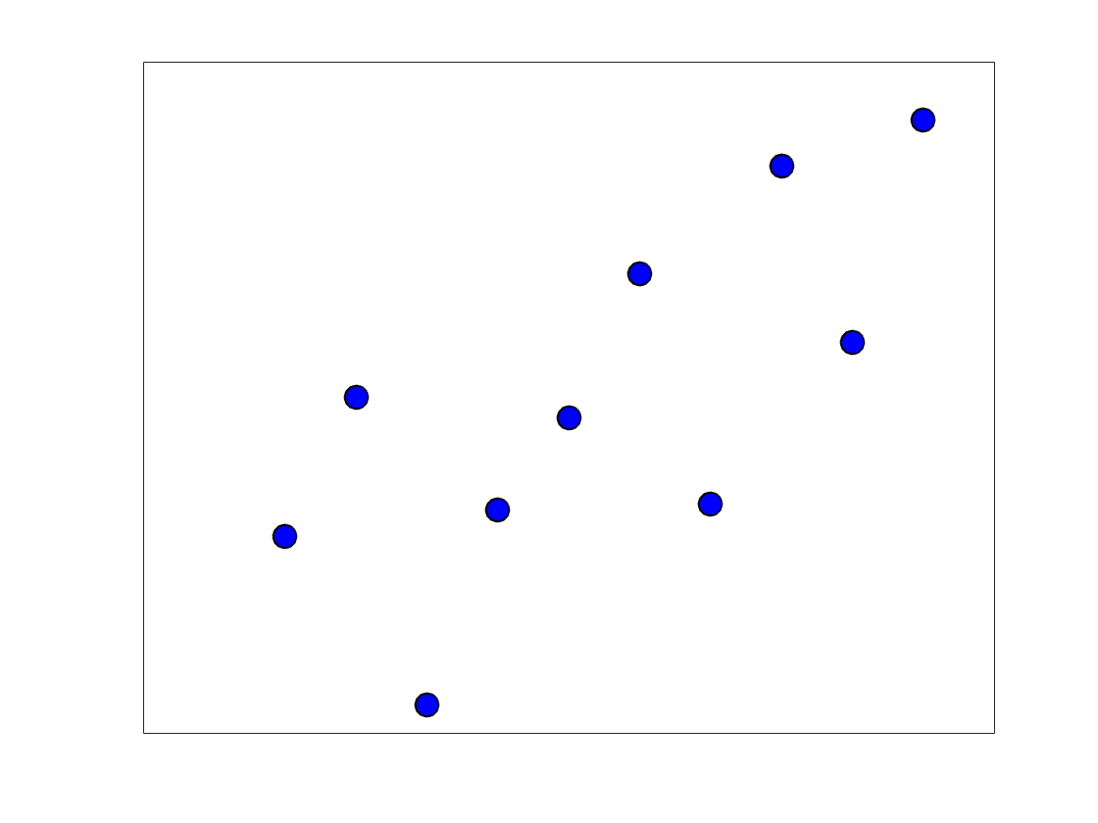
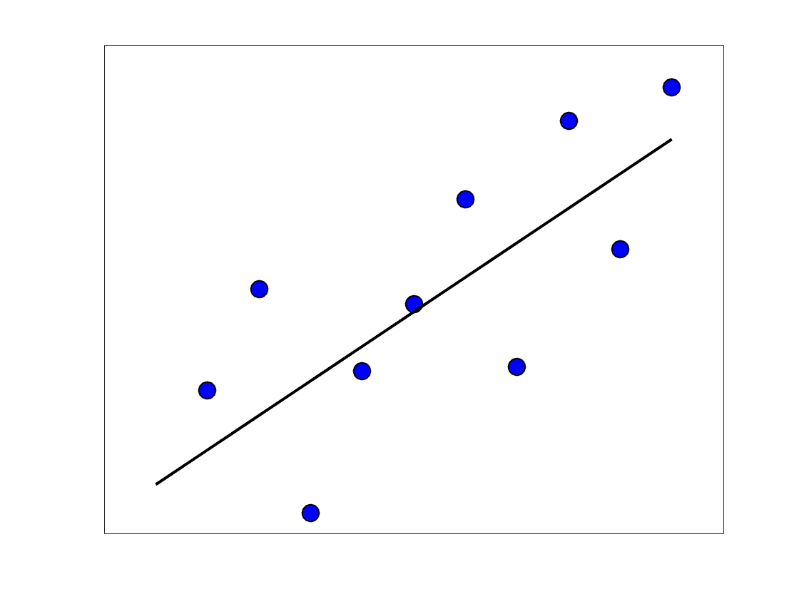
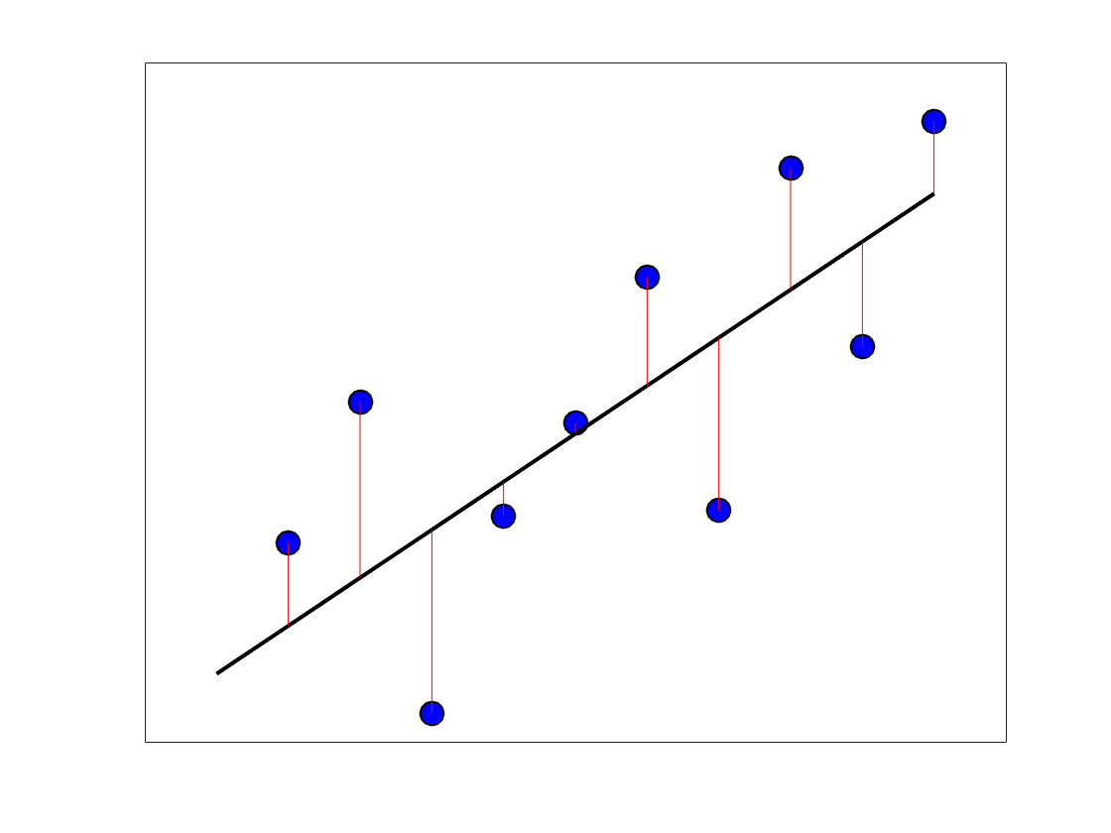
The regression problem: Where do you draw the line?
Happiness
Income
Notes:
Red: Residuals

Slide 55
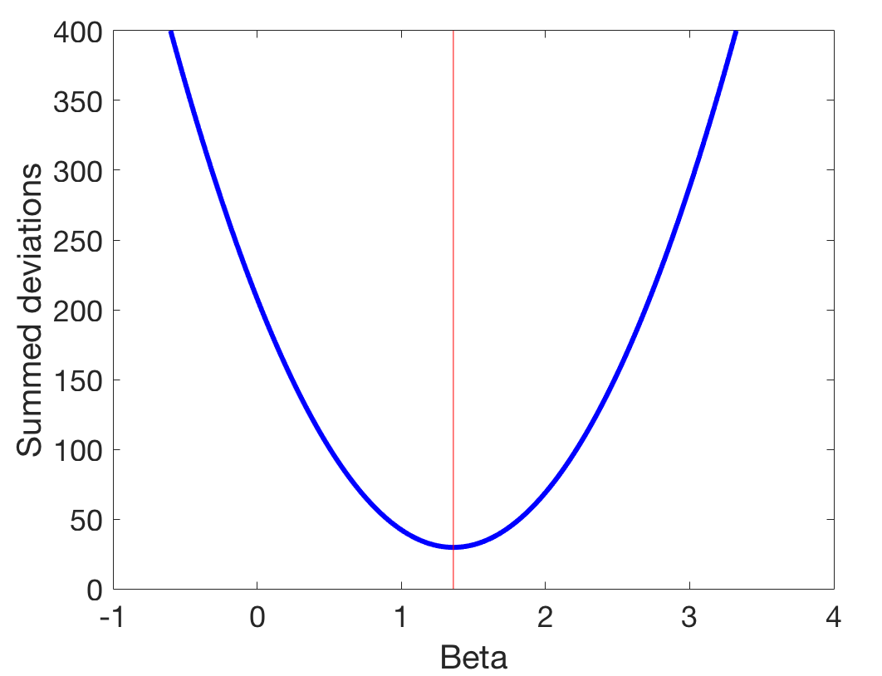
We minimize the sum of the squared differences
Between predicted and actual values
Why?
This makes
sense but is
not robust to
outliers.
Notes:
This is an optimization problem. Having a marble come to rest at the bottom.

Slide 56
Regression critically relies on correlation
Notes:
You go to a career counselor. They they test your IQ. You want to know how much money you can be expected to get with that. They consult a study where the relationship between IQ and income was measured. The question is: Where to draw the line?

Slide 57
Regression critically relies on correlation
Notes:
This is a grid of the standard deviations

Slide 58
Regression critically relies on correlation
Notes:
This is a line connecting the standard deviations. As you notice, as IQ increases by 1 SD, most points are *below* the SD line, so it raises less than that. But how much less?
You start in the mid point (mean of both distributions), then you go 1 SD over in both directions (x and y) and connect the 2 intersection points. Then extrapolate. That’s the line that connects the vertices of standard deviation lines. If r was = 1, this would be the regression line.

Slide 59
Regression critically relies on correlation
Notes:
Multiplying by the correlation of the SD. That gives the right amount.

Slide 60
Regression critically relies on correlation
Notes:
Do this for all SDs

Slide 61
Regression critically relies on correlation
Notes:
Connect the dots. This is the regression line. Note that there are two possible regression lines.
Say you come in with a given IQ, e.g. 115, our best guess of what you’ll make is maybe around 120k. But we also note that there is a lot of variation because correlation is only moderately high. Why? Because other things matter for income, not just IQ. For instance, work ethic, luck, social skills, organization (conscientiousness), creativity, talent, connections, education.

Slide 62
The general linear model (GLM)
β: Regression parameter(s), (weights)
X: Independent variable (Predictor)
Y: Dependent variable, (Predicted)
Simple linear regression:
Notes:
Assumptions: Independent effects, independent errors. The best possible case. The world is simple.
Partitioning of variation

Slide 63
Variance partitioning and model assessment
Notes:
Say that it is well known that.
As you can easily convince yourself
It is obvious…
→ Just kidding.
Show the animation.

Slide 64
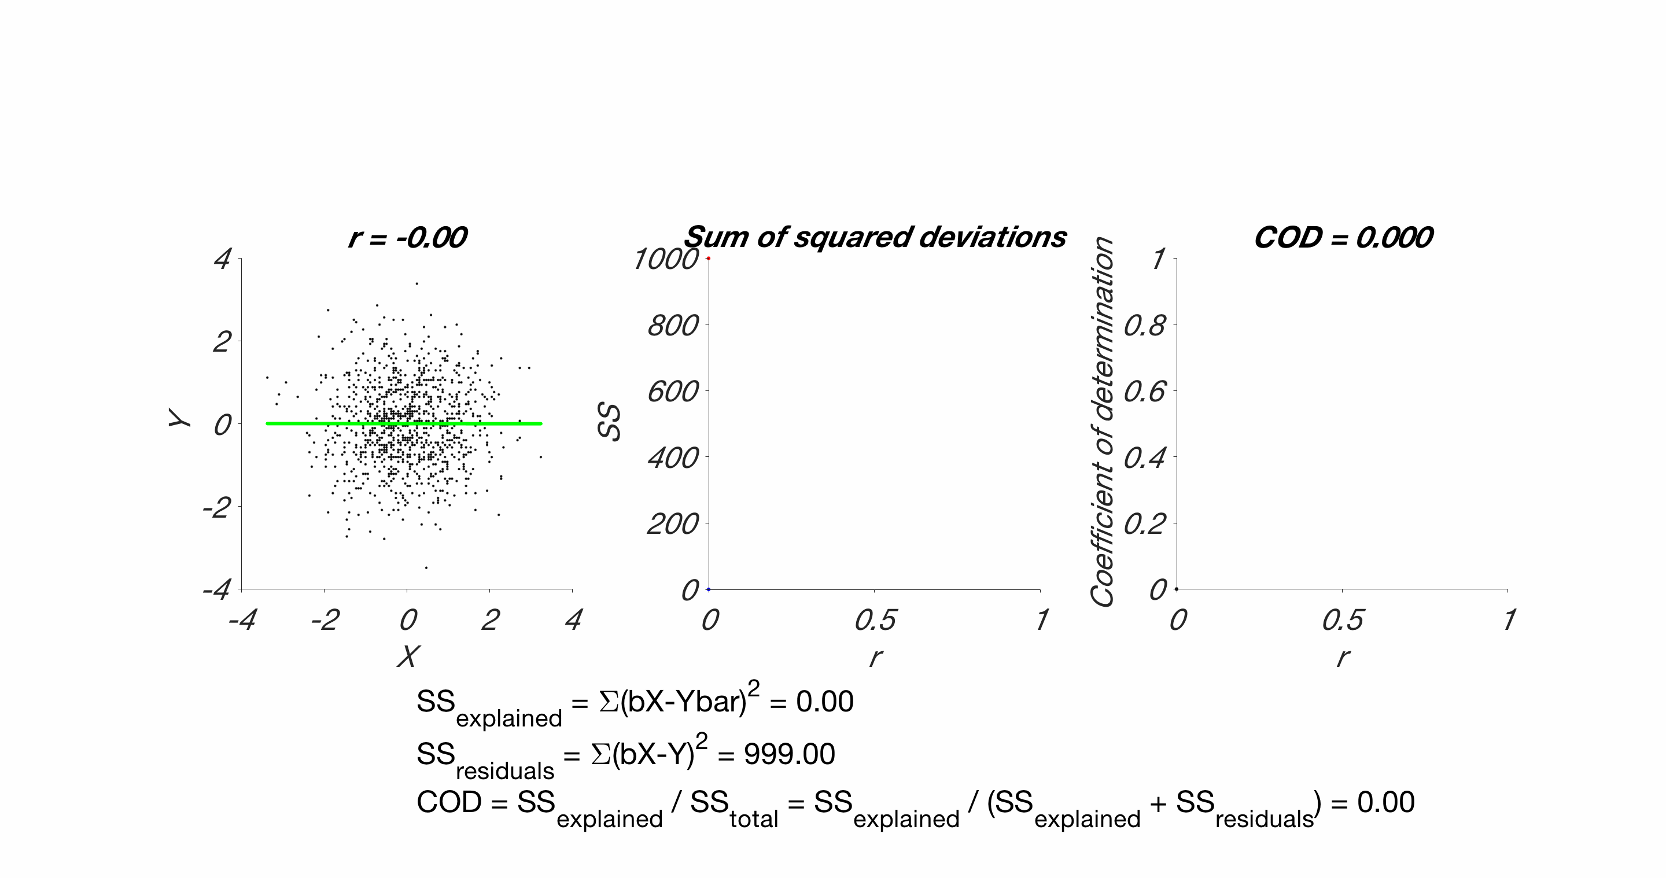
r, regression to the mean, variance partitioning, r^2

