Slide 1
Object recognition 1
Basic categories, Grouping, & Crowding
Denis Pelli
Psychology and Neural Science, NYU
December 8, 2015

Slide 2
Object recognition
We do it effortlessly yet no one knows how. The theories are appealing, but don’t explain much.
Definitions
Basic categories (Rosch)
Gestalt grouping (Wertheimer)
Crowding

Slide 3
What is object recognition?
Categorizing an image. Calling a chair a chair, despite variations in style, viewpoint, rendering, and surrounding clutter.
The category serves many purposes:
  Naming: “moose” “squirrel”.
  Individual identification: “Bullwinkle” “Rocky”.
  Recognition memory: I saw that moose before.
  Matching: this moose and that moose are the same moose.

Slide 4
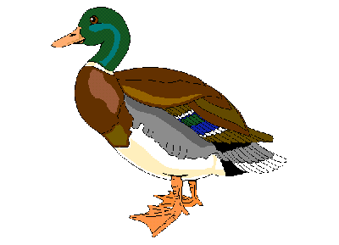
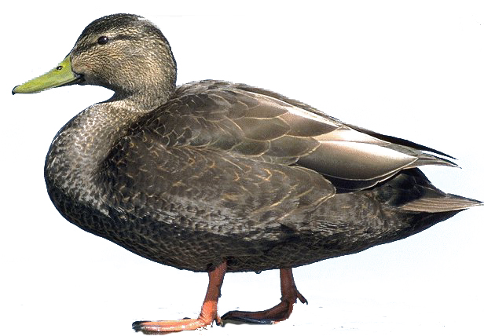
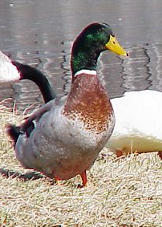
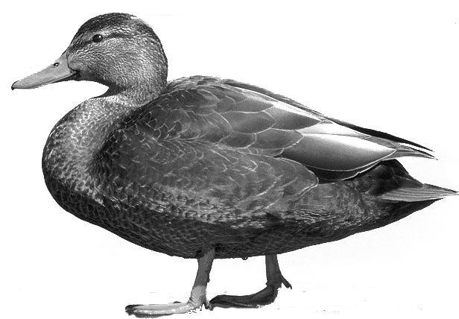

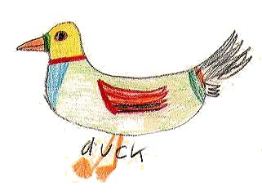

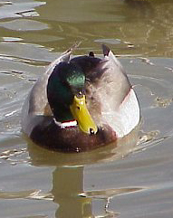
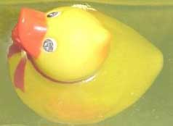
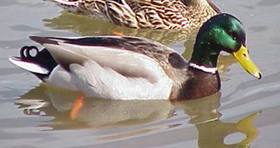
Invariance of recognition
Thanks to David Heeger

Slide 5
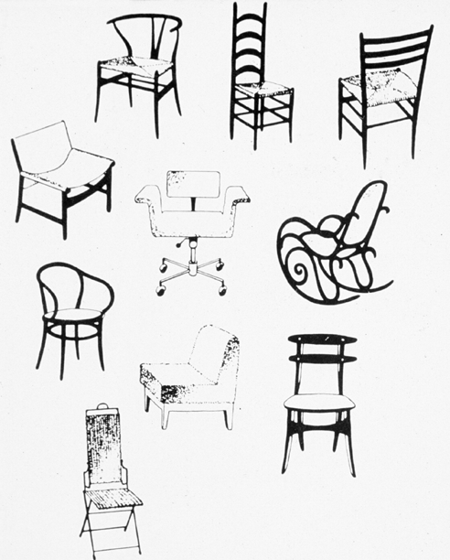
Novel examples need to be recognized.
Thanks to David Heeger
Notes:
OR-18, CD-10

Slide 6
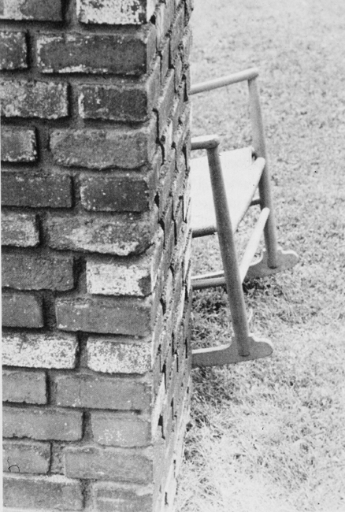
Occlusion. We often still recognize when only part of an object is visible.
Thanks to David Heeger
Notes:
OR-19, CD-10

Slide 7
Classical view of object categories
Definition of the category specifies necessary and sufficient properties.
Problems
It’s hard to define most natural categories. (Wittgenstein)
Fails to predict:
typicality (freq. & family resemblance) (Rosch)
unclear membership
intransitivity
Murphy 2002 The big book of concepts. Chapter 2.

Slide 8
Ordered by typicality
Furniture
chair
sofa
table
dresser
desk
bed
bookcase
footstool
lamp
piano
cushion
mirror
rug
radio
stove
clock
picture
closet
vase
telephone
Fruit
orange
apple
banana
peach
pear
apricot
plum
grapes
strawberry
grapefruit
pineapple
blueberry
lemon
watermelon
honeydew
pomegranate
date
coconut
tomato
olive
Rosch and Mervis (1975)

Slide 9
Theories of object categories:
prototype vs. exemplars
Prototype: A summary representation. A single unified representation of the entire category.
Feature list: Features that are usually found in the category members, but some features are more important than others.
Successes: Borderline cases. Typicality.
Exemplars: The conceptual category is represented by the set of remembered items.
Successes: Borderline cases. Typicality.
Murphy 2002 The big book of concepts. Chapter 3.

Slide 10
Basic categories are best.
Eleanor Rosch (1976) noted that children learned categories first in terms of concrete cases rather than defining features. Many tests showed that robins were much better "prototypes" of the class bird than were chickens or ostriches. And carrots were a better example of vegetable than were pickles. Rosch defined a hierarchy of categories: superordinate, basic, and subordinate:
    • A basic category is the largest class of which we can form a fairly concrete image, like chair or ball. These are the first classifications that children make.
    • Superordinate categories are collections of basic categories: furniture includes chairs, lamps, desks, beds, etc. Toys include balls, dolls, furry animals and blocks. No one object clearly represents them.
    •Subordinate categories represent divisions of basic classes: such as deck chairs, bar stools, teddy bears or school desks.
Rosch stated that the functional purpose of classes was "to provide maximum information with the least cognitive effort." Although all classes are fuzzy in nature, members of a language group maintain communication by rounding them off to their core, to their most common prototypes. These common prototypes have many features in common, although other members of the same class might share only a few of those features. For example, define a chair. And then think of whether or not a beanbag chair would fit in your definition? And what about a swing? Or a saddle? Or a throne?
http://www.sis.pitt.edu/~mbsclass/hall_of_fame/rosch.htm

Slide 11
Basic category
Preferred, used spontaneously.
Shortest name.
Shortest reaction time.
Learned first by children.
Most inclusive level at which one drawing can represent them all.
Most inclusive level at which category members share many attributes.
Superordinate category - functional (keeps you warm, you wear it)
Basic category - noun and adjective properties (legs, buttons, belt loops, cloth)
Subordinate category - adjective (blue)

Slide 12
Gestalt: perceptual grouping
Similarity
Proximity
Good continuation
Symmetry

Slide 13
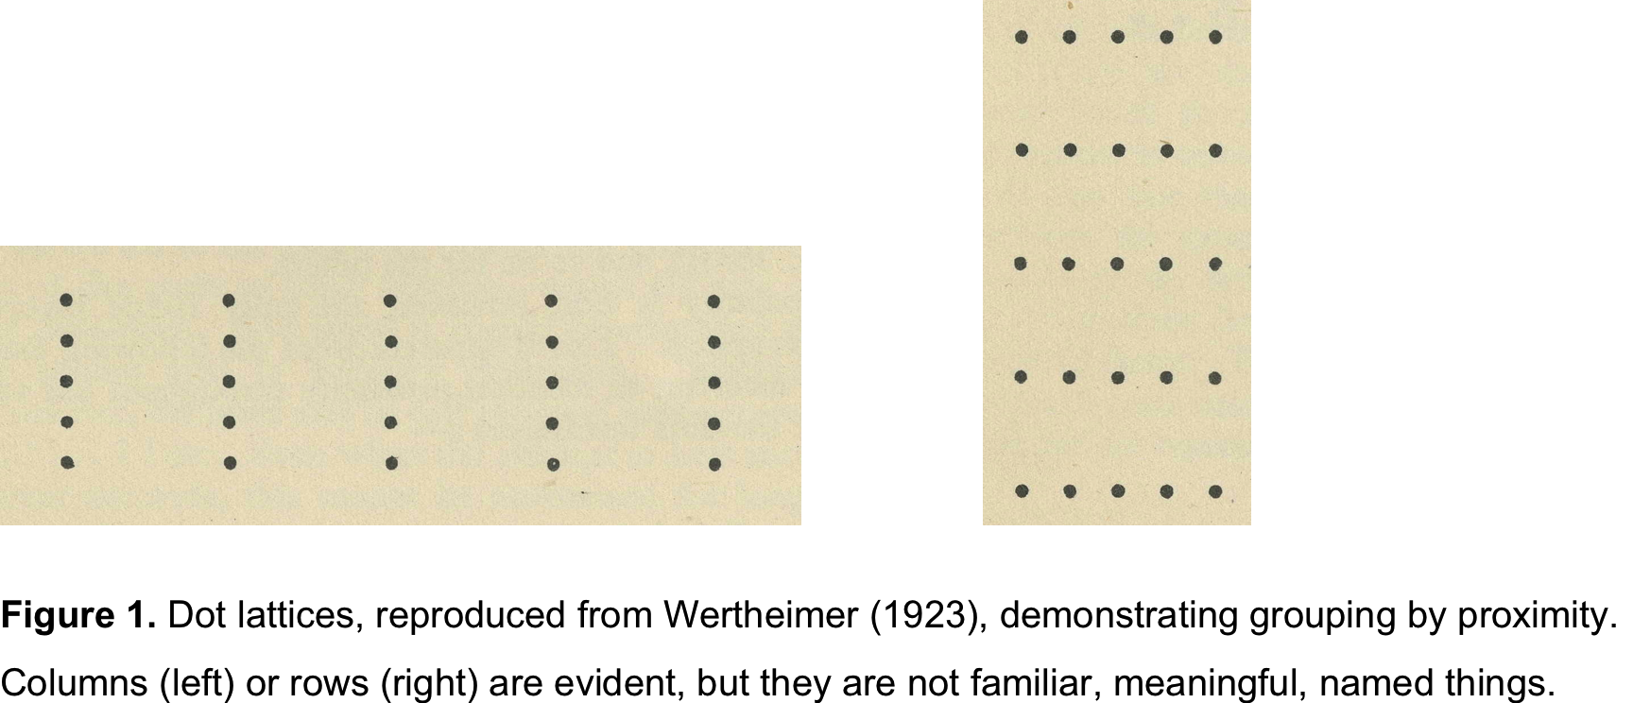
Wertheimer 1923

Slide 14
Grouping by proximity

Slide 15
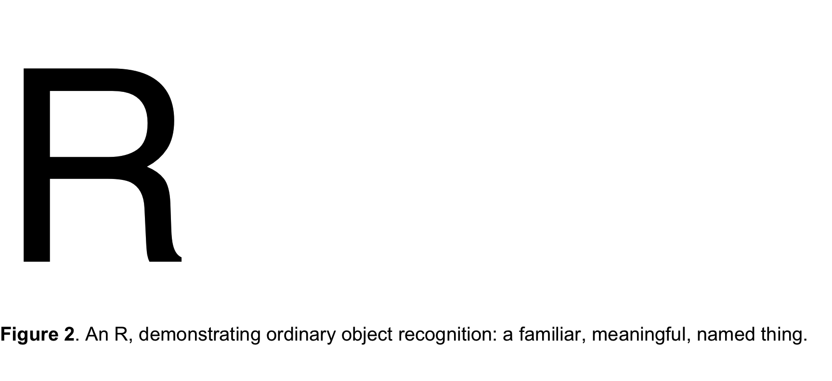

Slide 16
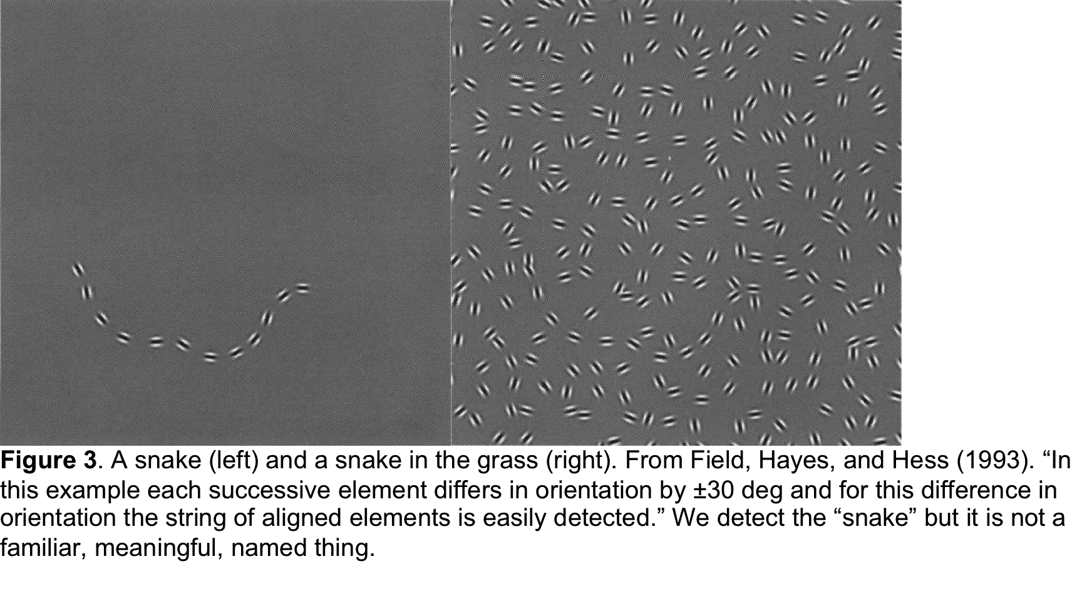
Field, Hayes, Hess 1993

Slide 17

Grouping by good continuation

Slide 18
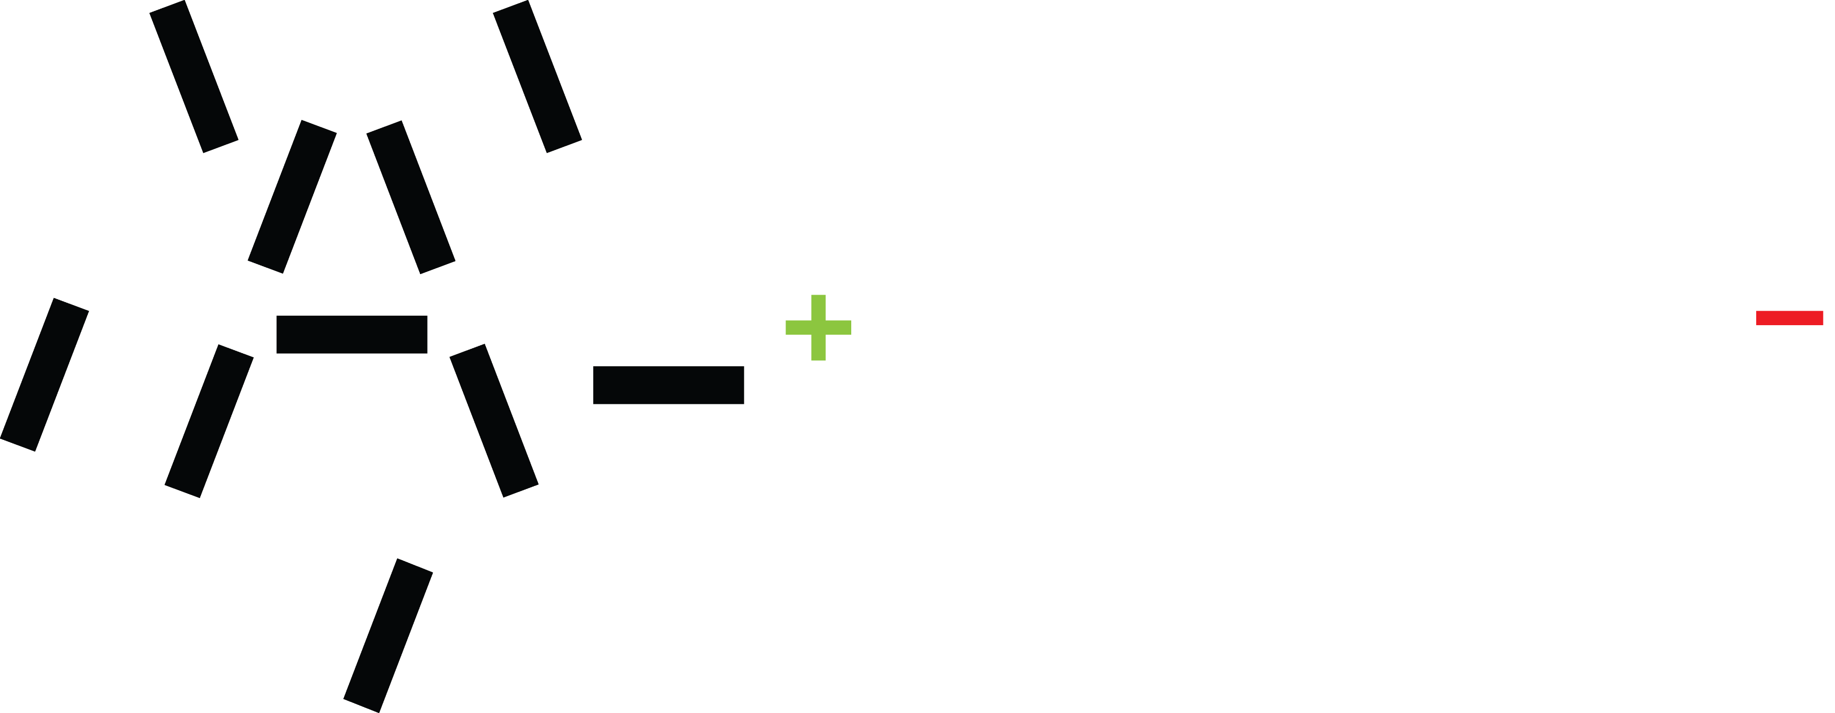
An A in chaff
Pelli & Tillman 2008 Nature Neuroscience
Notes:
The bars represent features. If you look directly at the A or at the green plus, your visual system can isolate the relevant features of the A and identify it. If you fixate too far away, on the red minus, the brain combines features from the A and the chaff and you get a jumble instead of a letter. This is crowding.

Slide 19
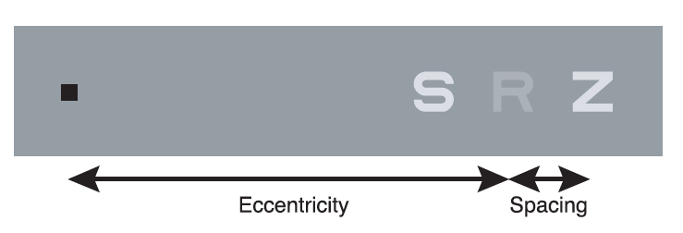
Pelli, Palomares, Majaj 2004 Journal of Vision

Slide 20
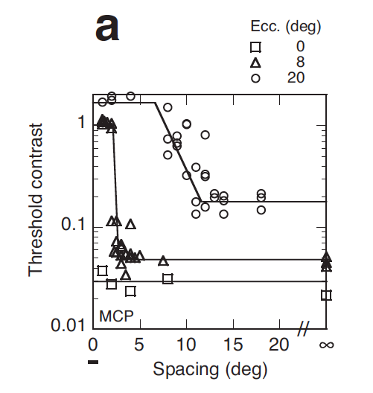
Pelli, Palomares, Majaj 2004 Journal of Vision

Slide 21
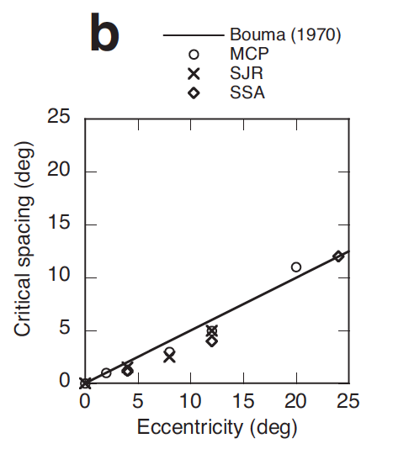
Pelli, Palomares, Majaj 2004 Journal of Vision

Slide 22

Bouma 1970 Nature

Slide 23
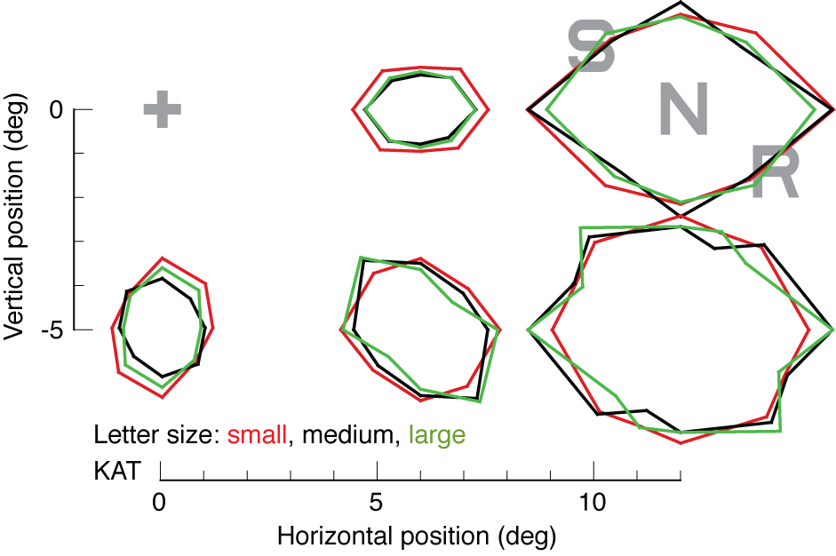
Critical spacing is proportional to eccentricity and independent of size
Pelli, Tillman, Freeman, Su, Berger, Majaj 2007 Journal of Vision
Notes:
A similar task with letter identification. Again the contours map out critical spacing, and critical spacing is increasing with eccentricity. But we also varied the size of the target. The three colored lines are three different letter sizes. As you can see, size doesn’t matter. What matters is eccentricity and spacing. That’s the Bouma law.

Slide 24
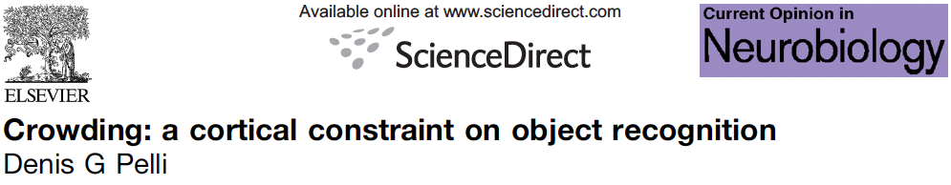
Pelli 2008 Current Opinion in Neurobiology

Slide 25


Pelli 2008 Current Opinion in Neurobiology

Slide 26

Intriligator & Cavanagh 2001 Cognitive Psychology

Slide 27
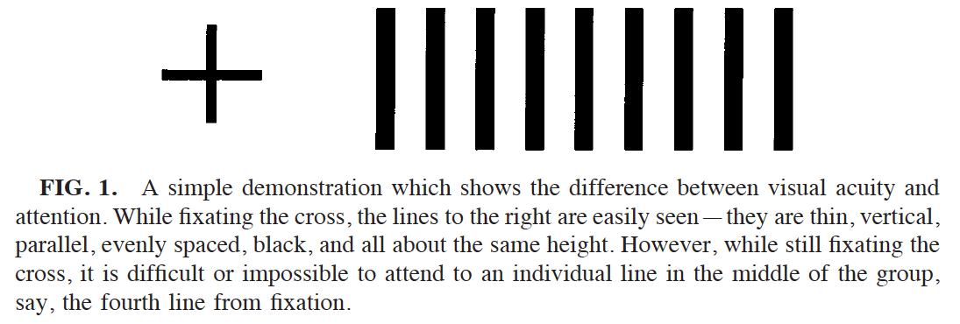
Intriligator & Cavanagh 2001 Cognitive Psychology

Slide 28
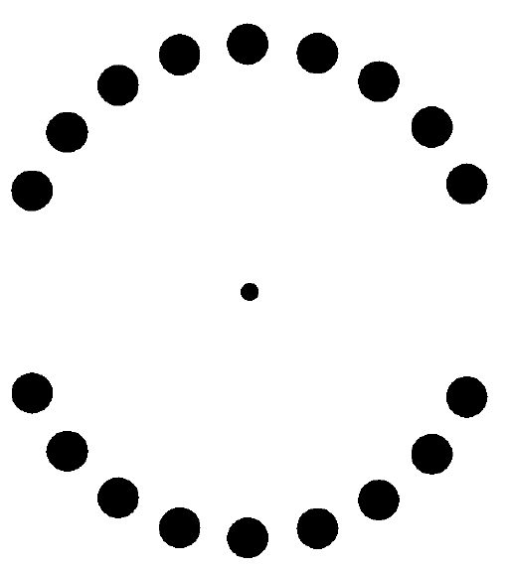
Intriligator & Cavanagh 2001 Cognitive Psychology

Slide 29
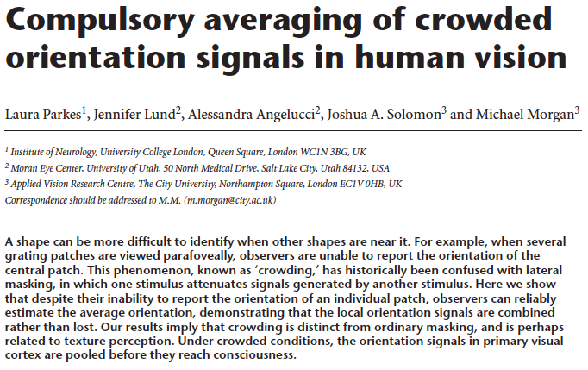
Parkes, Lund, Angelucci, Solomon, Morgan 2001 Nature Neuroscience

Slide 30
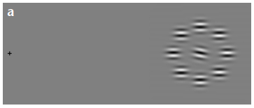
Parkes, Lund, Angelucci, Solomon, Morgan 2001 Nature Neuroscience

Slide 31
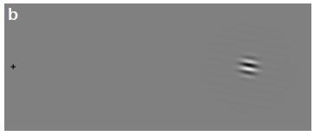
Parkes, Lund, Angelucci, Solomon, Morgan 2001 Nature Neuroscience

Slide 32
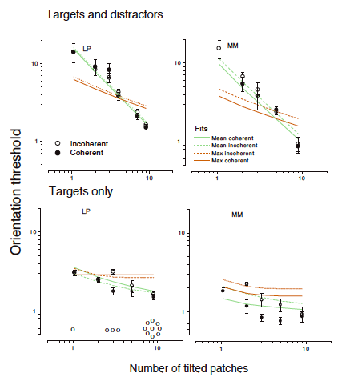
Parkes, Lund, Angelucci, Solomon, Morgan 2001 Nature Neuroscience

Slide 33
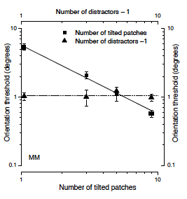
Parkes, Lund, Angelucci, Solomon, Morgan 2001 Nature Neuroscience

Slide 34
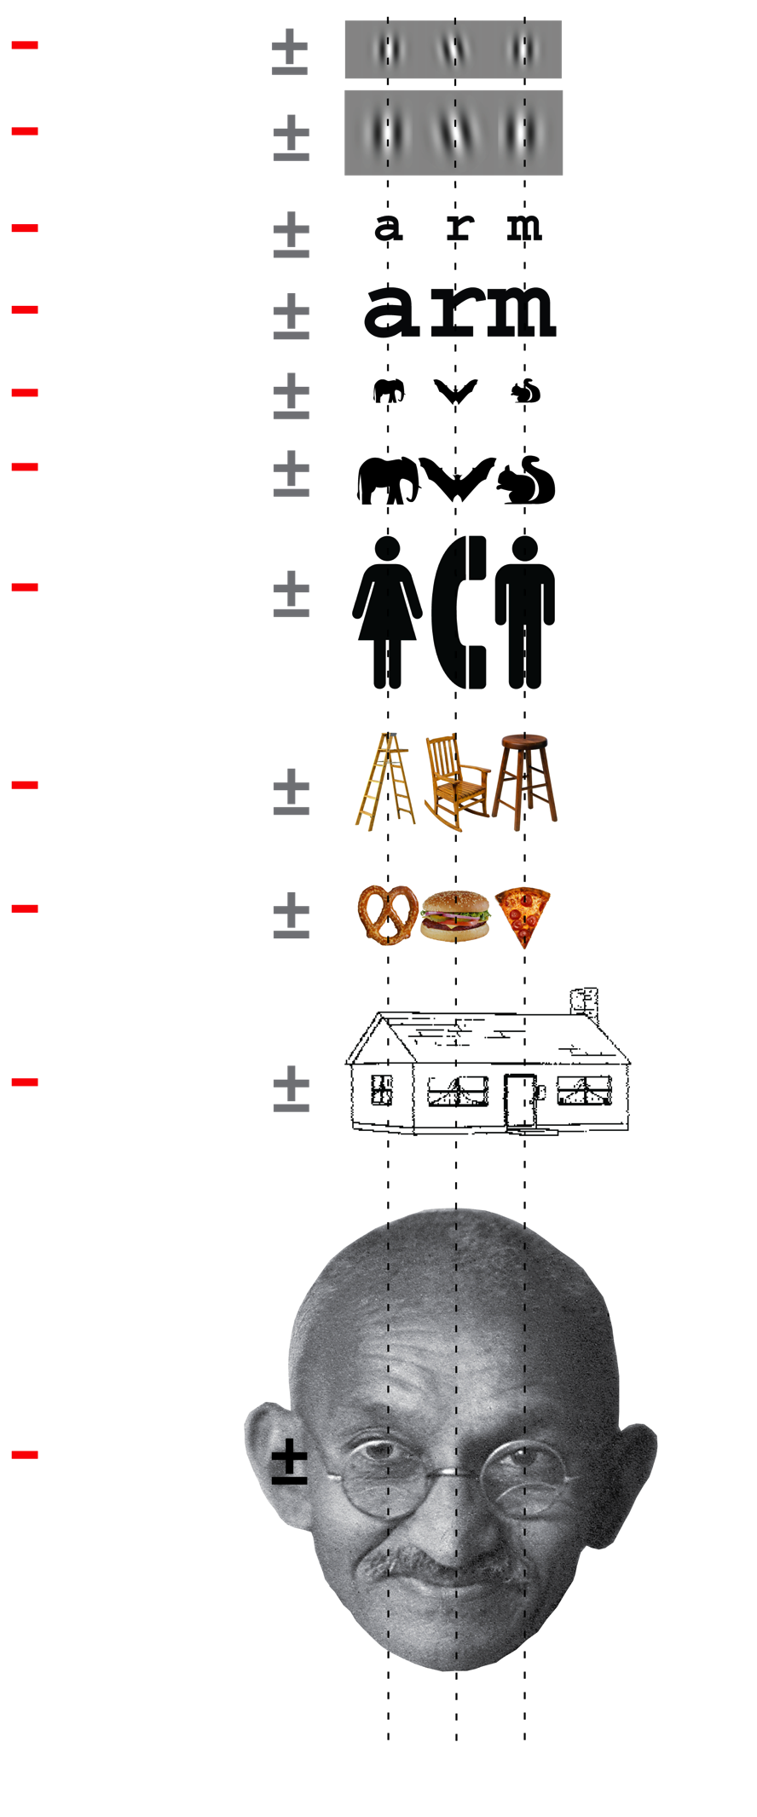
Critical spacing is independent of object and size
Pelli & Tillman 2008 Nature Neuroscience
Notes:
Bouma first noted in 1970 that critical spacing depends on distance from fixation, roughly half the eccentricity. When the object and flankers are similar, this is true regardless of the type of object or its size. This the Bouma law. The plus-minus represents threshold eccentricity for identifying the central object in each row. In the first two lines, the task is to tell the orientation the the middle grating. Cutting the size of the image in half does not change the critical spacing.

Slide 35
Critical spacing is independent of object and size
Pelli & Tillman 2008 Nature Neuroscience
Notes:
For objects that have parts, like this house and Gandhi, the parts have the same critical spacing.

Slide 36
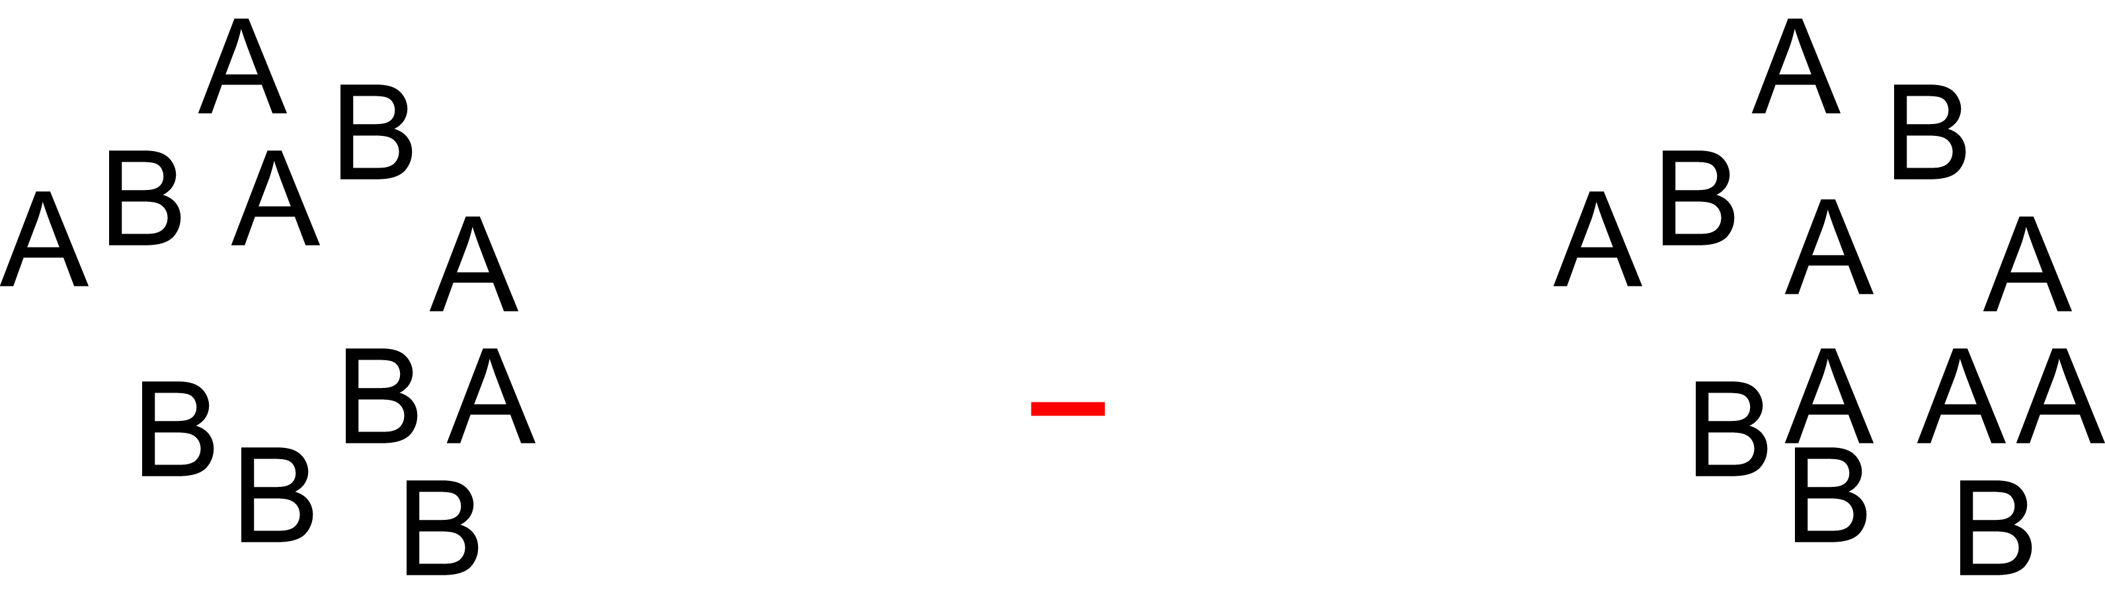
Effects of crowding on letter identity, number, and position
Freeman & Pelli 2007 Journal of Vision
Notes:
If you fixate the minus, you see two two clusters of letters that look identical. But, you fail to notice that the two clusters of letters differ in letter position, number, and identity. However, crowding does NOT impair detection.

Slide 37
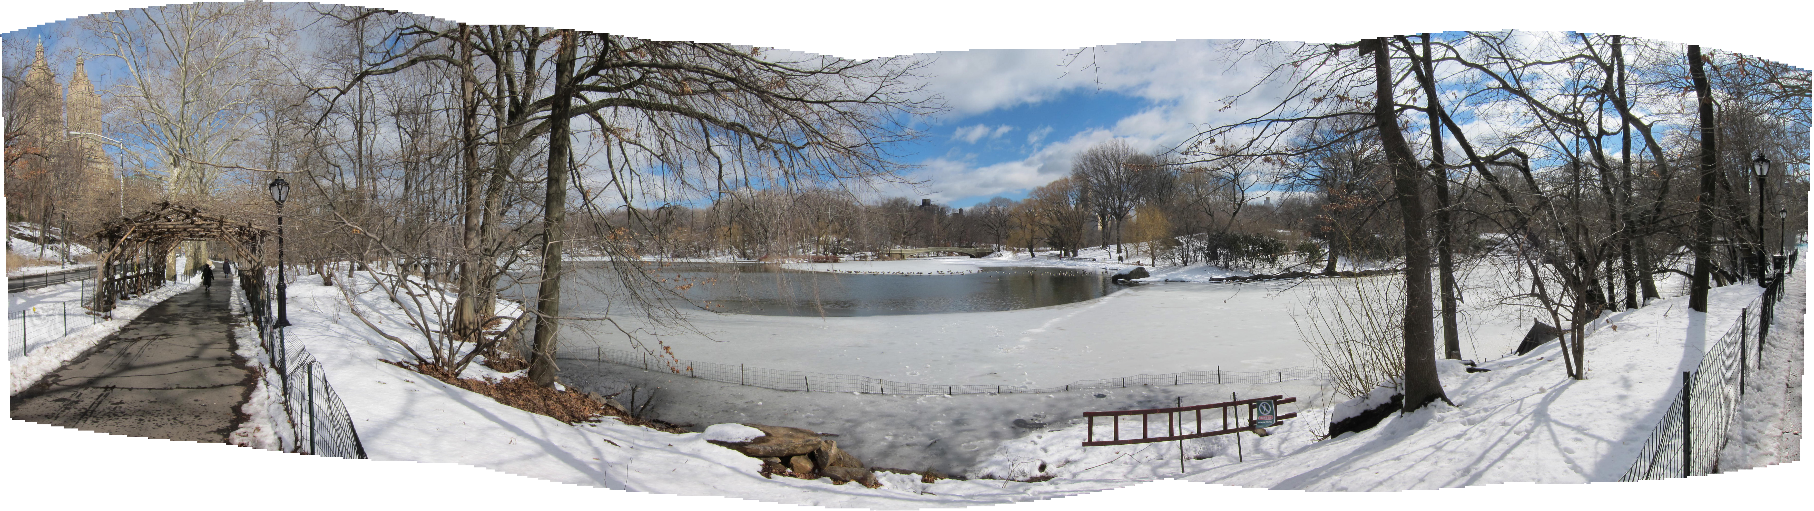

Slide 38

Crowding in a word
Pelli & Tillman 2008 Nature Neuroscience
Notes:
Crowding is often studied with letters, as Bouma did in the 1970’s. We measure the critical spacing – the minimal spacing required to avoid crowding. Here you can easily identify the lone r on the left when you fixate the minus, but you cannot identify the central r on right. This is because the spacing is less than critical. The whole word falls in one critical spacing and the features from all the letters are jumbled. If you move your fixation closer, to the green plus, you can recognize the r among flankers, because the letters are now more than critically spaced.

Slide 39
Faces are like words:
The governor and the King
Pelli & Tillman 2008 Nature Neuroscience
Notes:
The same is true for faces. The parts of the face must be separated by more than the critical spacing for you to recognize who it is. Thus, if you fixate on the red minus, you know there are two men there, but you can’t tell who is the governor (Arnold) and who is the King (Elvis). You must bring your fixation almost to the cheek in order to recognize the face.

Slide 40
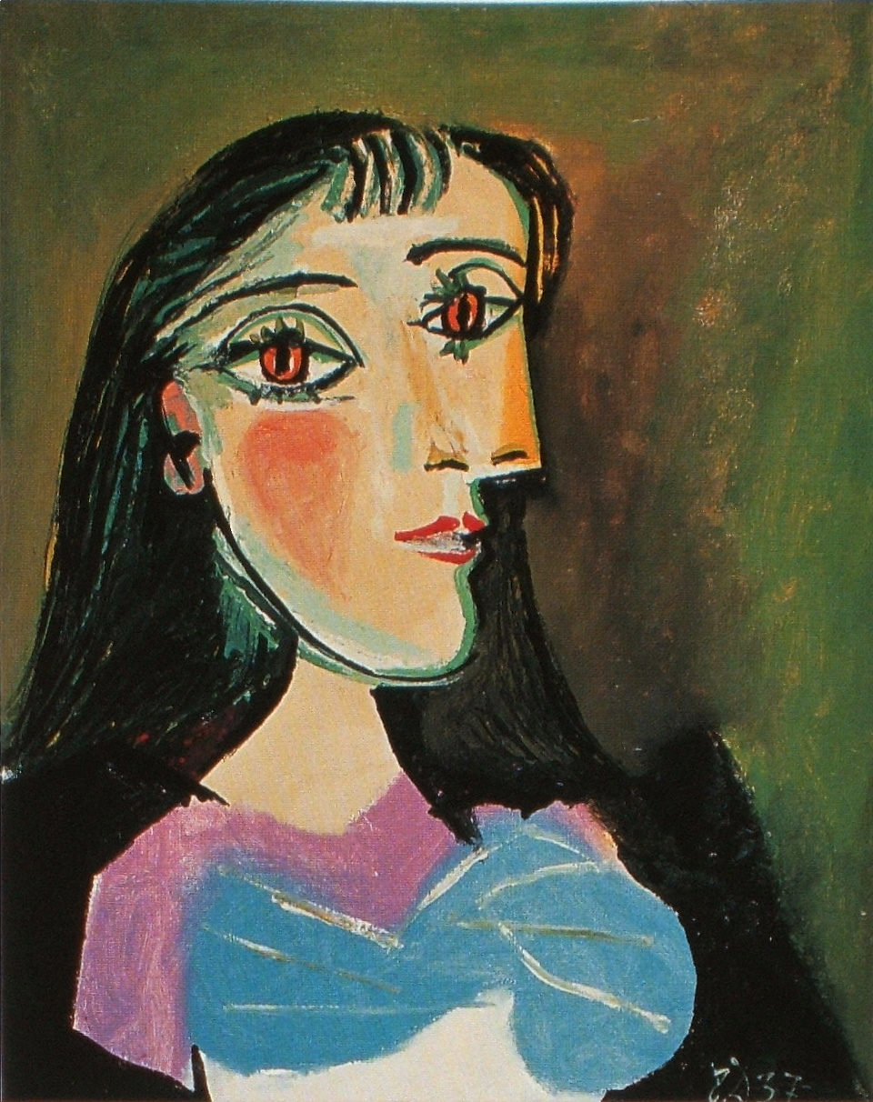
+
Pablo Picasso
Portrait of a woman, 1937

Slide 41
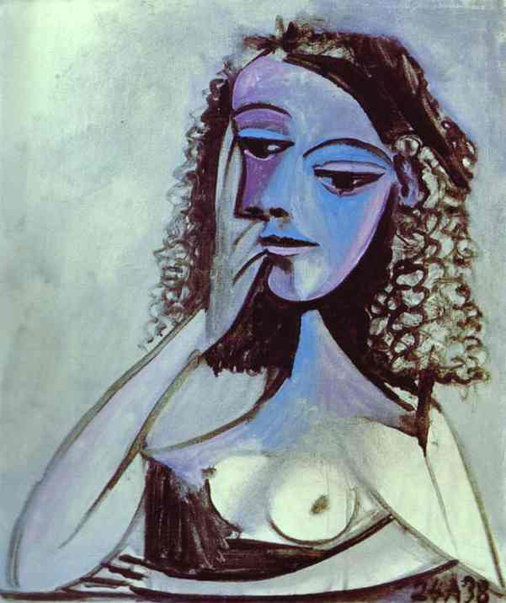
+
Pablo Picasso
Nusch Éluard, 1938

Slide 42
+
Pablo Picasso
Nusch Éluard, 1938
Charcoal and pencil on canvas.

Slide 43
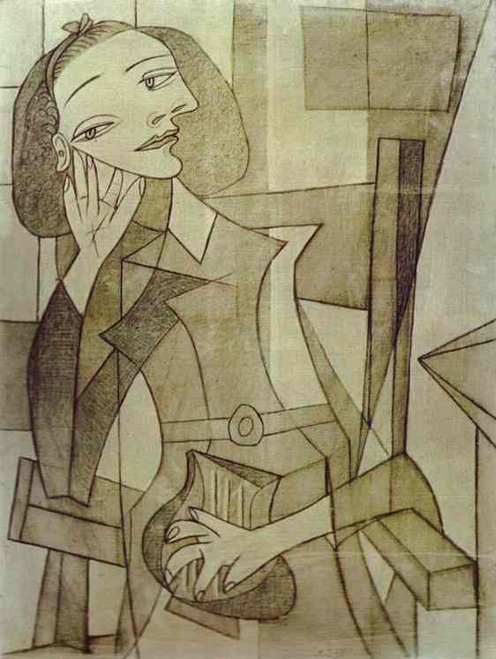
+
Pablo Picasso
Nusch Éluard, 1938
Charcoal and pencil on canvas.

Slide 44
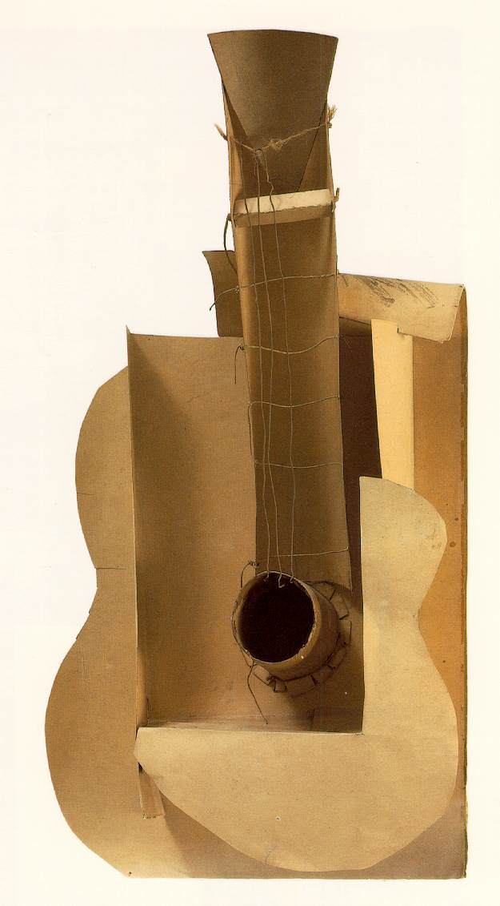
+
Pablo Picasso
Maquette for guitar, 1912

Slide 46
Object recognition 2
Review, Agnosia, Grouping & Crowding, 7 Principles
Denis Pelli
Psychology and Neural Science, NYU
December 10, 2015

Slide 47
Review
Critical comments on existing theories, in visual cognition, for how people recognize objects.
Treisman & Kanwisher 1998 Perceiving visually presented objects: recognition, awareness, and modularity. Current Opinion in Neurobiology.
2. Features

Slide 48
Treisman & Kanwisher 1998 Perceiving visually presented objects: recognition, awareness, and modularity. Current Opinion in Neurobiology.
How do we recognize objects? What are the theories? The central controversies in the field have been dichotomies:
Parts vs. whole
Structural vs. viewpoint-dependent
Conscious vs. unconscious
Perception vs. action
Dorsal vs. ventral
Lots of papers have accumulated evidence bearing on these issues, showing differences along these scales between tasks. In some cases patients reveal dissociations. These dimensions are real; there are data to be explained.
However, while initial positions were at either ends of the dichotomies, everyone has since drifted to moderate views that allow for intermediate positions or combinations of both extremes. As a consequence, no one is wrong. Since no one is wrong, one may well wonder whether the intermediate positions that embrace the whole gamut are testable scientific theories. Can they be refuted?
Except for part/whole in face recognition, these theories haven’t helped much in explaining everyday object recognition.

Slide 49
Treisman & Kanwisher 1998 Perceiving visually presented objects: recognition, awareness, and modularity. Current Opinion in Neurobiology.
Priming, matching, and repetition blindness are all object-specific, yet invariant across views.
Object files (Pylyshyn, multiple object tracking)

Slide 50
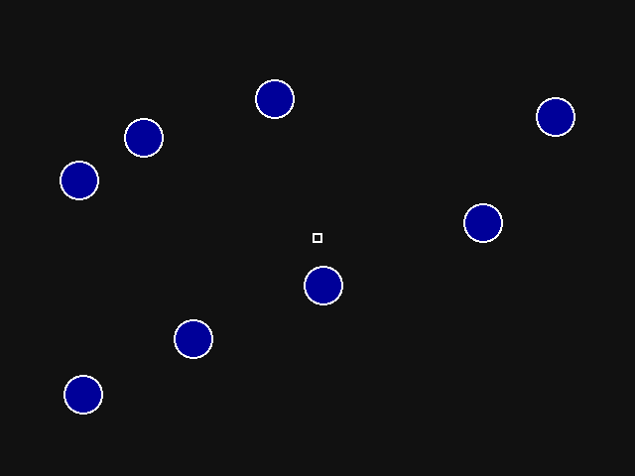
Pylyshyn, multiple object tracking

Slide 51
Treisman & Kanwisher 1998 Perceiving visually presented objects: recognition, awareness, and modularity. Current Opinion in Neurobiology.
“Wolfe (1998) has collected surprising evidence that previously attended object tokens revert to a similar unstructured state once attention is withdrawn, concluding that, ‘Vision exists in the present tense. It remembers nothing.’”

Slide 52
Treisman & Kanwisher 1998 Perceiving visually presented objects: recognition, awareness, and modularity. Current Opinion in Neurobiology.
Modularity

Slide 53
Modularity vs. consciousness
There is much evidence of modularity in the brain, in which some areas seem to know things that other areas don’t. Viewing the brain as a machine, this is an old familiar result from the nineteenth century, and a perfectly reasonable way to build a brain. However, if we are talking about the human brain, then the modularity challenges our intuitions about consciousness.
Ned Block distinguishes between phenomenal consciousness and access consciousness. Phenomenal consciousness consists of subjective experience and feelings. Access consciousness consists of that information being globally available in the cognitive system for the purposes of reasoning, speech and high-level action control. The key word is “globally”. Our intuition is that information should never be inconsistent among different parts of the same brain, or different aspects of our behavior.

Slide 54
Apperceptive agnosia & crowding
Strappini, Pelli, Di Pace, Martelli, under review at Cortex

Slide 55
What they say. First and third drawings: HJA in Humphreys and Riddoch, 1987; second drawing: SM in Behrman and Kimchi, 2003.
Strappini, Pelli, Di Pace, Martelli, under review at Cortex

Slide 56
What they draw.
A. apperceptive agnosic patient (from Lêe et al., 2002) B. normal observer PMS.
Strappini, Pelli, Di Pace, Martelli, under review at Cortex

Slide 57
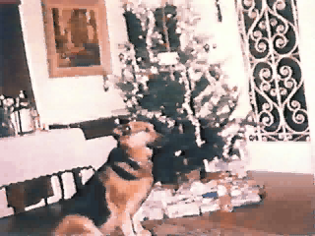
Apperceptive agnosia

Slide 58
Case | Sex | Age | Lesion |  | Etiology
Behrmann & Kimchi (2003) S.M. | M | 22 | right anterior and posterior temporal regions, corpo callosum and left ganglia |  | head injury
Behrmann & Williams (2007) C.R. | M | 16 | right temporal lobe lesion and microabcesses of the right temporal and medial occipital lobe |  | right temporal brain abscess
Behrmann et al. (1994) C.K. | M | 33 | unknown |  | motor vehicle accident
Boucart et al (2010) W.S. | F | 57 | bilateral atrophy of the parieto-occipital lobes |  | posterior cortical atrophy
Buxbaum et al. (1999) W.B. | M | 47 | unknown |  | large bilateral posterior intraparenchymal hemorrhage
Crutch & Warrington (2007) p1 | F | 74 | unknown |  | posterior cortical atrophy
Crutch & Warrington (2007) p2 | F | 58 | unknown |  | posterior cortical atrophy
Delvenne et al. (2004) N.S. | M | 40 | bilateral occipito-temporal junction and left parietal and frontal sites |  | car accident
Foulsham et al. (2009) C.H. | F | 63 | unknown |  | posterior cortical atrophy
Funnell & Wilding (2011) S.R. | F | 9 | bilateral attenuation in the temporal regions primarily right |  | encephalitis
Gilaie-Dotan et al. (2009) L.G. | M | 19 | unknown |  | developmental object agnosia and prosopoagnosia
Giovagnoli et al. (2009) R.M. | F | 64 | unknown |  | slowly progressive visual agnosia
Hiraoka et al. (2009) | F | 74 | right occipital, right half of the splenium of the corpus callosum extending forward to the pulvinar |  | posterior cerebral artery stroke
Joubert et al. (2003) F.G. | M | 71 | unknown |  | slowly progressive visual agnosia
Kiper et al. (2002) F.J. | M | 18 | bilateral symmetric occipital hypodensities |  | hemophilus influenzae
Kiper et al. (2002) M.S. | F | 7 | right occipital and no left occipital cortex |  | bacterial meningitis
Leek et al. (2012) I.E.S. | M | 78 | bilateral ventral-occipital, left lingual gyrus the fusifrom gyrus bilaterally |  | posterior cerebral artery stroke
Mendez et al. (2007) fourteen PCA patients | M&F | 53-72 | unknown |  | posterior cortical atrophy
Riddoch & Humphreys (1987) H.J.A. | M | 61 | bilateral inferior temporal gyrus, lateral occipitotemporal gyrus, the fusiform gyrus and the lingual gyrus |  | posterior cerebral artery stroke perioperatively
The eighteen individual patients and the group of fourteen Posterior Cortical Atrophy (PCA) patients taken from the literature for this study.
Strappini, Pelli, Di Pace, Martelli, under review at Cortex

Slide 59
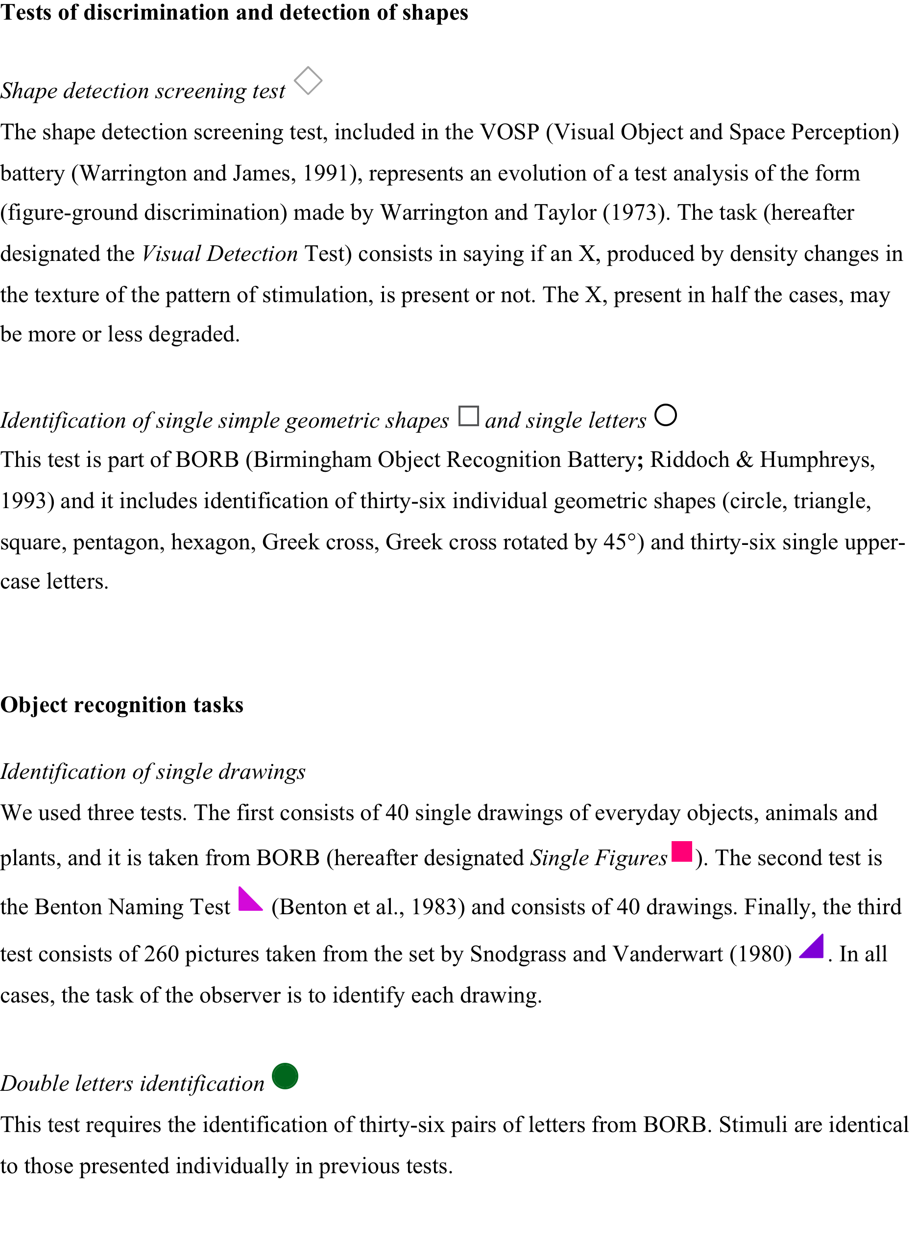
Strappini, Pelli, Di Pace, Martelli, under review at Cortex

Slide 60
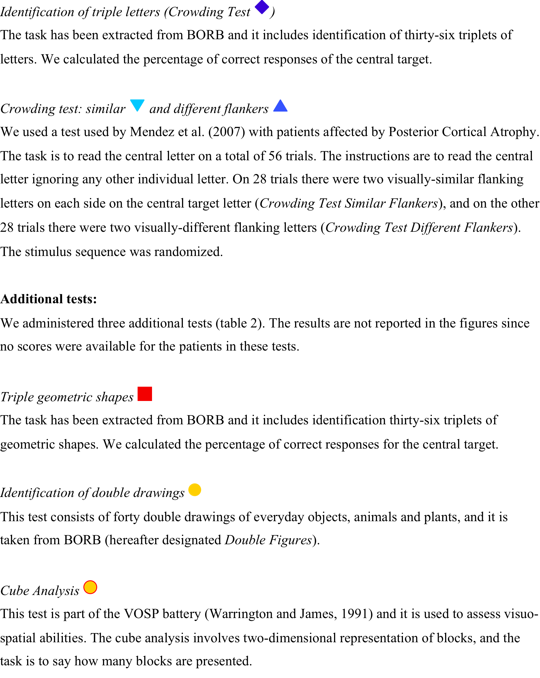
Strappini, Pelli, Di Pace, Martelli, under review at Cortex

Slide 61
Raw performance of the eccentrically-viewing normal observer (left) and the patients (right).
Strappini, Pelli, Di Pace, Martelli, under review at Cortex

Slide 62
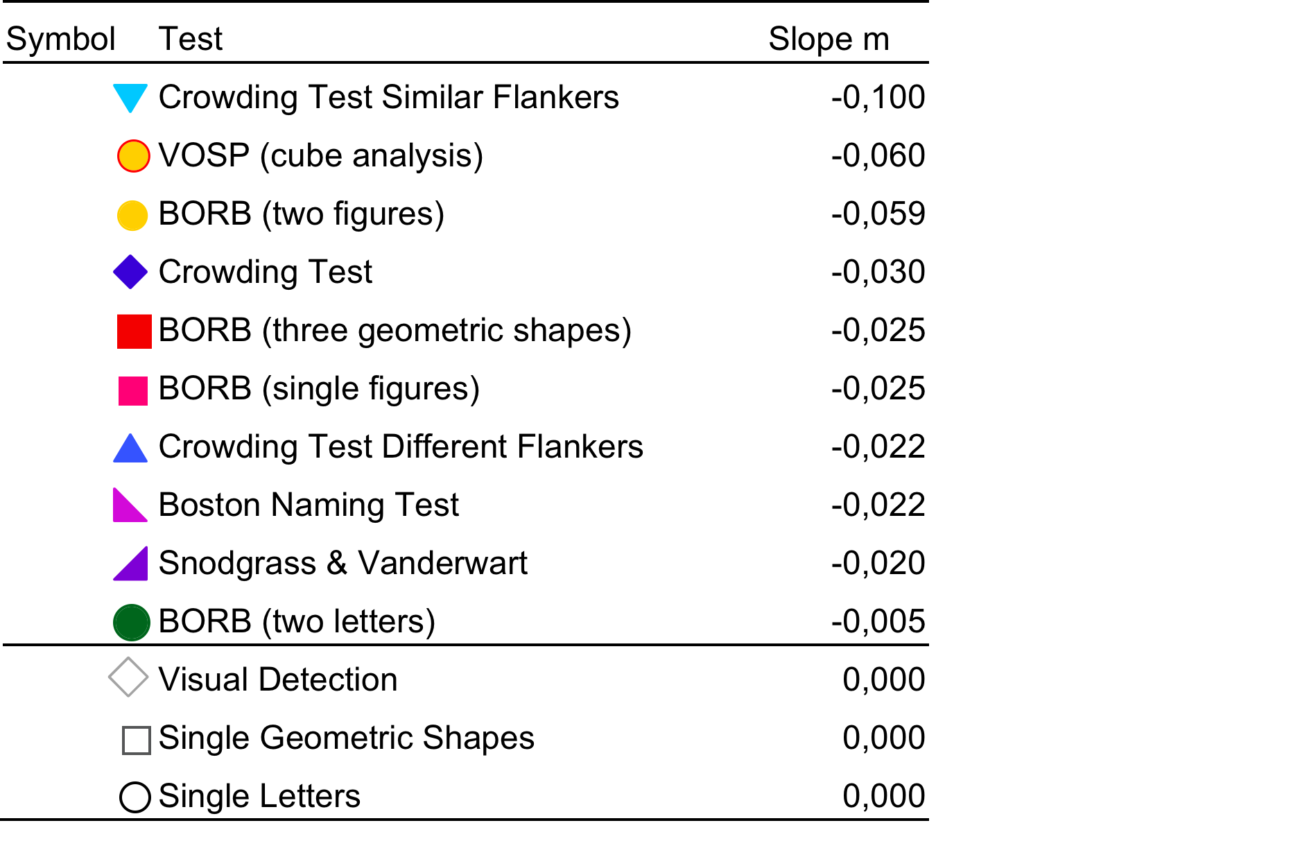
Strappini, Pelli, Di Pace, Martelli, under review at Cortex

Slide 63
Strappini, Pelli, Di Pace, Martelli, under review at Cortex

Slide 64
* Thus, apperceptive agnosia is like peripheral crowding.
Strappini, Pelli, Di Pace, Martelli, under review at Cortex

Slide 65
Grouping & crowding
Rosen & Pelli, in prep.

Slide 66
Rosen & Pelli, in prep.

Slide 67
Rosen & Pelli, in prep.

Slide 68
Rosen & Pelli, in prep.

Slide 69
Rosen & Pelli, in prep.

Slide 70
* Thus, the same conditions that promote grouping also promote crowding. Perhaps crowding is the smallest available grouping.
Rosen & Pelli, in prep.

Slide 71
7 PRINCIPLES OF OBJECT RECOGNITION
1-4. Known
5. Proposed
6-7. Deduced
Rosen & Pelli, in prep.

Slide 72
KNOWN PRINCIPLES:
1. CROWDING. Crowding is a bottleneck in object recognition.
2. EXTENT OF CROWDING. Ecc. dep.
3. GROUPING. Grouping is the combining of elements to recognize a composite object.
4. EXTENT OF GROUPING. Independent of eccentricity.
Rosen & Pelli, in prep.

Slide 73
PROPOSED PRINCIPLE:
5. CROWDING IS GROUPING. Crowding corresponds to the smallest available grouping at that retinal location. By “corresponds” we mean that crowding and grouping are both mediated by the same process of combining features for recognition over the same extent (the combining field). This is called “grouping” when recognition succeeds and “crowding” when recognition fails due to having too much in the combining field.
Rosen & Pelli, in prep.

Slide 74
DEDUCED PRINCIPLE:
6. BIG GROUPING CORRESPONDS TO PERIPHERAL CROWDING. Grouping (anywhere) of any given extent corresponds to crowding at some eccentricity. In other words, recognition (by grouping) is unaffected by placing the object out at the eccentricity at which the extent of crowding matches the original extent of grouping (e.g. the object size). PROOF. By Principle 2, any given crowding extent occurs at some eccentricity. By 5, the minimum grouping extent at that eccentricity equals that crowding extent. Thus any given grouping extent corresponds to the crowding extent at some eccentricity.
Rosen & Pelli, in prep.

Slide 75
DEDUCED PRINCIPLE:
7. UBIQUITOUS BOTTLENECK. The bottleneck is ubiquitous and applies to all grouping at every extent at any location. PROOF: By Principle 6, recognition at any given retinal location is equally good as recognition at the eccentricity at which the grouping extent equals the crowding extent. Since, there is a bottleneck at the eccentric site (Principle 1), and performance is equal (Principle 6), there must be an identical bottleneck at the original site as well.
Rosen & Pelli, in prep.

Slide 76
Object recognition 3
Features
Denis Pelli
Psychology and Neural Science, NYU
December 10, 2013

Slide 77
Features
Same features for letter identification as for grating detection.
Features do not scale with letter size.
Features are detected independently.
Feature are learned slowly, but feature combinations are learned quickly.
Cues are efficiently combined only when they each independently code the same object.

Slide 78
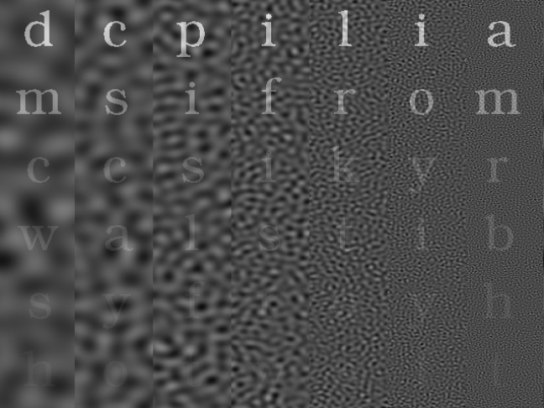
Solomon & Pelli (1994) Nature
Notes:
1. The first step is feature detection. This demo (originally on the cover of Nature) reveals the spatial frequency tuning of the feature detectors used to identify letters. The vertical scale is contrast. The horizontal scale is spatial frequency. The faintest letter that you can see in each column tells us how sensitive the lettter-identification channel in your eye is to noise at that spatial frequency. This function peaks at a middle frequency, about 3 c/letter at this size.

Slide 79
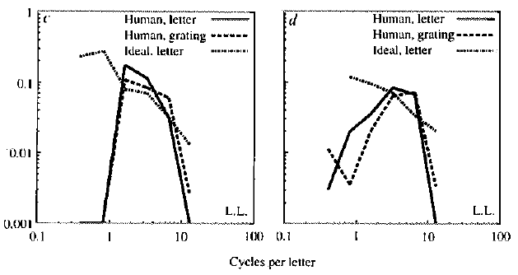
Gain
Solomon & Pelli (1994) Nature

Slide 80
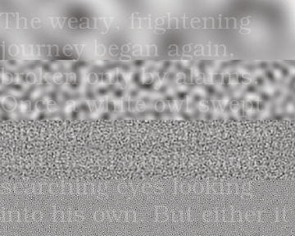
c/letter
0.15
0.6
2.4
9.7
Majaj, Liang, Martelli, Berger & Pelli (2003) Vision Sciences Society

Slide 81

Majaj, Pelli, Kurshan, & Palomares (2002) Vision Research

Slide 82
Majaj, Pelli, Kurshan, & Palomares (2002) Vision Research

Slide 83
Majaj, Pelli, Kurshan, & Palomares (2002) Vision Research

Slide 84
Majaj, Pelli, Kurshan, & Palomares (2002) Vision Research

Slide 85
Majaj, Pelli, Kurshan, & Palomares (2002) Vision Research

Slide 86
Majaj, Pelli, Kurshan, & Palomares (2002) Vision Research

Slide 87
Majaj, Pelli, Kurshan, & Palomares (2002) Vision Research

Slide 88
Majaj, Pelli, Kurshan, & Palomares (2002) Vision Research

Slide 89


Slide 90
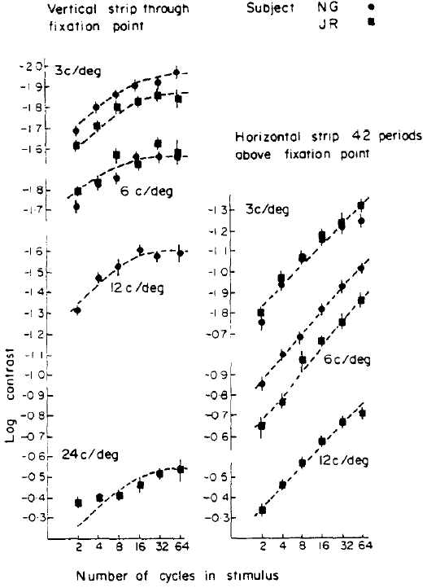
Robson & Graham (1981) Vision Research

Slide 91
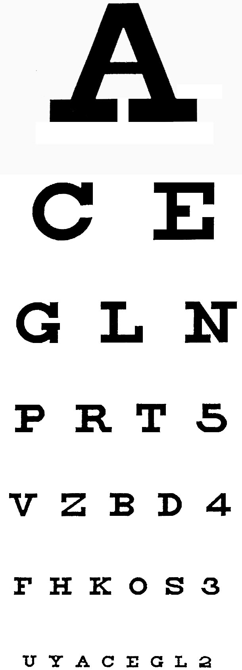

Slide 93
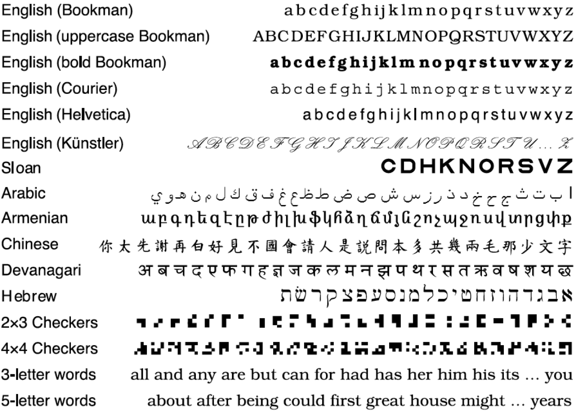

Slide 94


Slide 95
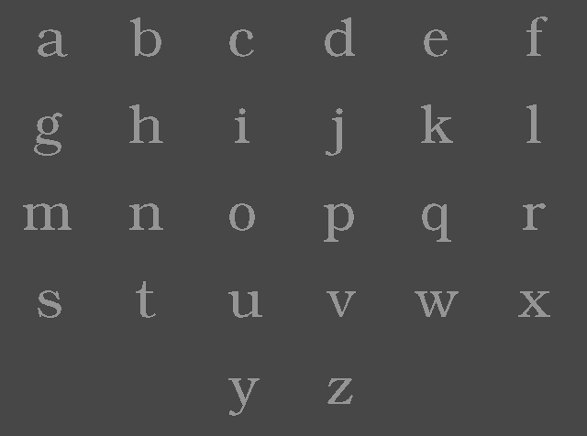

Slide 96
Efficiency
Complexity
Pelli, Burns, Farell, & Moore (2005) Vision Research

Slide 97
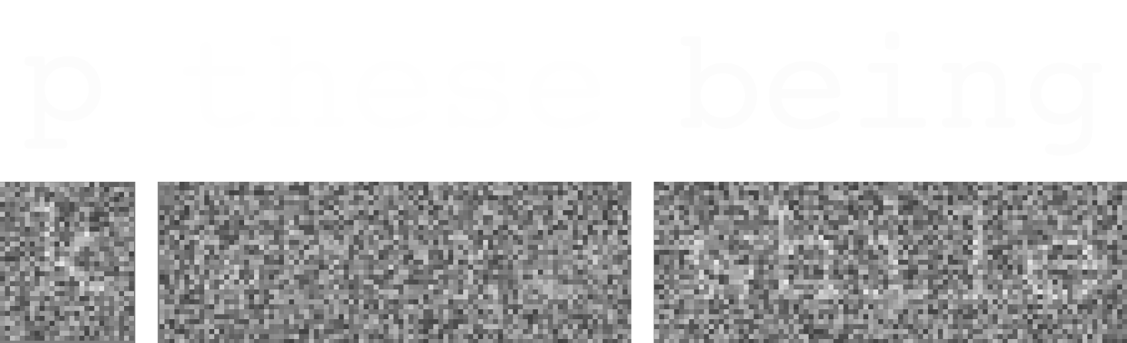
Pelli, Farell, & Moore (2003) Nature

Slide 98
Pelli, Farell, & Moore (2003) Nature

Slide 99
Pelli, Farell, & Moore (2003) Nature

Slide 100
Pelli, Farell, & Moore (2003) Nature

Slide 101
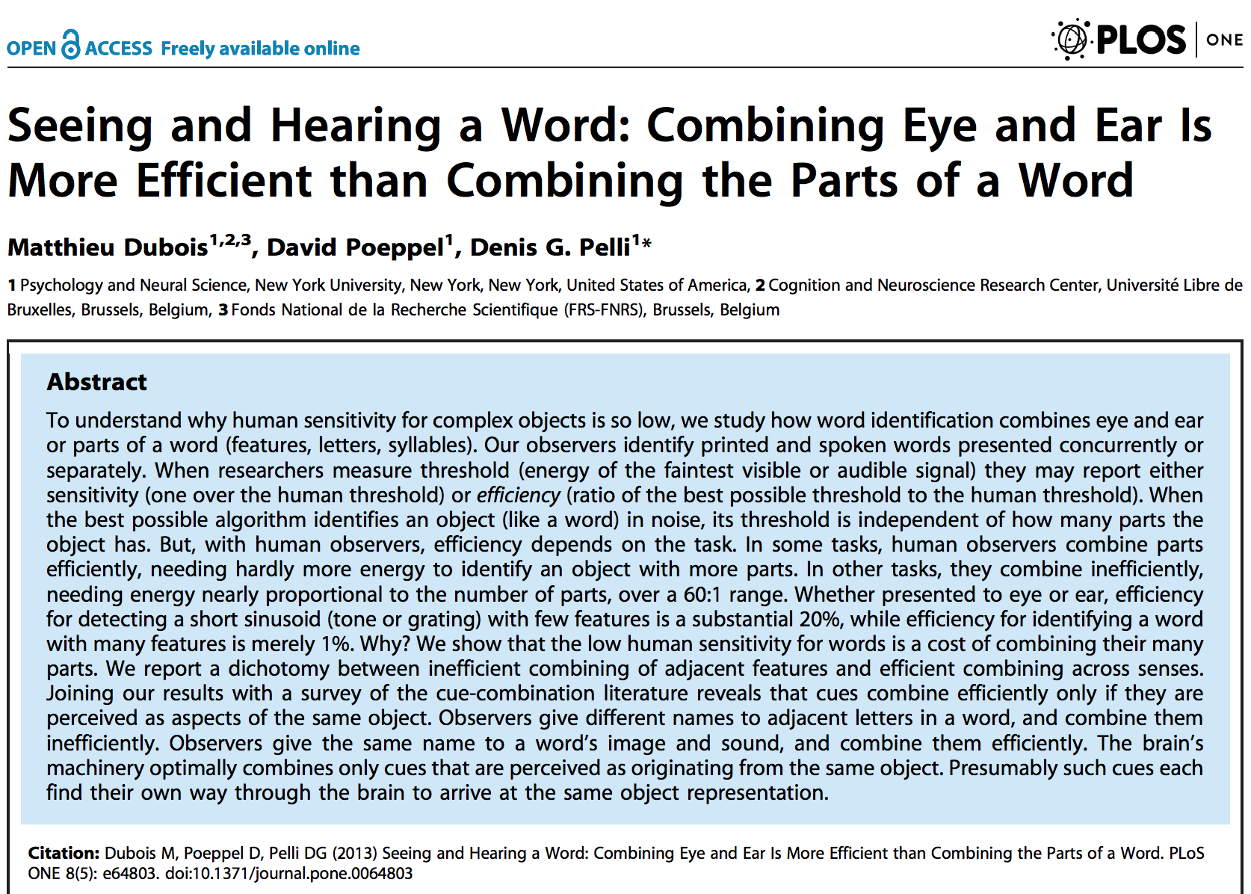

Slide 102
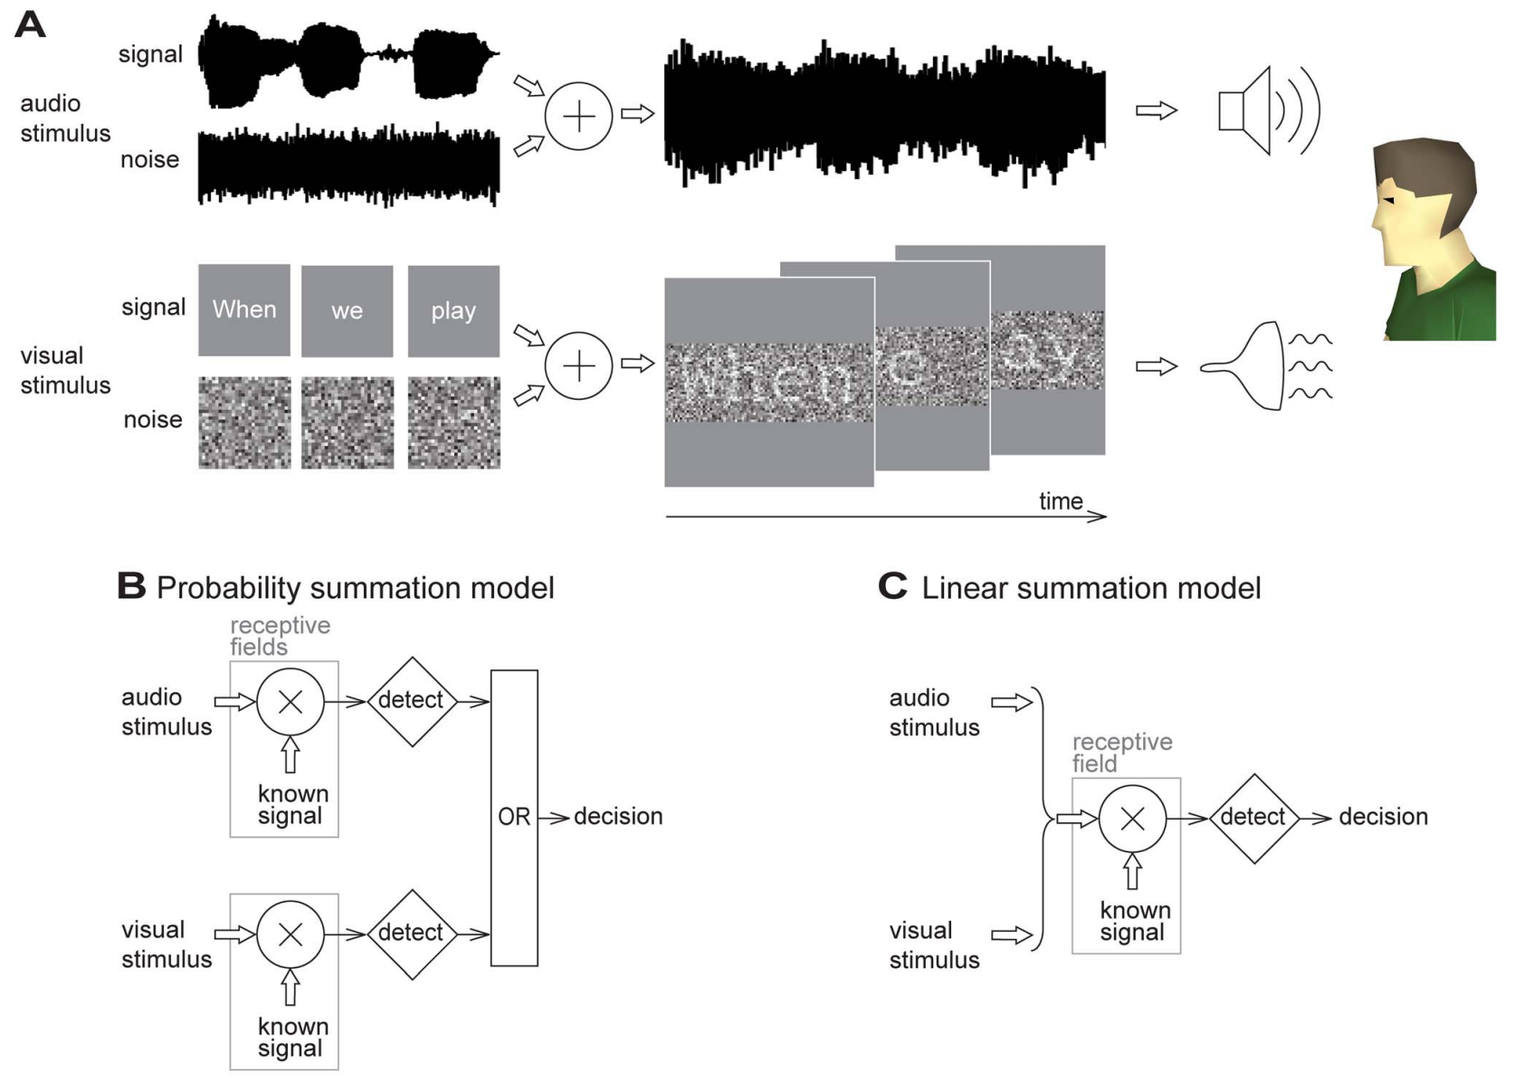

Slide 103
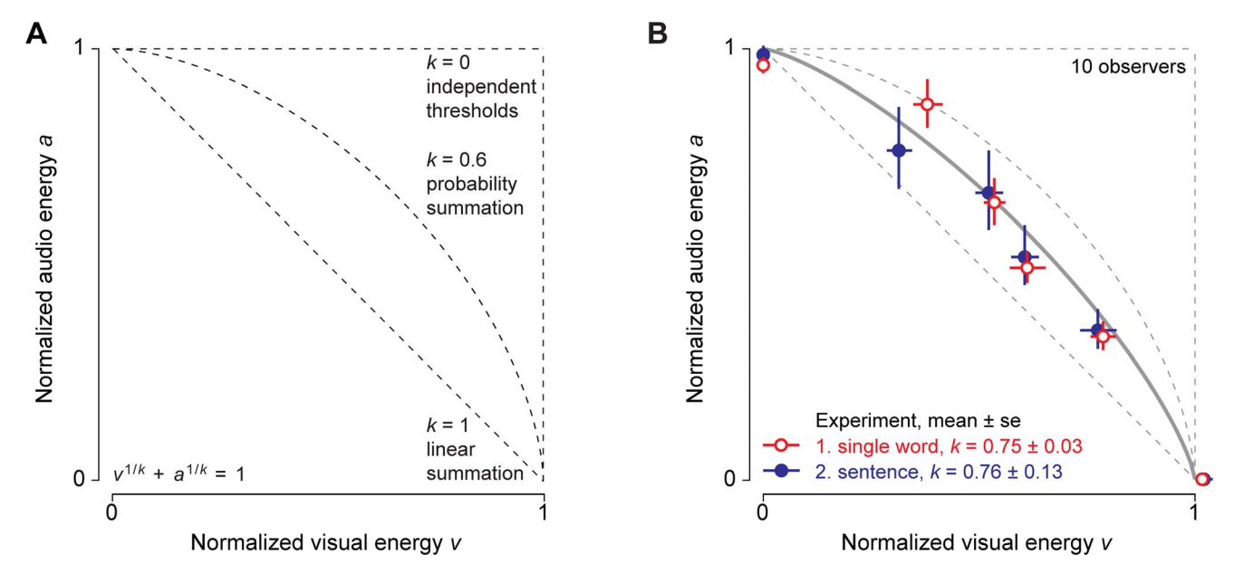

Slide 104
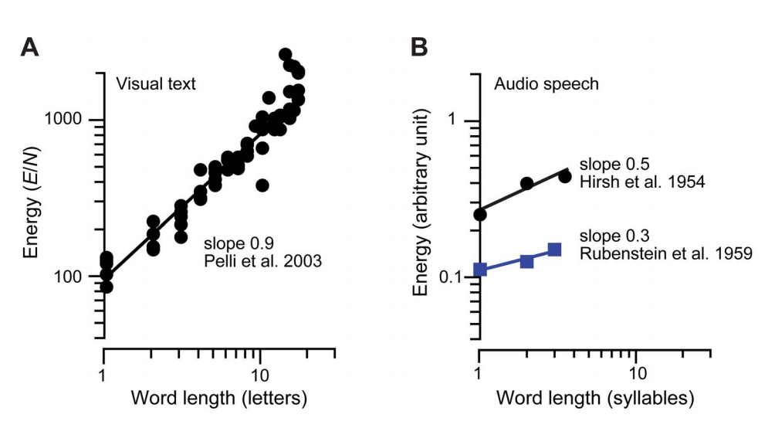

Slide 105


Slide 106


Slide 107


Conclusion (Dubois et al.)

Slide 108
Dubois, Poeppel, Pelli 2013

Slide 109


Slide 110
Features
Same features for letter identification as for grating detection.
Features do not scale with letter size.
Features are detected independently.
Feature are learned slowly, but feature combinations are learned quickly.
Cues are efficiently combined only when they each independently code the same object.

Slide 111
Learning to detect and combine the features of an object
Jordan W. Suchow
Harvard University
Denis G. Pelli
NYU
Suchow, J. W., & Pelli, D. G. (2013). Learning to detect and combine the features of an object. Proceedings of the National Academy of Sciences, 110(2), 785-790. doi:10.1073/pnas.1218438110.

Slide 112
To recognize an object, we first detect and then combine its features. Familiar objects are recognized effortlessly, but unfamiliar objects—like the faces of new acquaintances or the letters of a foreign alphabet—are hard to distinguish and must be learned through practice. Here, we dissociate two distinct failures of human object recognition in a letter-learning task: failing to detect the features and failing to combine them. Detection and combination are usually inseparable, because the human observer performs both unaided. We dissociate the steps by two independent manipulations: For each step, we do or do not provide a bionic crutch that performs the step optimally. Both steps may be performed solely by the human, solely by the crutches, or cooperatively, as the human does one step while a crutch does the other. Dissociating the two steps reveals important differences. Measuring threshold contrast (the faintness of a barely identifiable letter) as it improves with practice, we find that combining is six times more efficient than detecting, and that the rate of learning to combine is four times that of learning to detect. This difference explains much of the diversity of rates reported in perceptual learning studies, including effects of complexity and familiarity.
Suchow & Pelli 2013 PNAS

Slide 113
Suchow & Pelli 2013 PNAS
Notes:
Fig. 1. Gabor letters. The letters of the IndyEighteen alphabet are composed of gabors. Each gabor is oriented ±45 deg from vertical, and placed at 1 of 9 locations on a 3×3 grid. When a right-tilted and a left-tiilted gabor overlap, they form a plaid. We suppose that the gabors are detected independently, so that each gabor is a feature. With 2 orientations and 9 locations, there are 18 possible gabors, i.e. features. Each of the 8 IndyEighteen letters pictured here is a randomly-selected subset of the 18 possible features. Note that some features are common to many letters (e.g., 6 of these 8 letters contain a right-tilted gabor at the top right corner), while some features are common to just a few (e.g., 2 of these 8 letters contain a right-tilted gabor at the bottom left position).

Slide 114
Suchow & Pelli 2013 PNAS
Notes:
Fig. 4. Stimuli. When detecting and combining unaided, the human is presented with a gabor letter (upper left) faintly in noise (upper right). As the detector in a bionic collaboration, the participant is presented with a single feature faintly in noise (lower left), and as the combiner, with an imperfect set of features detected at high contrast (lower right). Getting closer or enlarging this figure makes it easier to see the noise.

Slide 115
Suchow & Pelli 2013 PNAS
Notes:
Fig. 2. Learning. The participant (DF on the left and CH on the right) detects and combines features to identify a letter from an alphabet of 8 IndyEighteen letters. Each composite observer was trained at threshold contrast, receiving just enough contrast to achieve criterion performance (75% correct). Using the contrast scale, on the left side, each of the lower four solid lines shows the composite observer’s threshold contrast c, and the top line is the ideal's threshold c_{I} = 0.01. The dashed line is the predicted threshold for the human observer on the assumption of additivity (Eq. 3). The right-hand vertical scale is efficiency (Eq. 1). In both vertical scales, learning goes up: efficiency increases upward and threshold contrast increases downward. Because efficiency is inversely proportional to theshold contrast squared, the log-log slope of efficiency is -2 times that of threshold contrast. These two graphs present thresholds and slopes for two of the participants, DF and CH. Similar results were collected from four other participants and can be found in Experimental Procedures.

Slide 116

Notes:
Table 1. Slope
Slope of identification learning in various experiments. Plotting threshold contrast as a function of the number of completed trials, we fit parameter b, the log-log slope. The dashed line separates the familiar from the unfamiliar. “Complexity” is our rating of complexity. For binary two-level images, we report the perimetric complexity (6); for greyscale images, we assume that each gabor has a complexity of 4, and that the complexity of n gabors is 4n.

Slide 117

Suchow & Pelli 2013 PNAS
Notes:
Table 1. Slope
Slope of identification learning in various experiments. Plotting threshold contrast as a function of the number of completed trials, we fit parameter b, the log-log slope. The dashed line separates the familiar from the unfamiliar. “Complexity” is our rating of complexity. For binary two-level images, we report the perimetric complexity (6); for greyscale images, we assume that each gabor has a complexity of 4, and that the complexity of n gabors is 4n.

Slide 118

Suchow & Pelli 2013 PNAS

Slide 119
Our result—the shallow slope of learning to detect and the steep slope of learning to combine—can explain the effects of stimulus complexity and familiarity on the rate of learning, where complex objects (requiring discrimination along many perceptual dimensions) are learned faster than gabors (12,37), and unfamiliar objects are learned faster than familiar objects (12).
It seems that complex objects are learned more quickly than gabors because complex objects require combination. Comparing across studies in the literature (Table 1), we find that learning to identify stimuli that require combination, such as unfamiliar faces (slope b = ‑0.40), band-pass filtered noise textures (‑0.26), 4´4 random-checkerboard patterns (‑0.16), and compound gratings (‑0.21) is much quicker than learning to detect a gabor (‑0.03, ‑0.05), which does not require combining.
Suchow & Pelli 2013 PNAS

