Slide 1
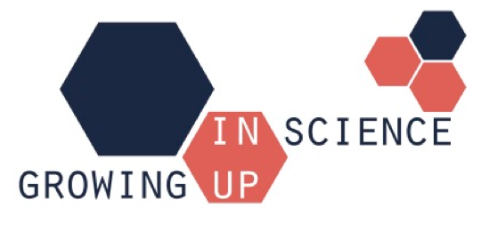
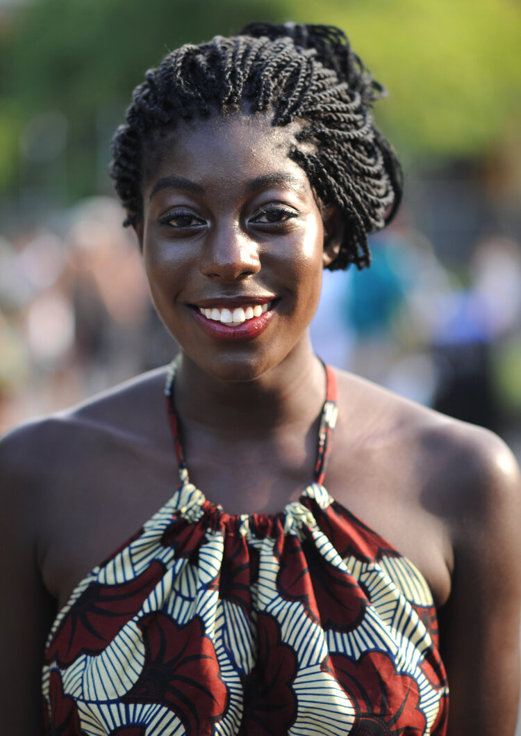
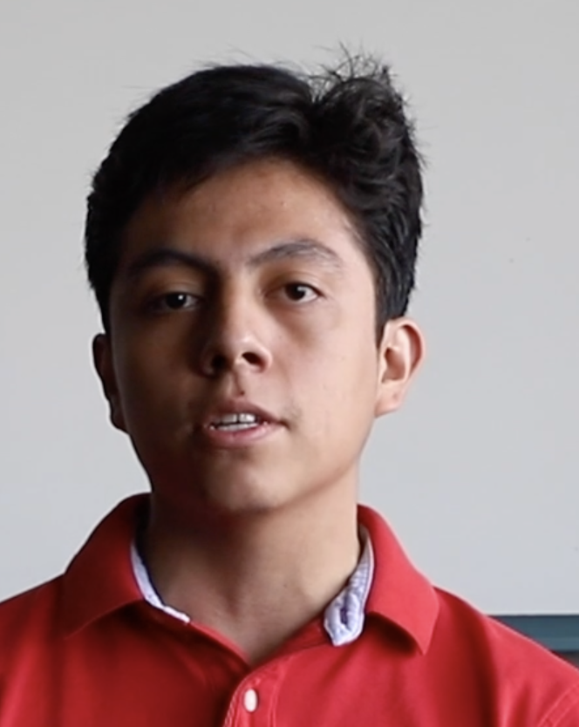
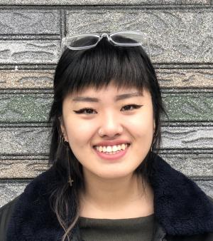
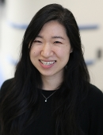
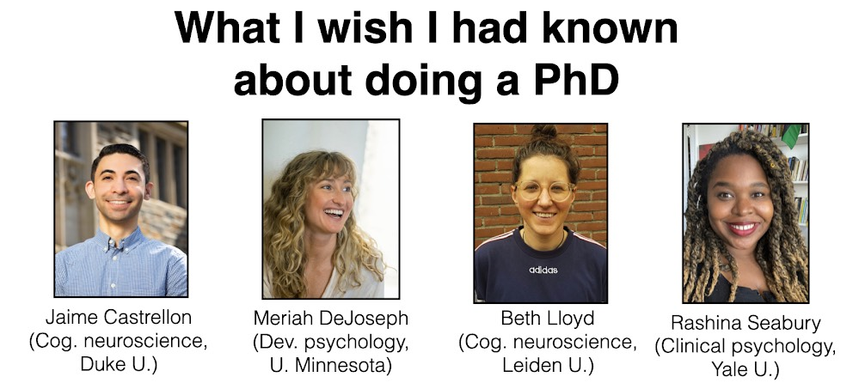
Welcome – thank you for joining us today! The meeting slides and recording will be posted online. You can type questions/comments in the chat and we will do our best to address them. You can change your name for anonymity. For general discussion, please use the chat (select “All panelists and attendees”).
July 21, 2022
What I wish I had known about doing a PhD
Ajua Duker
Social psychology
Yale U.
Carlos Gomez
Biomed. Eng.
Boston U.
Hannah Hok
Dev. psychology
U. of Chicago
Michelle Kim
Neuroscience
Mount Sanai

Slide 2
Thank you for the excellent suggestions for discussion!

Slide 3

Thank you for the excellent suggestions for discussion!
While PhD students share many common experiences, every individual’s journey is unique. Gaining insights from a number of different people can help paint a more complete picture of PhD life.

Slide 4
How did you realize you wanted to do a PhD?
Why did you want to do a PhD and how did you know you were ready?
What steps did you take to prepare?
  College major? Research experience?
Did you know what you wanted to research?
  How specific do you need to be with your interests/research before doing a PhD?

Slide 5
What was the application and interview process like?
How did you decide where to apply? (how many schools?)
  How did you balance considerations for prestige of institution, professor fit, location, etc.
How did you prepare for interviews? Any advice/tips?
How did you ultimately pick who/what lab you wanted to work with?
A couple resources on these topics:
https://www.sciencemag.org/careers/2018/09/applying-phd-these-10-tips-can-help-you-succeed
https://www.sciencemag.org/careers/2019/02/ace-your-phd-program-interviews-prepare-answer-and-ask-these-key-questions

Slide 6
What does a typical day in PhD life look like?
How did you come up with your long-term research plan and how do you manage day-to-day activities to meet your long-term goals?
How/how often do you communicate with your advisor about your goals and to ask for support?
What materials (e.g. textbooks, software, technology) and skills do you use on a daily basis? Did you build these skills prior to or during PhD?
  Did any of this come as a surprise to you?
When do you apply for funding, conference presentations, etc.? How have you identified these opportunities?
A couple resources on these topics:
https://phdlife.warwick.ac.uk/2018/08/29/a-day-in-the-life-of-a-phd-student-part-1/
https://writingcenter.unc.edu/2020/04/day-in-the-life-grad-student/

Slide 7
How do you balance work and life?
Do you only communicate with your advisor for professional goals/support?
  What happens if you have a conflict with your advisor?
What does your support system look like and how did you build it?
What interests do you pursue outside the lab?
What can and should you do if you realize your expectations are incongruent with your advisor’s/collaborators’?
A couple resources on these topics:
https://www.sciencemag.org/careers/2017/05/yes-you-can-have-life-outside-lab
https://www.nature.com/articles/nj7654-375a

Slide 8
What happens after?
How do you maintain your passion for studying the same topic 5+ years? What if your interests change?
What’s one lesson that took you the longest to learn?
How do you deal with failure, burnout, impostor syndrome, interpersonal issues and/or biases?
What career options are there for people who complete a PhD?
  What are your goals after your PhD? Academia or industry?
A couple resources on these topics:
https://www.elsevier.com/connect/9-things-you-should-consider-before-embarking-on-a-phd
https://www.nature.com/articles/d41586-019-03459-7

Slide 9

LIGHTNING ROUND!
What is one piece of advice you’d give your pre-PhD student self?
Some tips for new PhD students:
https://www.psychologytoday.com/us/blog/caveman-politics/201509/6-insider-tips-new-phd-students
https://www.nature.com/articles/d41586-018-07332-x
https://www.insidehighered.com/advice/2019/03/19/advice-students-just-beginning-their-phds-opinion

Slide 10
A few more resources
“All About PhD Applications” by Lucy Lai
https://lucyblogs.wordpress.com/2018/08/02/all-about-phd-applications/
“Things I wish I’d known from Day 1 of my PhD” compiled by Ya’el Courtney
https://drive.google.com/file/d/1Tndw5xkcMLBQYrx62DDusQbSScKqx0qK/view
“Resources and tips for undergrads and postbaccs pursuing PhD programs in psychology: by Meriah DeJoseph
http://meriahdejoseph.com/grad-school/resources-and-tips-for-undergrads-and-postbaccs-pursuing-phd-programs-in-psychology/
Application materials from NYU Psychology students
https://drive.google.com/drive/folders/1eZ1CMG-bZQlPtB6OkduFy0Qq2-uS-mjH

